Slide 1
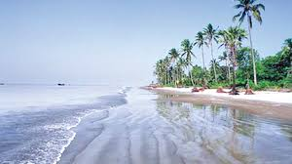
to multimedia class

Slide 2
Identity
MD.ABDUR ROUF
Lecturer in English
Khalna Islamia Fazil (Degree) Madrasha
Subrajpur,Patnitola,Naogaon.
E-mail- rouf301285@gmail.com
Mobile no: 01767650169

Slide 3
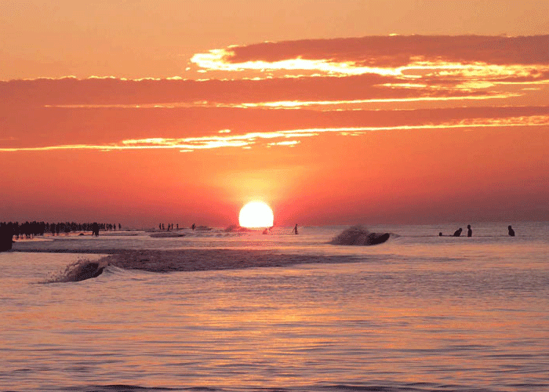
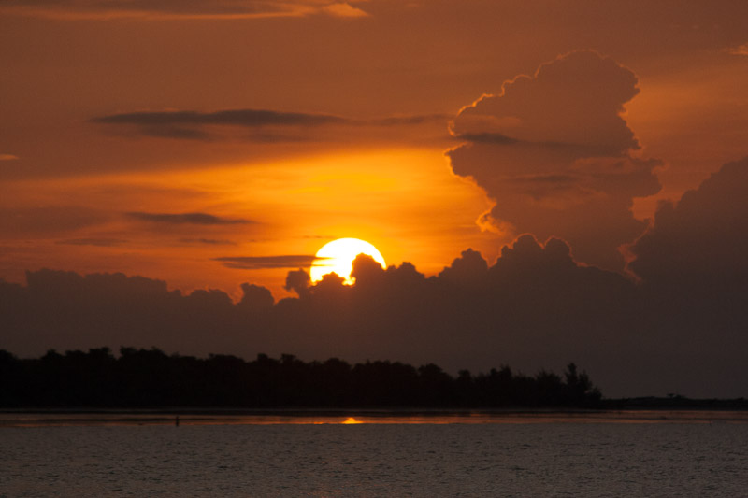
Have you seen these picture?
Sunrise
Sunset

Slide 4
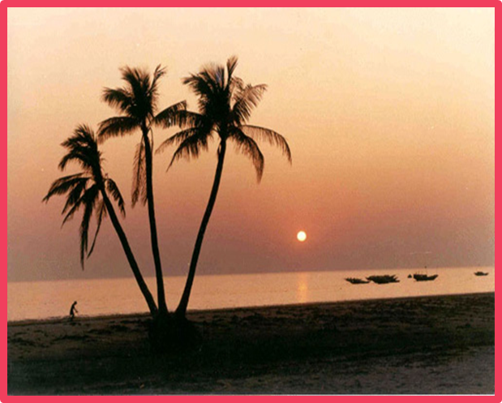
Our today’s lesson is -
Kuakata : Daughter of the sea
Unit - 08 , Lesson - 5

Slide 5
Learning outcomes
At the end of the lesson students will be able to -
To tell the meanings of several words.
To give answer to some questions about Kuakata.

Slide 6
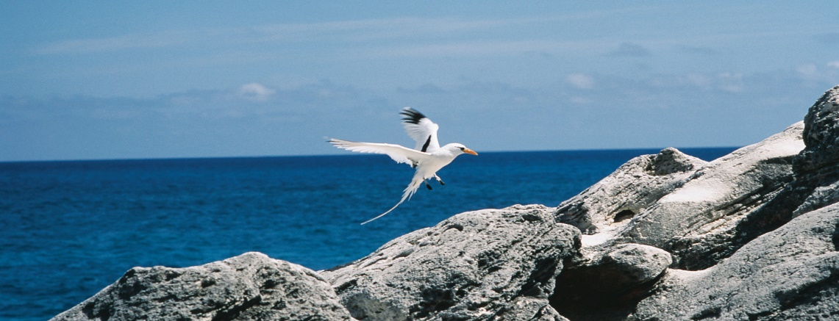
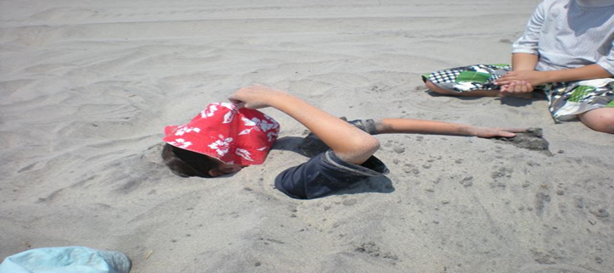
Key words
Picturesque
Attractive in appearance
Sandy
Covered with sand

Slide 7
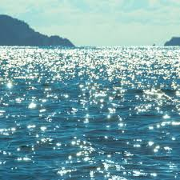
Expanse-
-An large area of land, water or sky
unique-
-Single, solitary, incomparable
Shimmering-
-Reflecting a gentle light moving slightly; glimmer

Slide 8
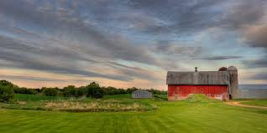
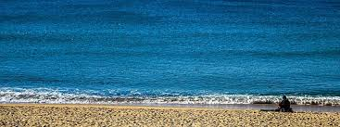
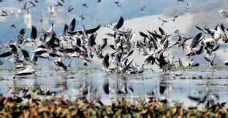
-A house and a surrounding area of land
Homestead-
Virgin-
-Fresh; new; unmarried
sanctuary-
-Protection or a safe place

Slide 9
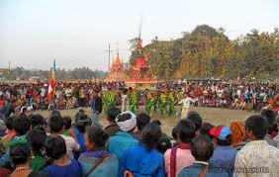
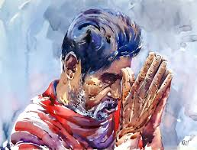
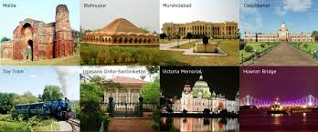
Indigenous-
-Existing naturally; native
Devotee-
-Worshipper; admirer; disciple
-inherent features belonging to the culture of a particular society such as traditions, languages or buildings
Heritage-

Slide 10
Read the passage silently.
Kuakata, locally known as Sagar Kannya (Daughter of the sea) is a rare scenic spot located on the southernmost tip of Bangladesh. Kuakata in Latachapli union under Kalapara Police Station of Patuakhali district is about 30 km in length and 6 km in breadth. It is 70 km from Patuakhali district headquarters and 320 km from Dhaka. An excellent combination of the picturesque natural beauty, sandy beaches, blue sky and the shimmering expanse of water of the Bay of Bengal and the evergreen forest makes Kuakata a much sought after tourist destination.
The name Kuakata takes its origin from the story of a ‘Kua’ or well-dug on the sea shore by the early Rakhaines settlers for collecting drinking water. The Rakhaines had landed on Kuakata coast after being expelled from Arakan by the Mughals. Following the first well, it became a tradition to dig wells in the neighborhood of Rakhaine homesteads for fresh water supply.
Kuakata is one of the unique spots which allow a visitor to watch both the sunrise and the sunset from the beach. That perhaps makes Kuakata one if the world’s most attractive beaches. The long and wide beach at Kuakata has a typical natural setting. This sandy beach slopes gently into the Bay and bathing there is as pleasant as is swimming of diving.

Slide 11
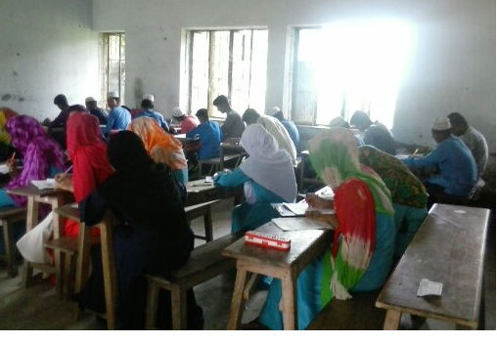
Pair Work
Write the answer of the following questions in pairs.
Where does the name ‘Kuakata’ come from?
What is most unique feature of Kuakata beach?
What are the some traditional events that take in Kuakata?
4. Where is Kuakata located?
5. Would you like to visit Kuakata? Make a list of 3 things you’d like to do while in Kuakata.

Slide 12
Write down a short letter about visiting Kuakata.

Slide 13
