Slide 1
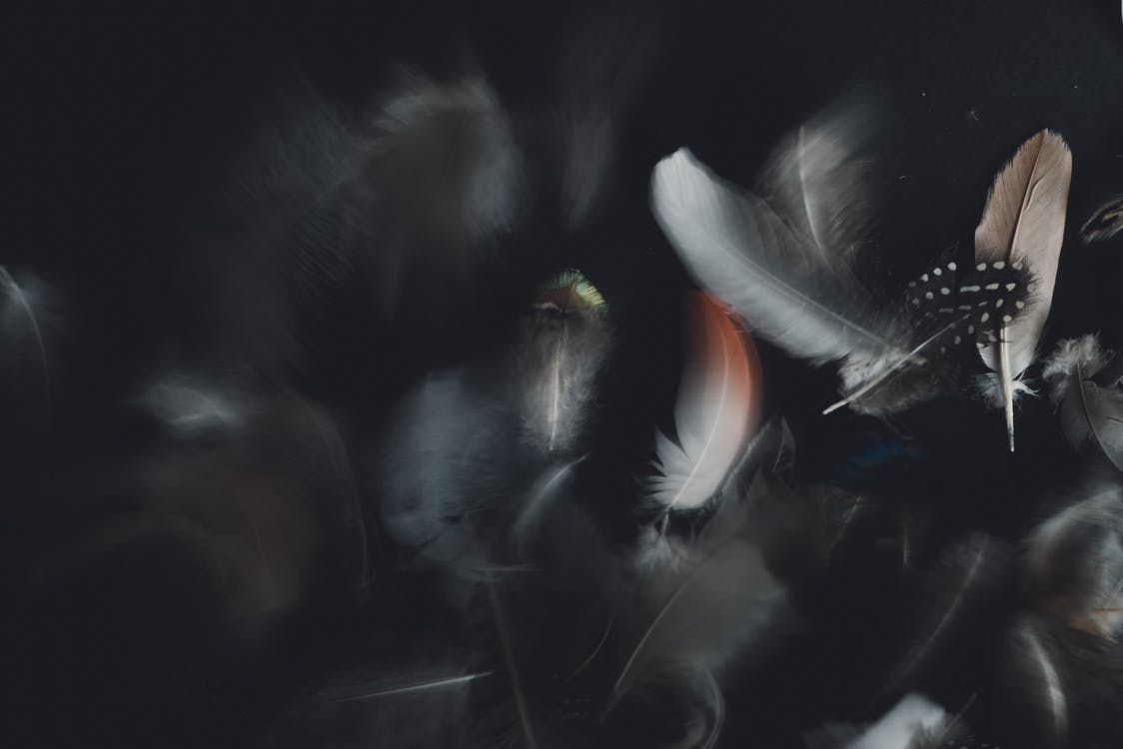
Dear colleagues,
This is the second content on ‘Tag Question.’ This content is made to achieve several learning outcomes. I will make more contents on the same topic. As this item is contextual, I have tried my level best to place it. If you find any lacking, recover it yourself. But before going to present it in the class you should follow the instructions below the slides so that you can present it effectively. In case of any inquiry please call me over cellphone- 01710-305331.
Yours lovely
Babinton Chandra Das(Kiron)

Slide 2
WELCOME TO DIGITAL CLASS

Slide 3
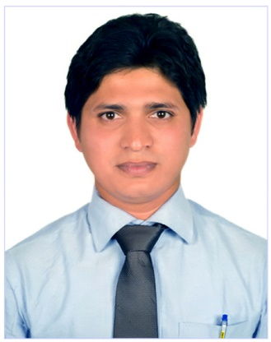
Babinton Chandra Das(Kiron)
Assistant Teacher(English)
Hon’s & Masters in English
B.Ed
IELTS & Phonetics
Farakkabad High School,
Chandpur Sadar, Chandpur.

Slide 4
Class-Nine & Ten
Subject: English Second Paper
Topic: Grammar
Time: 45 minutes

Slide 5
Question Tag.
He is a boy,
isn’t he?
What is this?

Slide 6
Our Today’s Class is on
Tag questions

Slide 7
Learning Outcomes
After we have studied this lesson, we will be able to-
define question tag
identify tag operators
apply tag
different use of tag

Slide 8
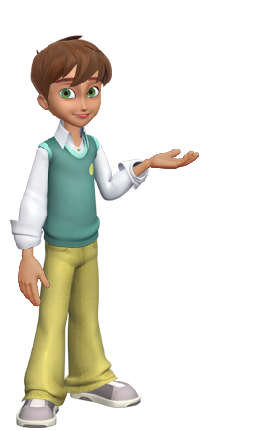
You are Jisan, aren’t you?
Tag
Adding something with other
A tag question is a question that is used at the end of a statement to get the support from the listener.

Slide 9
A computer operator.
Am, is, are ,was, were, shall, should, will , would, can, could, may, might, have, has, had, must, ought, dare, need.
Tag question operators
Do, does & did (Used in action verbs)

Slide 10
Tag question basic/contraction form of the operators.
Am not = aren’t/ain’t
Is not = isn’t
Are not = aren’t
Was not = wasn’t
Were not = weren’t
Will not = won’t
Shall not = shan’t
Can not = can’t
Could not = couldn’t
May not = mayn’t
Might not = mightn’t
Must not = mustn’t
Has not = hasn’t
Have not = haven’t
Had not = hadn’t
Do not = don’t
Does not = doesn’t
Did not = didn’t
Ought not = oughtn’t
Dare not = daren’t
Need not = needn’t

Slide 11
Mahbuba was our good friend,
wasn’t she?
He is a regular student,
Isn’t he?
Amran was ill,
wasn’t he?
Belal has a nice car,
hasn’t he?
Mim can go there,
can’t he?
Note: Pronoun is used in stead of noun.

Slide 12
How will you add tag, if there is no operator in the sentence?
My mother cooks very well,
doesn’t she?
don’t we?
We play football regularly,
He went to market yesterday,
didn’t he?
Notes
If there is V₁ with ‘s/es’, add tag with doesn’t/does,
2. If you find V₁ without ‘s/es’, add tag with ‘don’t/do’,
3. If you find V₂ , add tag with ‘didn’t/did’ as operator.

Slide 13
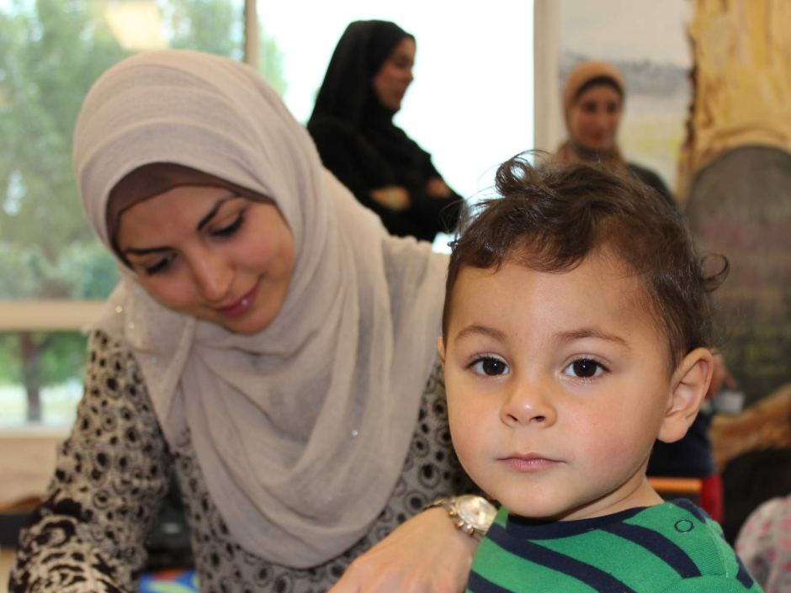
don’t they?
Every mother loves her child,

Slide 14
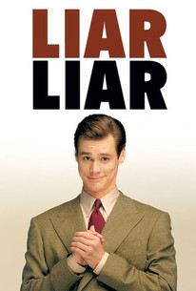
Nobody believes a liar,
do they?

Slide 15
Exceptions
If you find ‘s/es after everybody, everyone, nobody, no one, somebody, some one, one, none, the above rules will not be effective. In that place you have to add ‘don’t they/do they’
Everyone respects him,
don’t they?
Nobody likes a man of bad temper,
do they?

Slide 16
never, rarely, seldom, hardly, barely and scarcely are--
treated as negative though they appear to be positive. | Positive tag
He never came again, | did he?
She can rarely come these days, | can she?
You hardly ever came late, | did you?
I barely know you, | do I?
You would scarcely expect her to come, | would you?

Slide 17
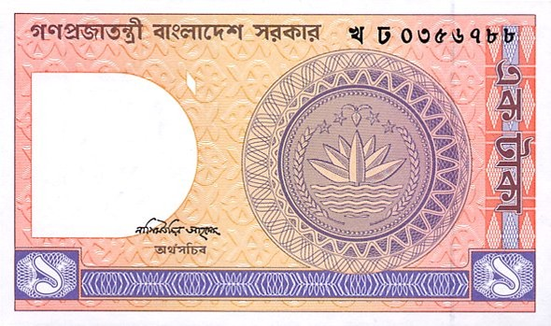
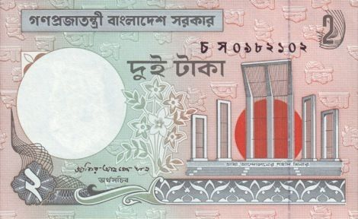
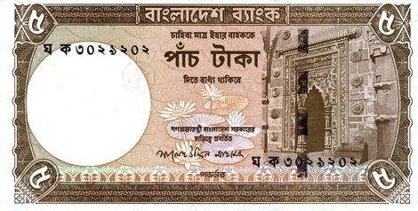
More exceptions
I have a few money,
don’t I/haven’t I ?
a few, a little = Affirmative
few, little = Negative
I have few money,
do I/ have I?
There is a little water in the jar,
isn’t there?
There is little water in the jar,
is there?

Slide 18
Action /do verb
don’t/doesn’t +?
I need your help,
don’t I?
She needs a pen,
doesn’t she?
But
You need not worry,
need you?
I need not go there,
need I?
Modal verb
need + Sub(pronoun) +?

Slide 19
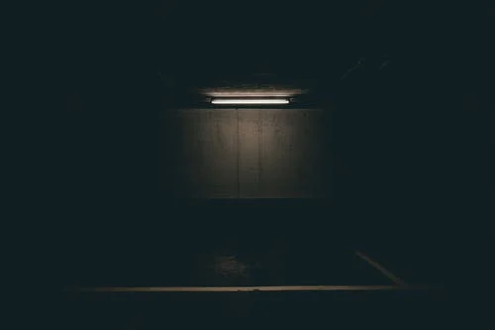
If I had any scope, I’d visit London,
wouldn’t I?
Subordinate clause
Principal clause
Follow
I’d visit = I would+ v₁
I’d visited = I had+ v₃
Last year I’d visited London,

Slide 20
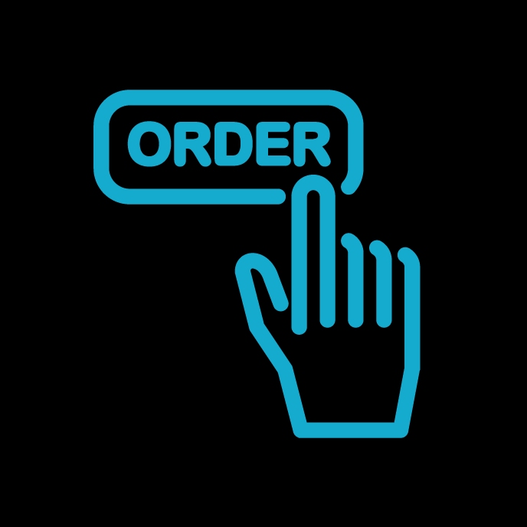
Tag question in imperative sentence
Follow me,
will you?

Slide 21
Let me say something,
will you?
Let him go,
will you?
Let them enjoy the game,
will you?
Exception in one place
Let us settle the matter,
shall we?
Let’s go out for a walk,
shall we?
Note: Will you, won’t you etc. Are used In the imperative sentences.
But shall we is used when Let us is shown in the sentences.

Slide 22
Good bye (I bide good bye),
don’t I?
Hasan, (He is Hasan),
isn’t he?
Who cares (Nobody cares),
do they?
Yes, (Yes, it is)
isn’t it?
No, (No, it is not)
is it?
Good morning, good afternoon, good evening, good night, thank you, ( I bide / wish / say…) don’t I?

Slide 23
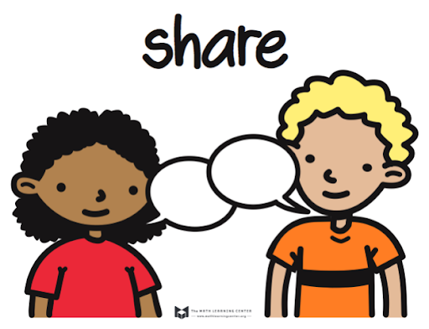
Pair Work
Add tag in every sentence of the following passage.
Ovi is a good boy. He goes to school regularly. Everybody loves him. Once he went to visit cox’s bazar. As he became ill, he could not visit Saint Martin. He told his friends, Let’s go back to Dhaka.

Slide 24
HOME
WORK
Make 20 sentences with above rules.

Slide 25
See you again in the class(part-3)

