Slide 2
স্বাগতম

Slide 3
The content Prepared by……
Muhammad Golam Rabbani
MBS(Management) MEd
Assistant Teacher
Begum Rahima Girls’ High School
Mobile No: 01770822913
Email: mdrabbani1975@gmail.com
Some slides credited by Hemi Hossain

Slide 4
Revolution means a forcible overthrow of a government or social order, in favour of a new system.

Slide 5
Industrial revolution is defined as the changes in manufacturing and transportation that began with fewer things being made by hand but instead made using machines in larger-scale factories.
An example of the industrial revolution was the era of making yarn with a “Spinning Jenny” instead of spinning one spool at a time.

Slide 6
The Fourth Industrial Revolution (or Industry 4.0) is the ongoing automation of traditional manufacturing and industrial practices, using modern smart technology. Large-scale machine-to-machine communication (M2M) and the internet of things (IOT) are integrated for increased automation, improved communication and self-monitoring, and production of smart machines that can analyze and diagnose issues without the need for human intervention.

Slide 7
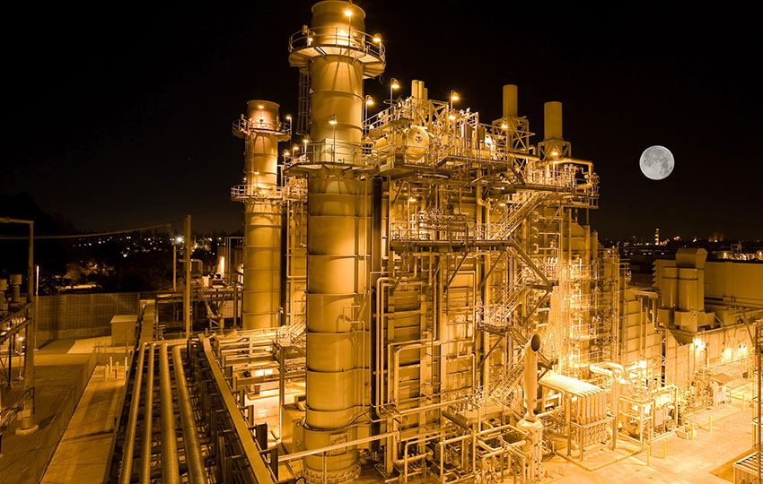

Slide 8
4 Industrial revolutions

Slide 9
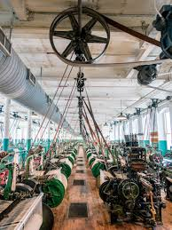
1st Industrial revolutions

Slide 10
1st Industrial Revolution

Slide 11
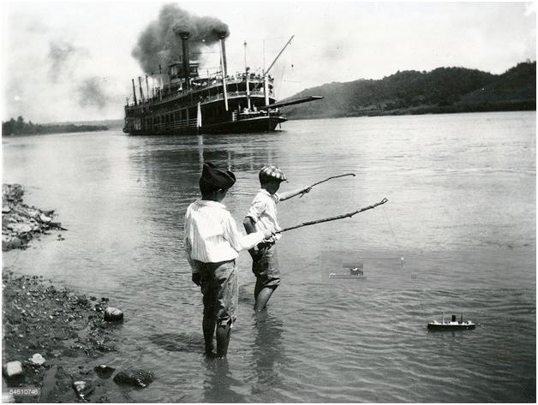
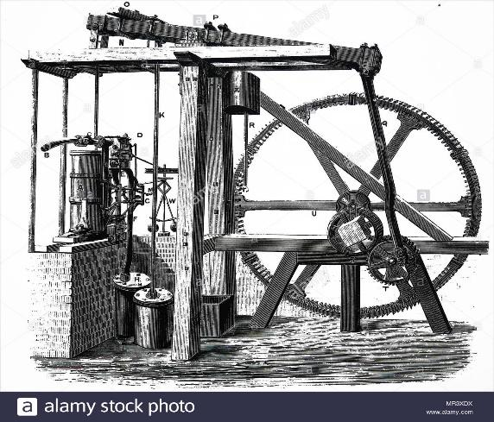
1st Industrial Revolution
Steam Engine

Slide 12
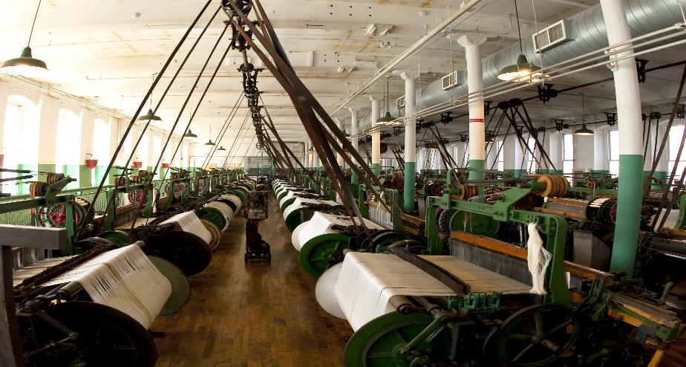
1st Industrial Revolution
Weaving loom

Slide 13
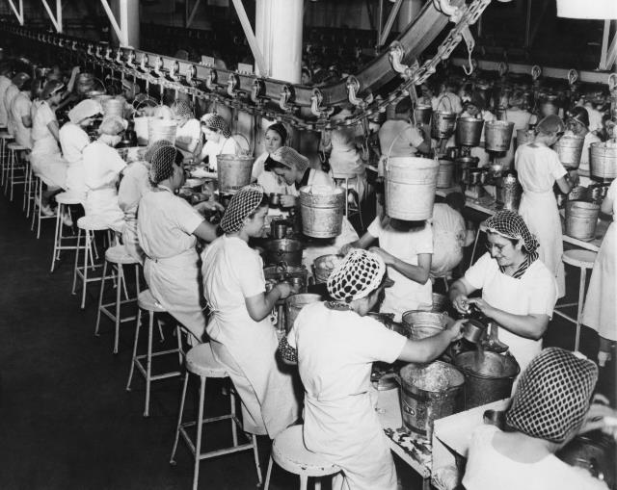
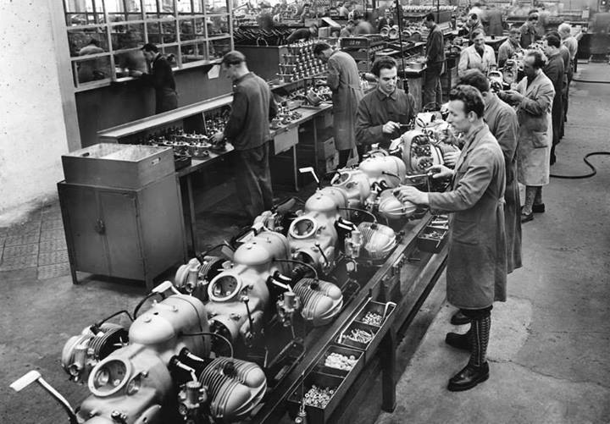
2nd Industrial Revolution
Assembly Line

Slide 14
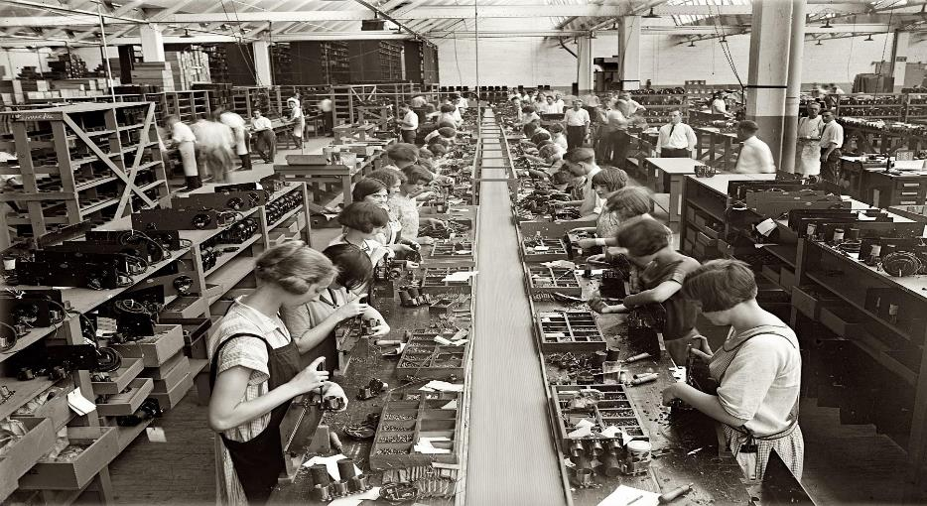
2nd Industrial Revolution

Slide 15
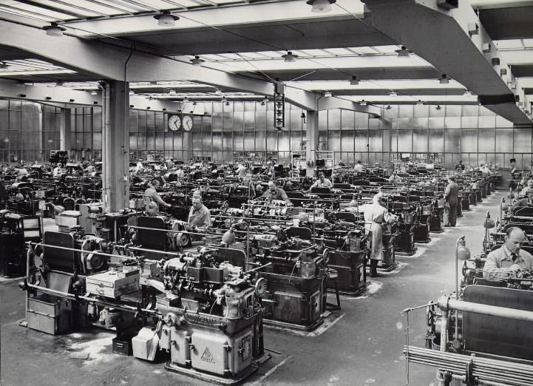
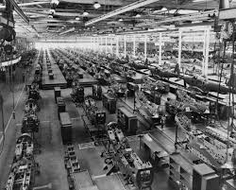
2nd Industrial Revolution
Mass Production

Slide 16
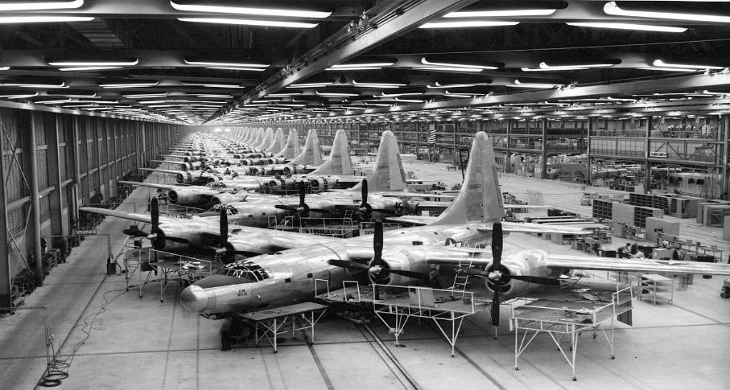
2nd Industrial Revolution
Usage Electicity in a Factory

Slide 17
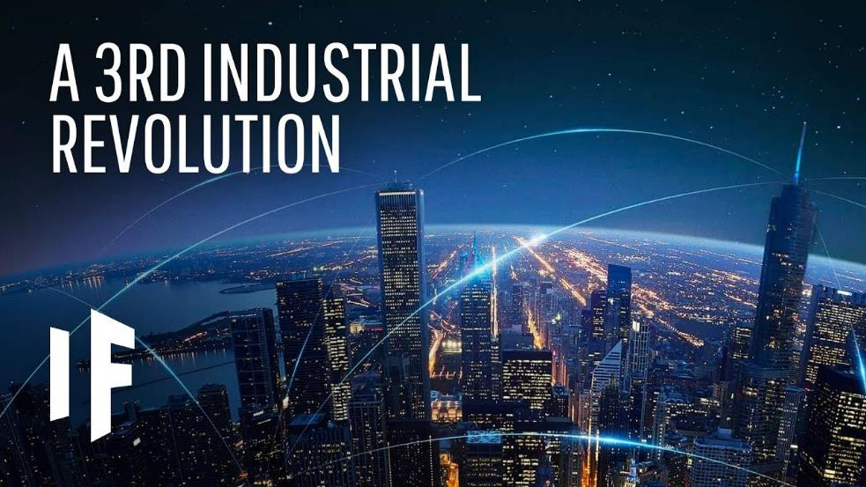

Slide 18
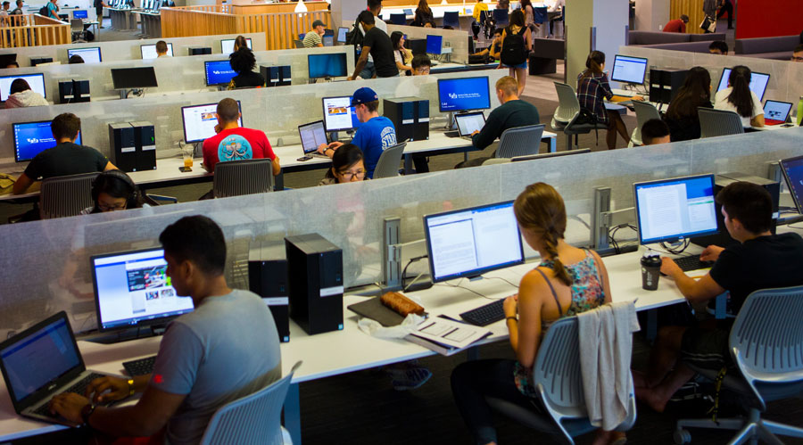
3rd Industrial Revolution
Computers

Slide 19
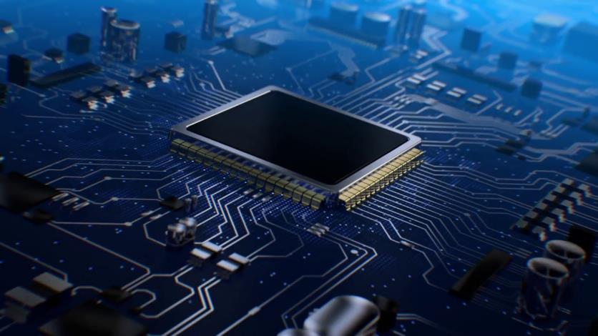
3rd Industrial Revolution
IT Micro Circuit

Slide 20
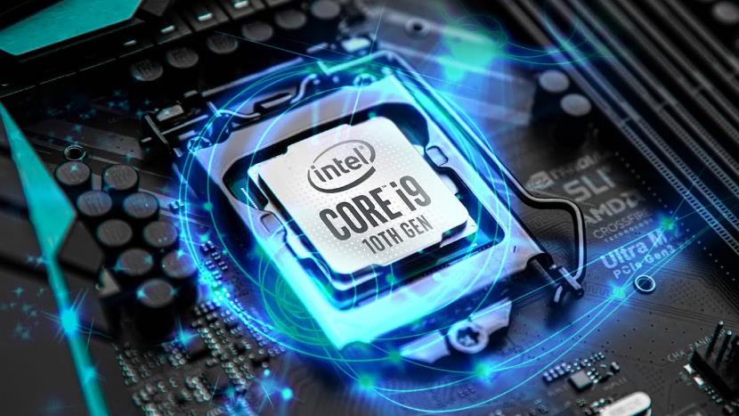
3rd Industrial Revolution
Processor

Slide 21
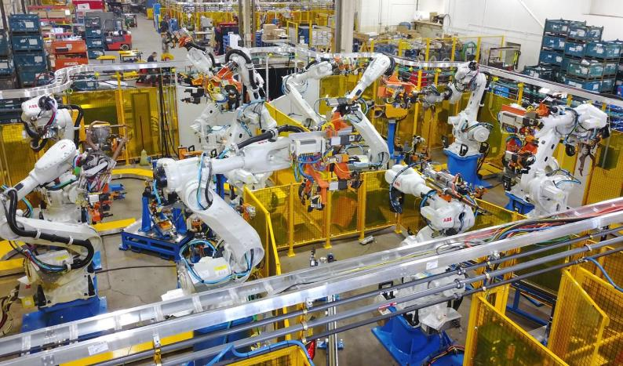
3rd Industrial Revolution
Automated Production

Slide 22
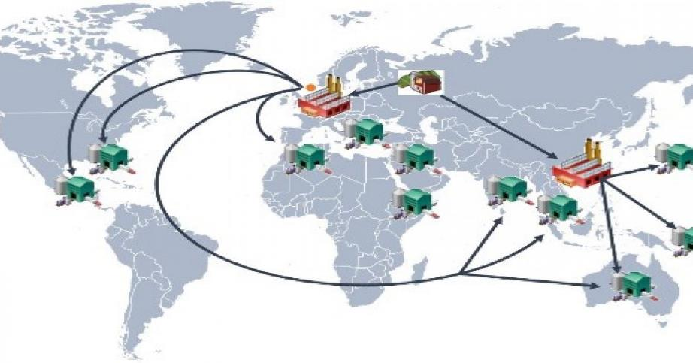
3rd Industrial Revolution
Global supply chain

Slide 23
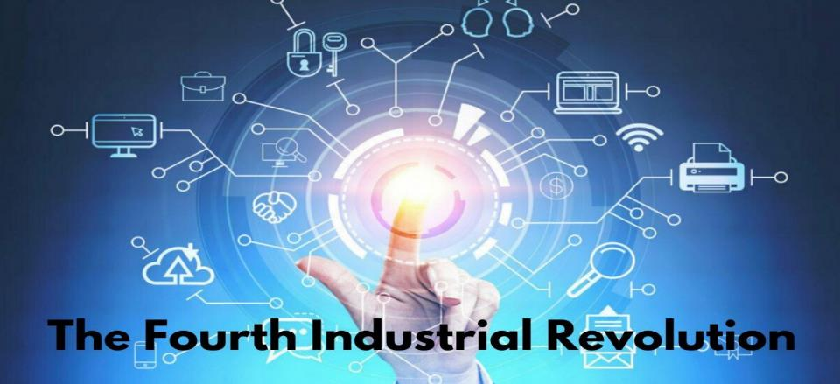
4th Industrial Revolution
Mass connectivity

Slide 24
4th Industrial Revolution
Connectivity with smart tools

Slide 25
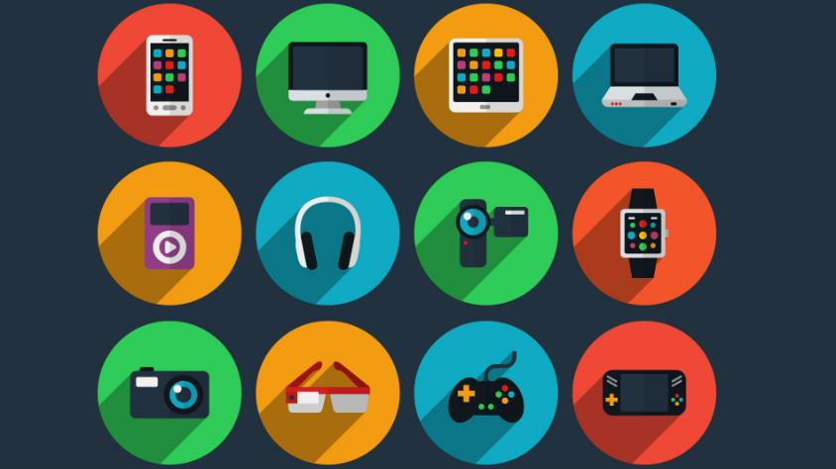
4th Industrial Revolution
Smart Technology

Slide 26
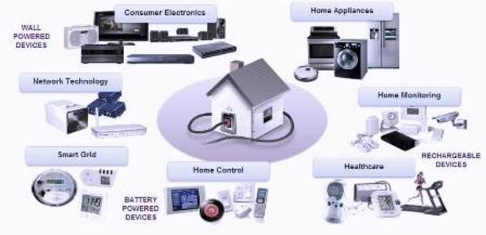
4th Industrial Revolution
Smart Technology for home

Slide 27
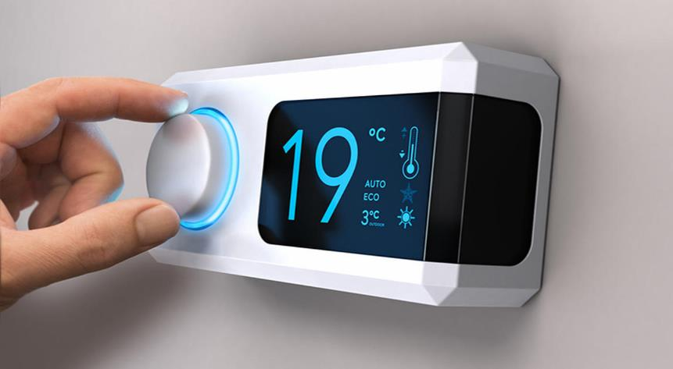
4th Industrial Revolution
Smart Technology for home/office

Slide 28
4th Industrial Revolution
Real – Time Data

Slide 29
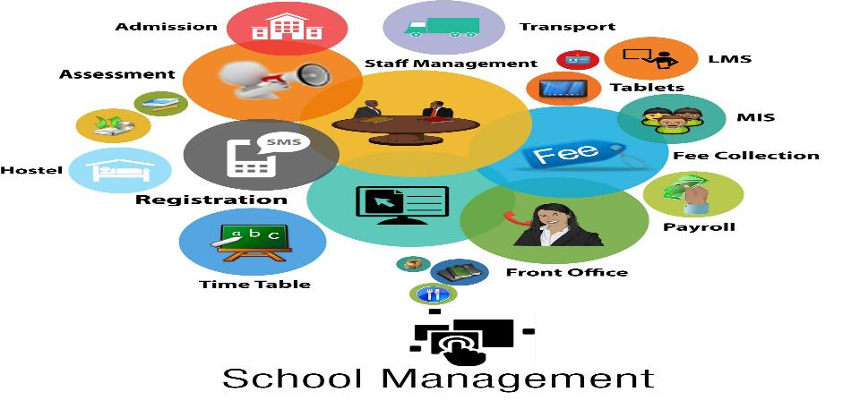
4th Industrial Revolution

Slide 30
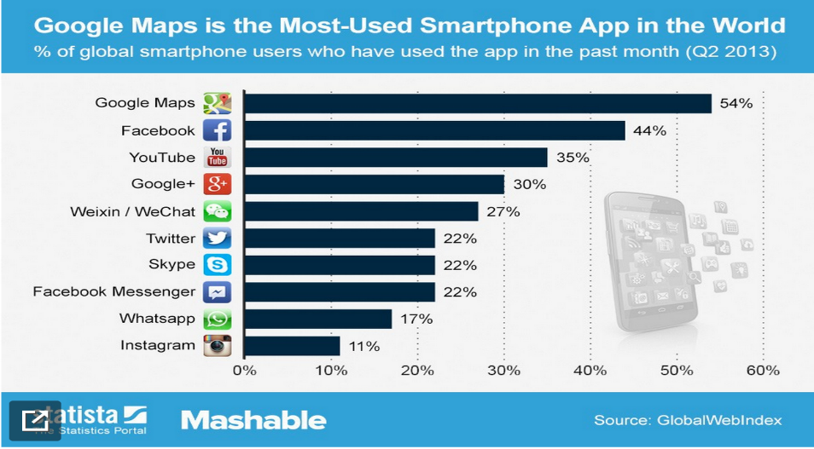
4th Industrial Revolution

Slide 31
4th Industrial Revolution
Zoom,
Google Meet,
OBS,
Google Classroom,
Facebook Live,
Youtube Live,
Streamyard Live Etc.

Slide 34
What impact will bring in education sector during the industrial revolution 4.0 ?
Are the teachers ready for the revolution 4.0 in education?

Slide 36
A teacher is a mentor. He should be mentoring one to one
Digital Transformation In Education to Win IR 4.0
It is necessary for a teacher
Mind Set
Adopt Ability
Skills
Tools or Resources
STEM = Science, Technology, Engineering, Math

Slide 38
AOR
Above the line
GROW
MIA
BED
Under the line
BED = Blame, Excuse, Deny
AOR = Accountability, Ownership, Responsibility
GROW = Goal, Reality, Options, Will (Or Way Forward)
MIA = Massive Immediate Action

Slide 39
Are we prepared for Industrial Revolution 4.0 in Education?

Slide 42
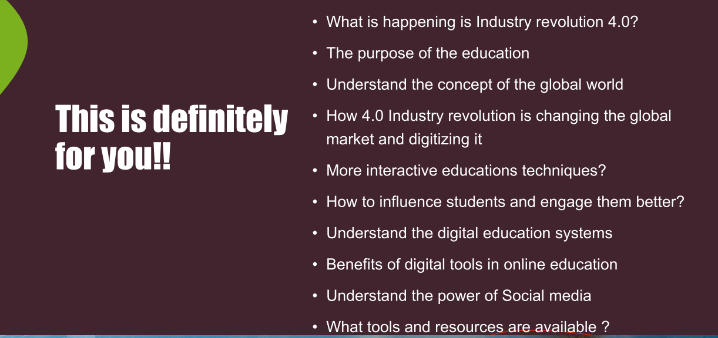

Slide 55
See you again next class.

