Slide 1
my
dear students

Slide 2
 Prepared By 
 Lesson Detail 
Md. Sultan-ul Arefin
Assistant Teacher
Gurudaspur Model Govt. Primary School
Gurudaspur, Natore.
Class: Five
Subject: English
Unit: 20, Lesson: 1-2
Title: Life is beautiful

Slide 3
Creating Emotion
Creating students’ emotion by showing a video song on the-
“Dewy Late Autumn morning of Bangladeshi Village”
The link of the video is given below.
https://www.youtube.com/watch?v=TauuMKV1VlE

Slide 4
Showing picture, I will ask some questions to my students
Look at the picture attentively and answer the questions.
Let’s watch the picture

Slide 6
Questions:
1. What do you see in the picture?
3. How is she walking?
2. Is she normal like us?
Possible solutions:
3. She is walking with a stick.
A woman is walking.
2. I think no.

Slide 7
Lesson Declaration
Well, To day we are going to read-
Life is beautiful
- It’s a beautiful-----------------for school.

Slide 8
Learning outcomes--
Listening:
3.4.1: understand statements made by the teacher and students.
4.2.1: understand and enjoy simple stories.
Speaking:
1.1.1: say words ,phrase and sentences with proper sounds and stress.
6.2.1: talk about people, objects, events etc.
Reading:
1.5.1:Read words ,phrases and sentences in the text with proper pronunciation stress and intonation.
1.7.1: read paragraphs, dialogues ,stories ,letters and other texts.

Slide 9
Let’s see some pictures

Slide 10
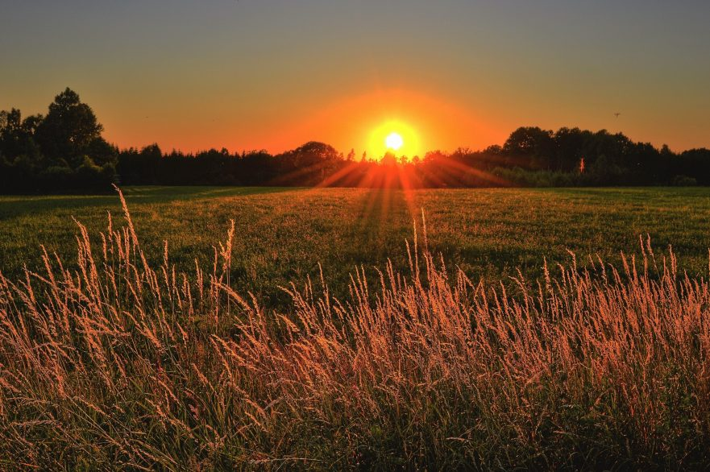
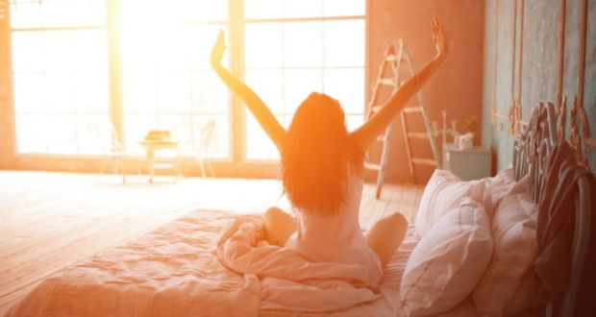
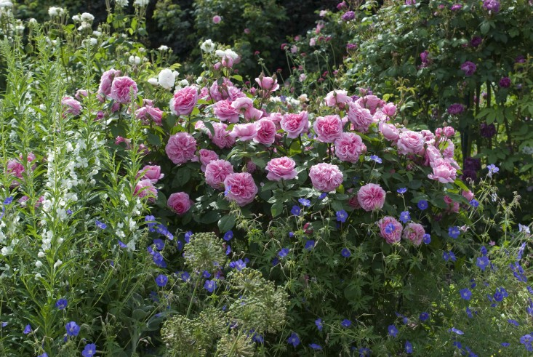
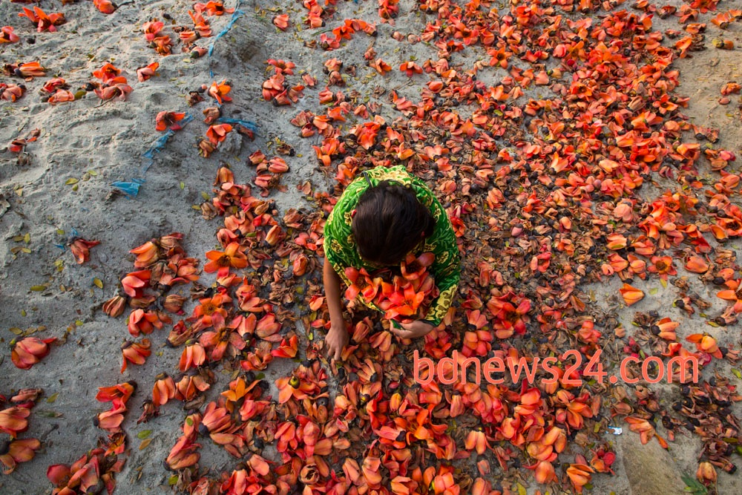
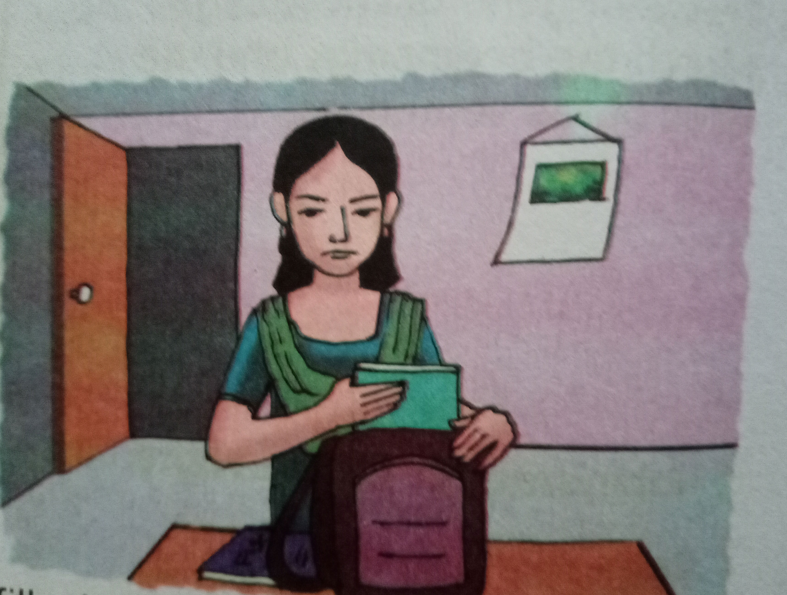
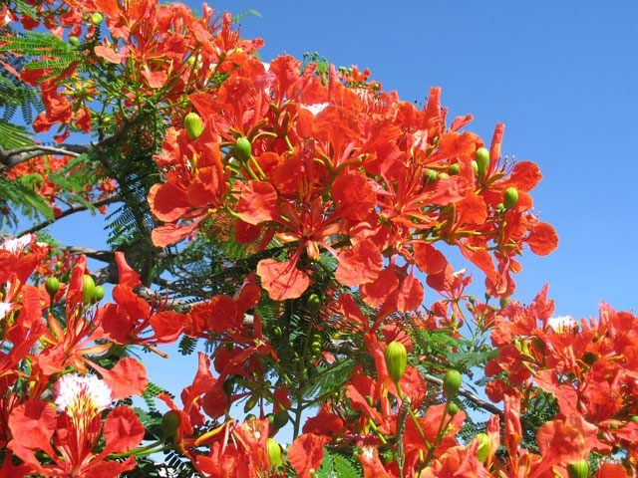
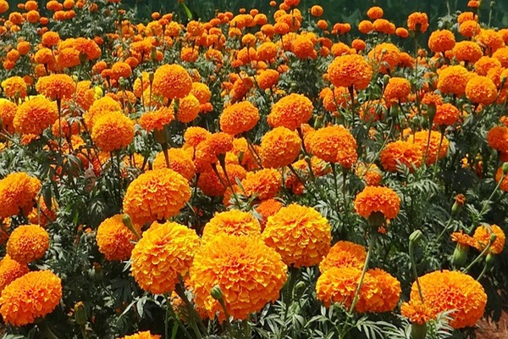
1. What do you see in picture-1?
2. What do you see in picture-2?
1
2
3. When do you see such type of scenery in picture-3?
4. What is the girl doing in picture 4?
3
4

Slide 11
Teaching Vocabulary
Do you know the meaning of these following words?
Beautiful, Spring, Get up, Early, Happy, Warm, Smell
.

Slide 12
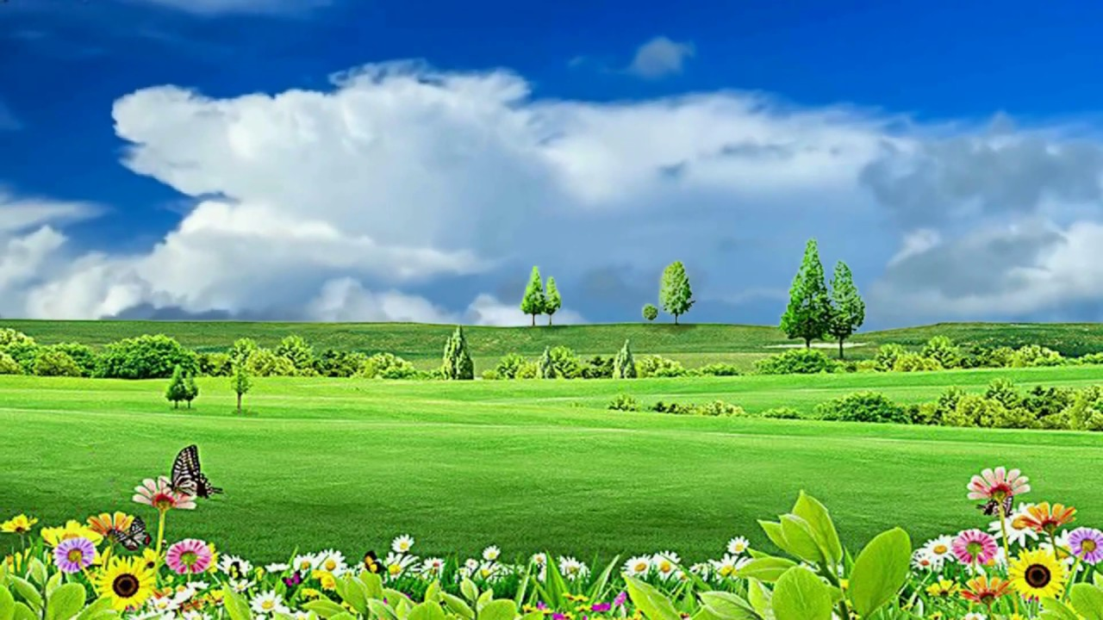
Beautiful
pleasing the senses or mind aesthetically.
Similar meaning
:
fine
Bangladesh is a very beautiful country.

Slide 13
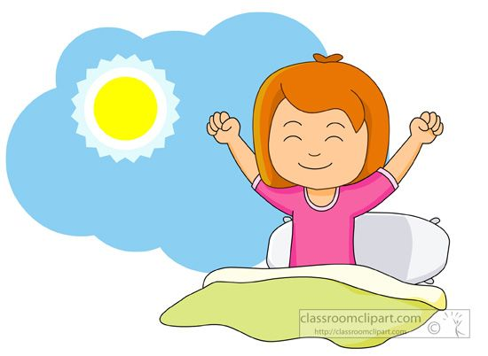
Get up
rise or cause to rise from bed after sleeping.
Similar meaning
:
Rise
I get up from bed at 5 a.m.

Slide 14
Early.
before the usual or expected time
Similar meaning
:
Soon
He gets up early. .

Slide 15
Happy
.
feeling or showing pleasure or contentment.
Similar meaning
:
cheerful
I am happy to see you.
.

Slide 16
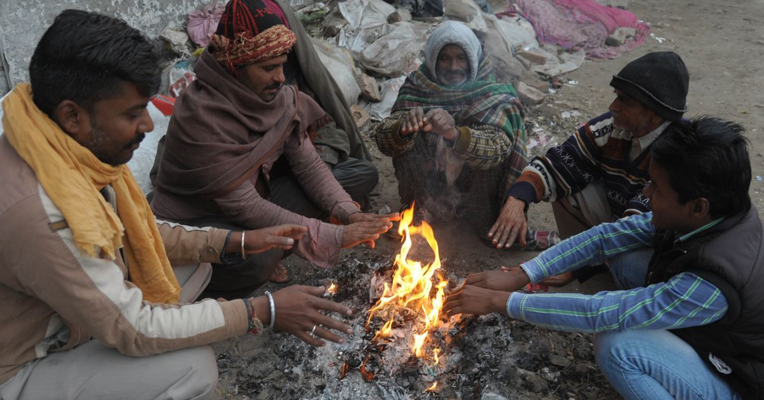
Warm
.
(especially of clothes or furnishings) providing physical ease and relaxation.
Similar meaning
:
comfortable
The sunlight gives us warm in winter.
.

Slide 17
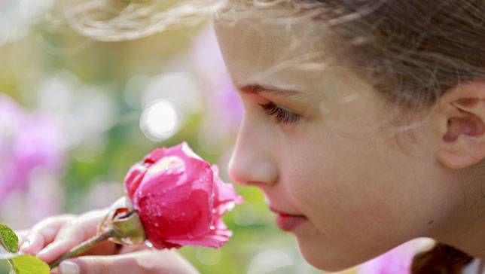
Smell
.
the faculty or power of perceiving odours or scents by means of the organs in the nose.
Similar meaning
:
scent
The rose smells sweet.
.

Slide 18
PRACTICE
Playing Game
Dear students, now we are going to play a game. It is called “Bingo Game”. Listen the instruction carefully.
After playing the game I will rewards the winner(s).

Slide 19
Let’s play the bingo game.
Beautiful
Get up
Spring
Happy
Early
Warm
Trip
Window

Slide 20
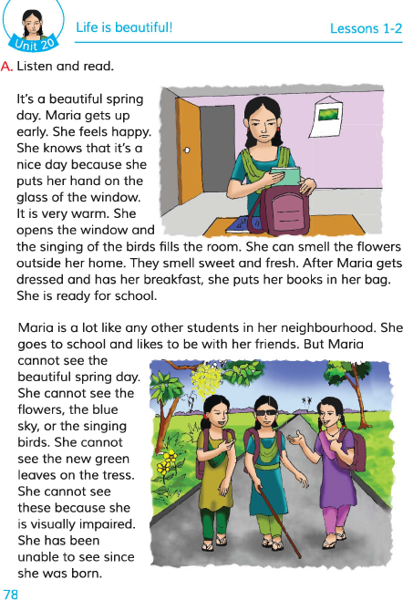
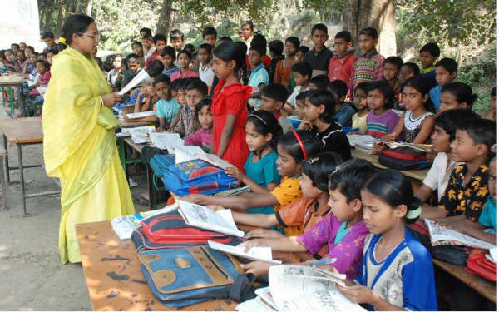
Teacher’s Model Reading
Dear students, open your English book at page 78. I am reading the text loudly, please put your fingers on the text.

Slide 21
Group Reading
In this stage the students will read the text in group.

Slide 22
Pair Reading
In this stage the students will read the text in pair.

Slide 23
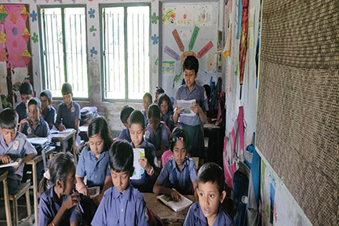
Student’s reading
In this stage one student reads the text and others listen.

Slide 24
Silent Reading
Students, please read the
text silently and try to understand.

Slide 25
Group work
:
Group A
Why does Maria feel happy?
:
Group B
2. When does Maris get up?
:
Group C
3. What season is mentioned in this text?

Slide 26
Solution to the question:
1. Maria feels happy because the weather is warm and the birds are singing. She smells the flowers outside her home. 2. Maria gets up early.
3. Spring season is mentioned in this text.

Slide 27
Pair work
Beautiful
Get up
Early
Warm Smell
Soon
Pretty
comfortable
Scent
Rise

Slide 28
Evaluation
Solution:
Write true/ false.
It’s a beautiful winter day.
Maria is a school going girl
Maria is an early riser.
Maria is born blind.
Maria’s favourite subject is English.
False
True
True
True
False

Slide 29
Task
Make five sentences about “Your Morning activities” in your own words.

Slide 30
very much
my dear students for your nice co-operation.

