Slide 1
Welcome

Slide 2
Introduce of Teacher -
Md. Rezaul Karim
Head Teacher
Jawrani GPS
Hatibandha , Lalmonirhat

Slide 3
Class Introduce
Class – Four
Unit - 16
Lesson 1-2
Lesson′s Name – Sagar’s week
Time – 40 mins.

Slide 4
Learning Outcomes-
At the end of this lesson, students will be able to
To recognize sound differences in the context of words.
recognize sound differences in the context of words.
To say words phrases and sentences with proper sounds, stress and intonation.
To makesentences using words and phrases.

Slide 5
Creating Safety Environment through greetings-
How are you?
How do you feel?
Are you ready?

Slide 6
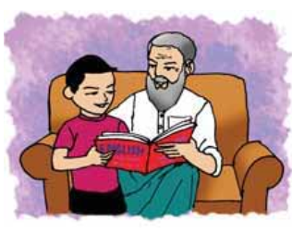
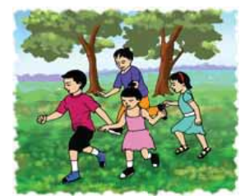
Let’s go see a picture-

Slide 7
Questions about the picture-
What can you see in the picture?
What are they doing?
Who are in the picture?
Do you think, what would be that?

Slide 8
Lesson declaration-
Today′s lesson is- “Sagar and his family”.

Slide 9
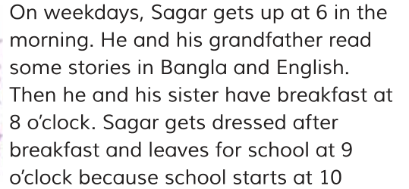

Slide 10
Pronunciation, make sentences and meaning of the key word.
Weekday’s ( কাজের দিন) – Sagar get’s up early on weekday’s.
Breakfast ( সকালের নাস্তা) –Raima has her breakfast at 7 o’clock.
Leave ( ত্যাগ করা বা ছেড়ে যাওয়া) – Mita leave for school at 8 o’clock.

Slide 11
Students loud reading with me again and again –
Then , students silent reading for answer the following questions-

Slide 12
Group work-
Questions
When does Sagar get up?
Which subject does Sagar studies?
What does Sagar first do ?
Write , True for T- false for F in your answer sheet.
Sagar get’s up late
Sagar first say’s his prayers.
Sagar studies Bangla and Math.

Slide 13
Evaluation :
What does Sagar first do ?
Who helps the Sagar?
When does sagar get up?

Slide 14
Home work –
Make five sentences about your daily routine.

Slide 15
BYE

