Slide 1
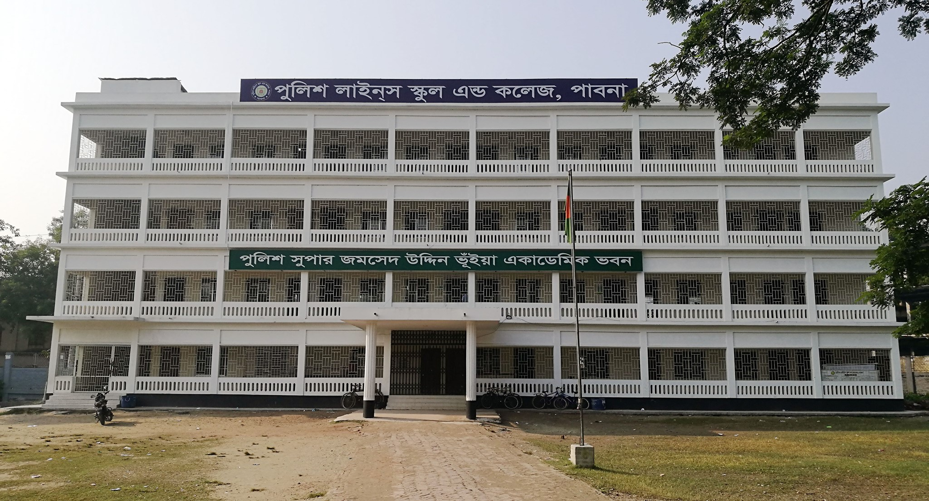
Welcome to the presentation

Slide 2
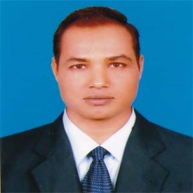
Introduction
Md. Mizanur Rahman
B.A.(Hons.), M.A. in English, B.Ed.
Assistant Teacher
Police Lines School and College, Pabna.
E-mail: mizanplsc@gmail.com
Cell Phone :01737979719
Class: VI
Subject: English 1st Paper
Lesson: One
Lesson Title: Going to a new school
Class Duration: 40 minutes
Date: 28/09/2020

Slide 3
Look at the picture
What do you see in the picture?

Slide 4
Today’s Lesson
Going to a new school

Slide 5
Learning Outcomes
At the end of the lesson, the students will be able to:
read and understand text .
write the answer of questions.
choose the best answer and fill in the gaps.
write a short paragraph on the first day experience of his/ her shcool.

Slide 6
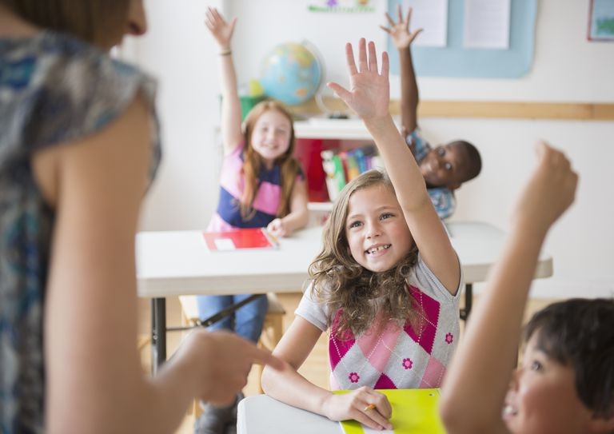
Key words presentation
Warmly
adverb
Syn. cordially
Ant. harshly
Meaning: receive some one or somebody very cordially or heartly.
Example: A teacher warmly greeted the students in the class.

Slide 7
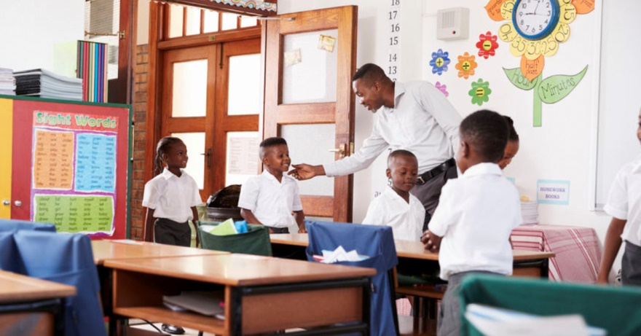
Greet
Verb
Syn . Address, welcome
Ant. ignore
Meaning: address or welcome some one or somebody.
Example: Tarun became very glad to see the warmly greeting of the teachr.

Slide 8
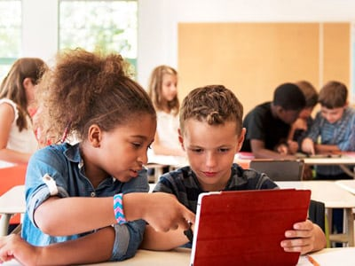
Read the text.
My first day at the new school was interesting. I was going to school with my father in a rickshaw. We reached school after fifteen minutes. My father said goodbye and left me at the school gate. I went in and found that everyone had gone to class. I walked into my classroom and found a seat. After sometime a teacher came and warmly greeted us. I found the students very friendly in my new class.

Slide 9
Individual Work
Match a word from Column A with a word (or words) from column B that has (or have) similar meaning.
Column A | Column B
interesting frightened happy excited warmly | lovingly amusing afraid glad thrilled

Slide 10
Pair Work
Read the text again and answer the following questions
Who went with Tarun first day at the new school?
Where did his father leave him?
How did the teacher greet Tarun?
By which did he go to the new school.?
What did he notice after entering the school?

Slide 11
Group Work
Now write down similar information about yourself.
My name is .
I am years old.
I have ------------------eyes, ------------------hair and I am ----------- , -------------- tall
I am good at ---------------------and ----------------
My hobbies are --------------------- and -------------
I like to ----------------- and ---------------------------
I really don’t like -------------------.
John Junior
11
black
black
4 feet
2 inches
Playing badminton
Reciting poems
travelling
writing
Write stories
Eat fruits
Any kind of oily food

Slide 12
Evaluation
Now choose the correct answer to each question from the alternatives given and write the corresponding number of the answers in your answer script.
We reached school after fifteen minutes. Here ‘reached’ is similar to
Got ii. Started iii. Left iv. Arrived
b. I found the students very friendly in my new class. Here ‘new’ means.
Additional ii. Ancient iii. Fresh iv. Old

Slide 13
c. I walked into my classroom and found a seat. Which of the following words is not a synonym of the word ‘Classroom’?
School room ii. Class presence
iii. Lecture theater iv. lecture hall
d. I walked into my classroom and found a seat. The word ‘walk’ means
i. Go on foot ii. Run iii. Jump iv. Step
e. After sometime a teacher came and warmly greeted us. What does ‘greet’ mean?
Leave ii. Farewell iii. Defect iv. Welcome
f. Tarun and his father went to school
On foot ii. By bus iii.by rickshaw iv. By train
g. His teacher behaved
i. Cruelly ii. Hardly iii. Roughly iv. cordially

Slide 14
Home Work
Now write a paragraph on how you felt on your first day at school and why you felt so.

Slide 15
Thanks to all
See you again in the next class.

