Slide 1
WELCOME

Slide 2
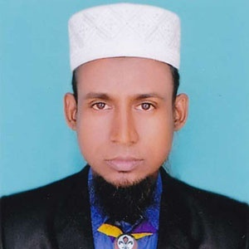
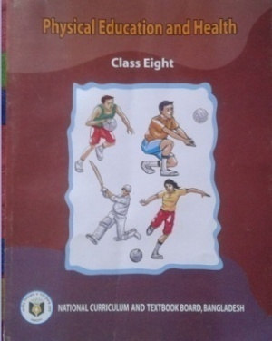
INTRODUCING
Md. Amirul Islam
Teacher
Millennium Scholastic School & College, Bogura
E-mail: iamirul113@gmail.com
Subject: (142)Phisical Education & Health
Class: VIII
Chapter: Five
Heading: Sports for Life
Topic: Badminton
Date: 01.08.2020

Slide 3
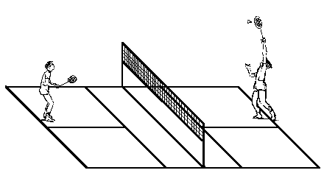
Look at the pictures
What are these?

Slide 4
Today`s Topic is Badminton

Slide 5
Learning out come …….
At the end of this topic we will able to do -
1. Talk about the Badminton game.
2. Described the rules of game
3. Explain the technique
4. Practice obeying the rules of Badminton
5. Skillful to participate in the game.

Slide 6
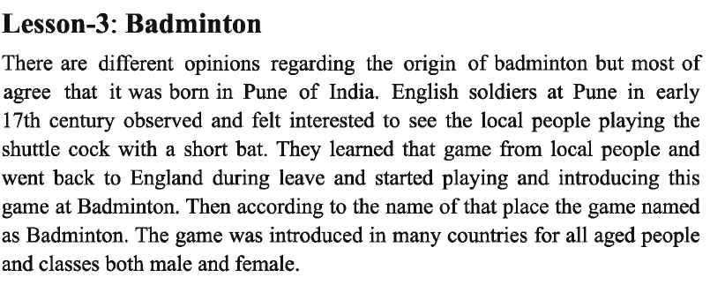
History
Badminton:

Slide 7
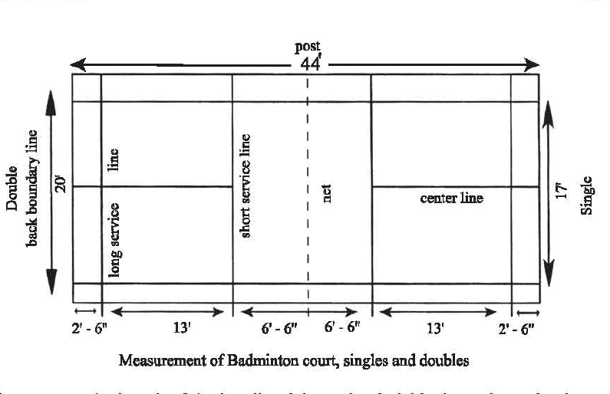
Playing Court
Net Heeght- 5‘-1"

Slide 8
Equipment

Slide 9
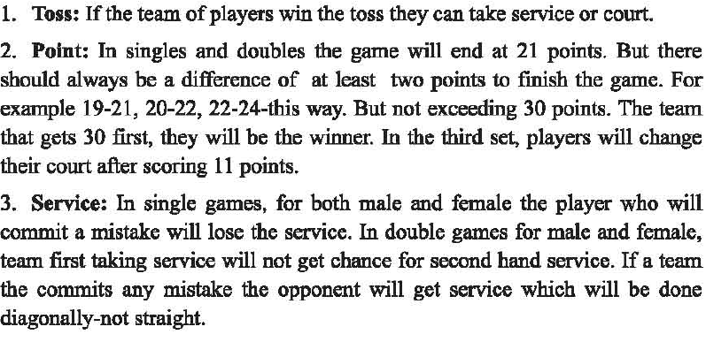
RULES

Slide 10
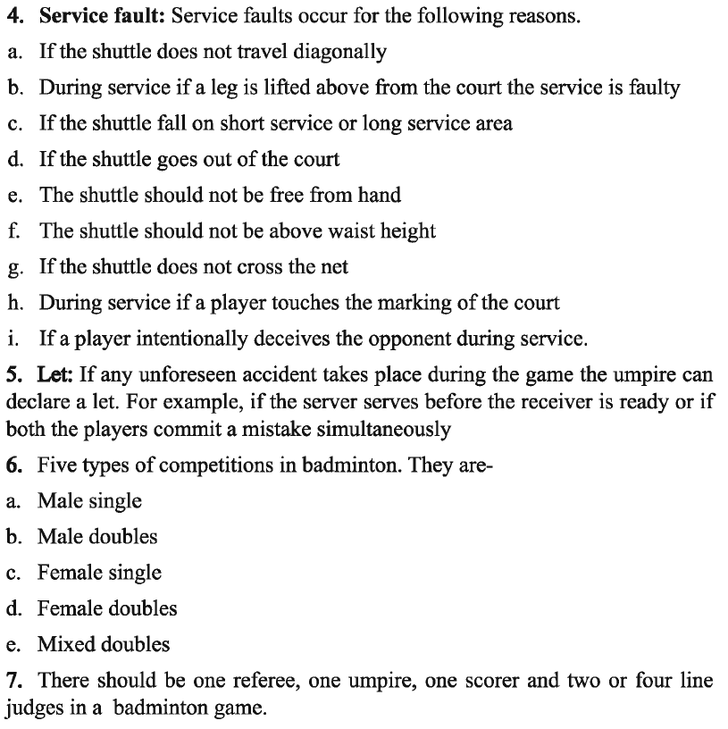

Slide 12
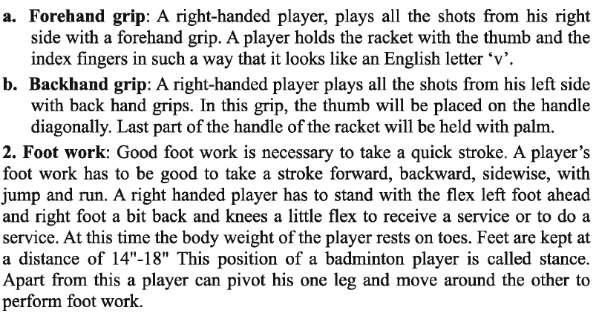

Slide 13
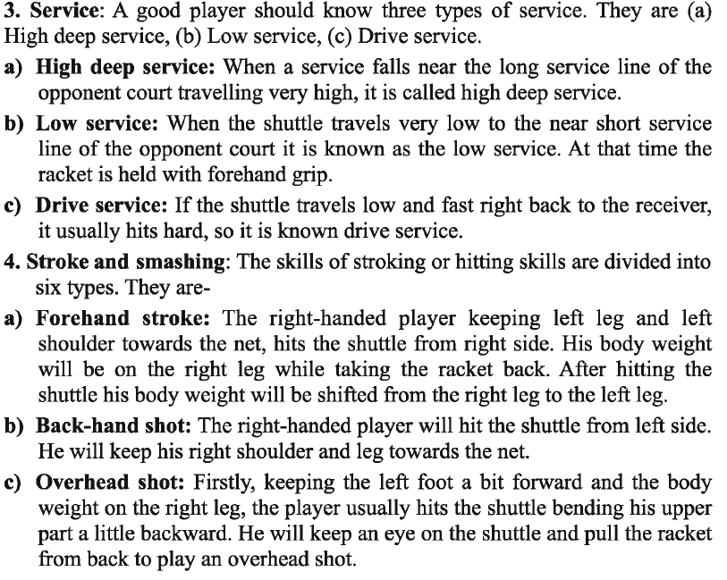

Slide 15
Home Work
Write an assignment on Badminton

