Slide 1
Welcome My Dear Students

Slide 2
PRESENTATIONBY
HASAN MD. ZONAYED
SENIOR TEACHER
CHANDGAON N.M.C MODEL HIGH SCHOOL
CHANDGAON,CHITTAGONG
MOBILE-01715433150
E-MAIL-hasantr1971@gmail .com

Slide 3
Class: Ten
Subject: English-1(Independence Day)
Unit -3,Lesson-4

Slide 4
Wreath

Slide 5
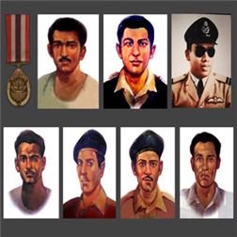
10 Heroes of Bangladesh
Martyr

Slide 6
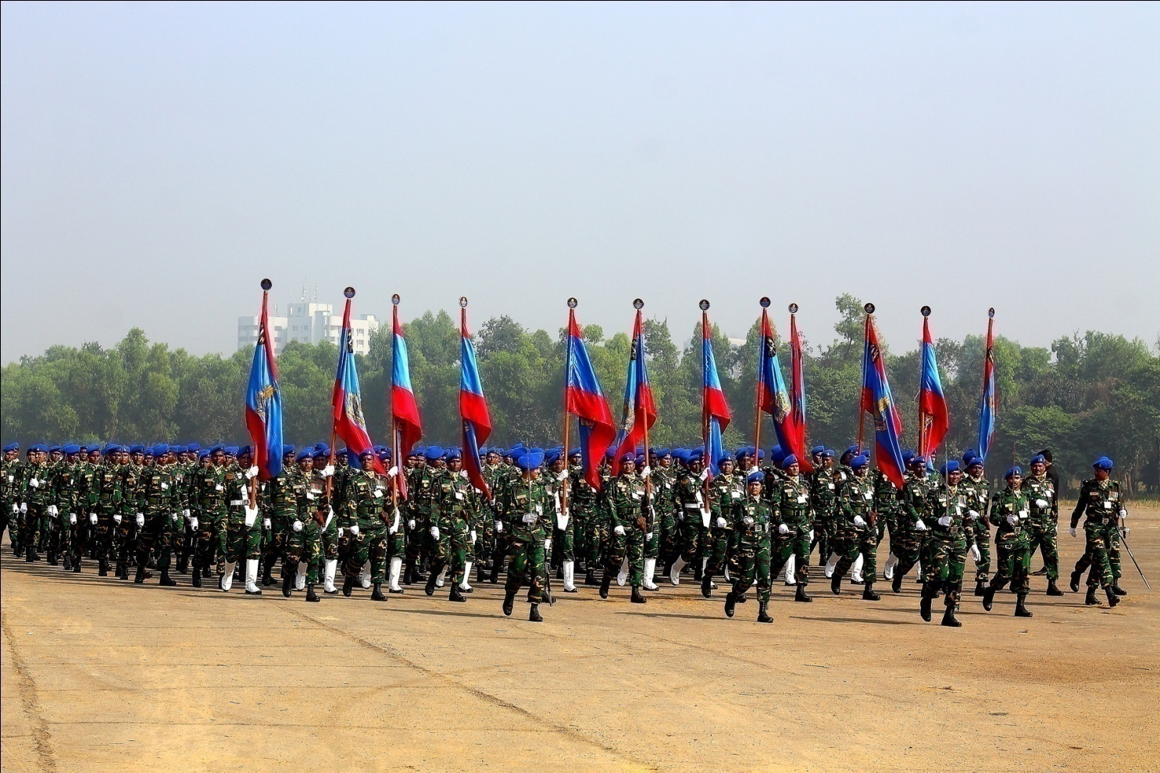
On 26 March
National Parade Ground of Bangladesh

Slide 7
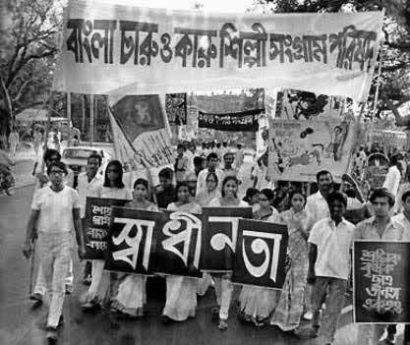
26 March, 1971

Slide 8
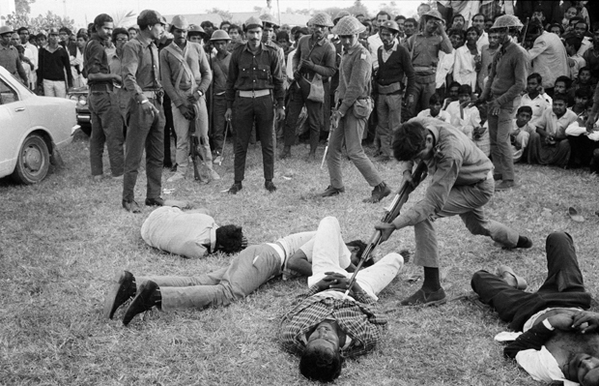
Pakistani army killed Bengali people

Slide 9
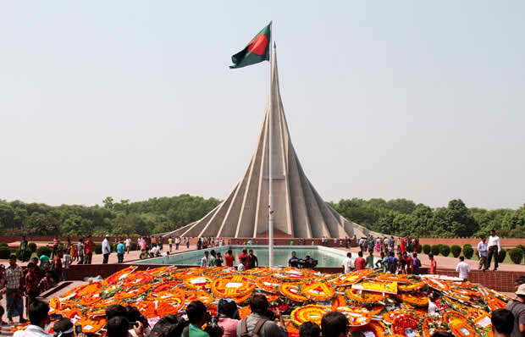
26, March
INDEPENDENCE DAY

Slide 10
Learning outcomes
From this lesson students will be able to -
Describe the independence day.
Use words and make sentences
Choose the correct answer from the alternative
Ask and answer question

Slide 11
New words and their meanings
Wreath –Circular arrangement of flowers.
Enthusiasm-excited, engrossing interest.
Diplomat - Government representative abroad.
Highlight- Emphasize something.
Entertain- Amuse or interest audience.
Fervor- Very strong feelings about something.
Illuminate- Light up, illumine.
Spectator- Somebody who watches an activity.
Martyr- Somebody who sacrifices own life for noble cause.

Slide 12
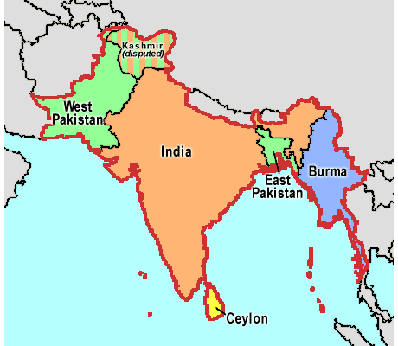
Is it possible to communicate easily from West Pakistan to Bangladesh (Former East Pakistan)?
Bangladesh

Slide 13
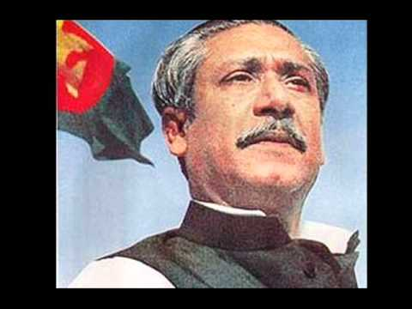
Do you Know him?
Father of the Nation
Shekh Mujibur Rahman

Slide 14
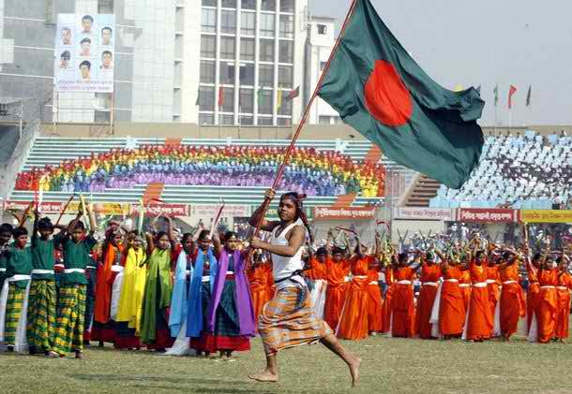
Biggest Festival of Bangladesh

Slide 15
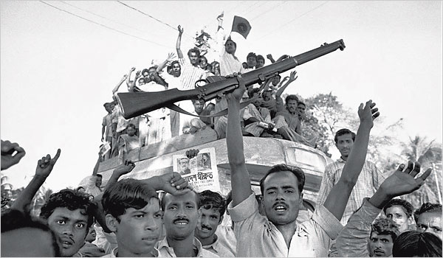
After the independence
Brave Bengali people

Slide 16
Team work
How do the various organization and institutes observe the independence day?

Slide 17
Evaluation:
Choose the best answer:
Our biggest festival is-
a) Victory day b) Shaheed day c) Pahela Baishakh d)Independence day
2. The celebration of Independence day begins with—
a)Procession b)Gunshot c)Placing wreaths of national memorial
d)The display of parades by defence force.
3. The national memorial is
a) On Dhaka university campus. b) at the Ramna park
c) At Savar d)Near Dhaka Medical College
4) On Independence Day national Parade is held-
a) At the national parade ground. b)In the streets
c) In the decorated vehicles d) In Dhaka stadium.

Slide 18
Home work
How do you observe 26 March as an independence day in your school? Give a short description.

Slide 19
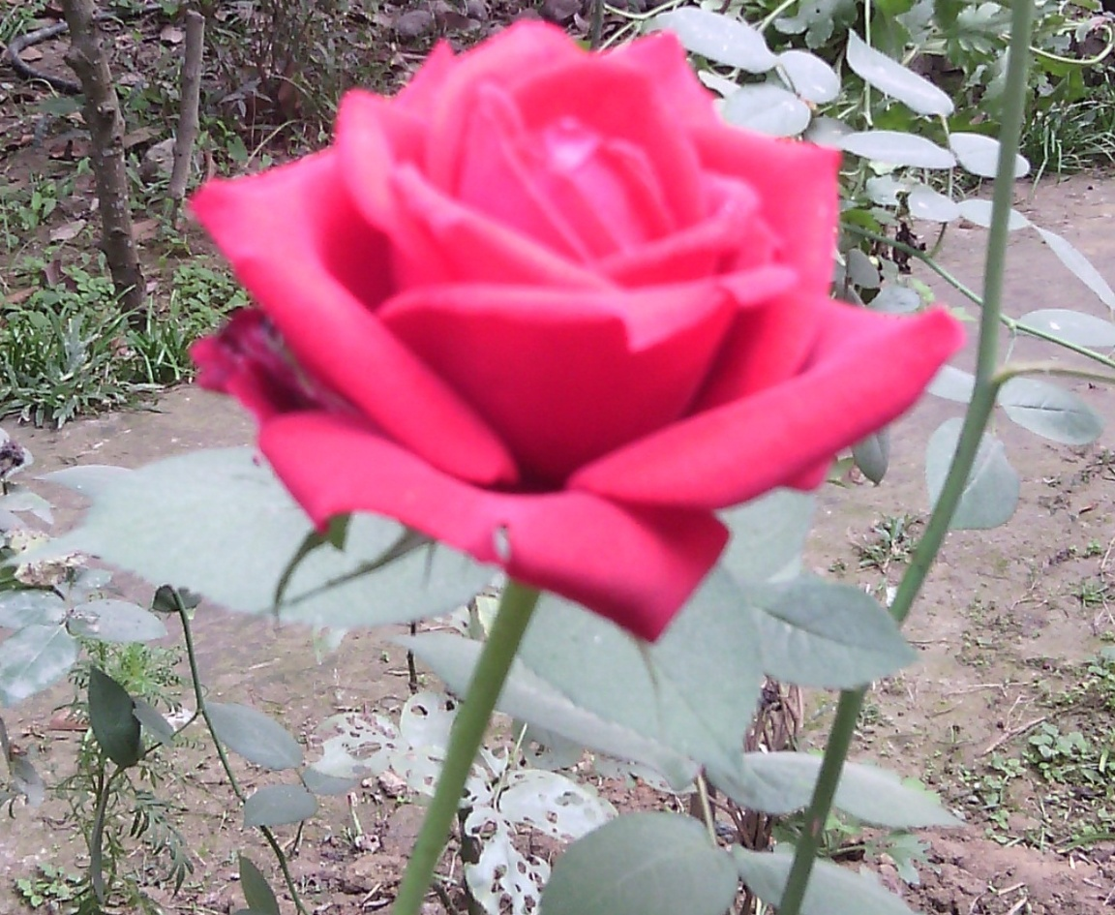
Thank you all

