Slide 1
WELCOME

Slide 2
TEACHER’S IDENTITY
HELAL AHMED
M.A(English);B.Ed
Asst.teacher of English
Pagla Govt. Model High School & College
South Sunamganj, Sunamganj
E-mail:helalenglish925@gmail.com

Slide 3
Lesson introduction
Subject : English 1st pape Unit : 08
Lesson : 01
Page : 110
Class: Nine/Ten
Time:45 mins

Slide 4
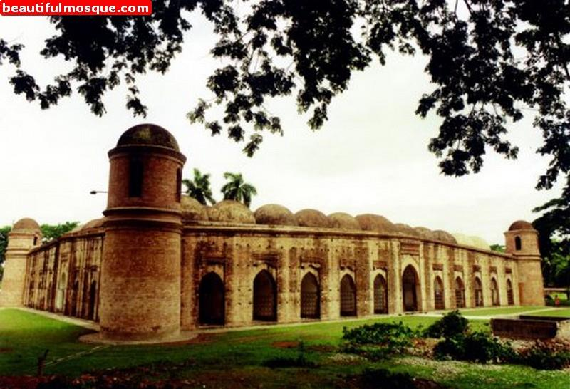
LOOK AT THE PICTURES

Slide 5
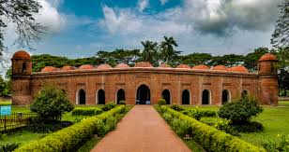
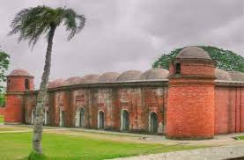
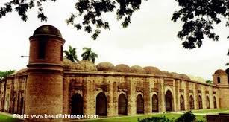

Slide 6
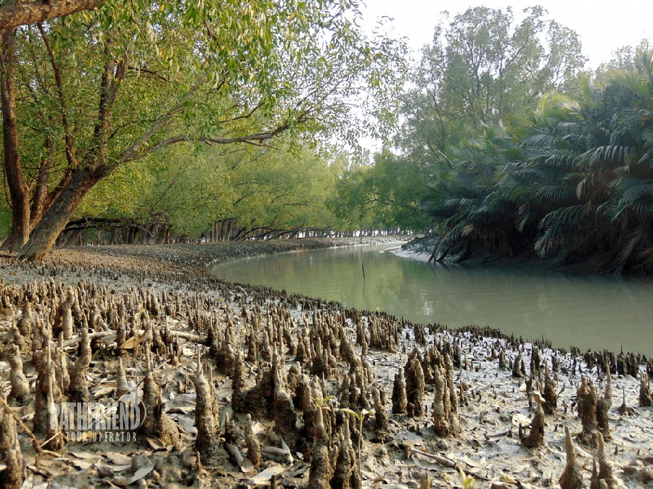

Slide 7
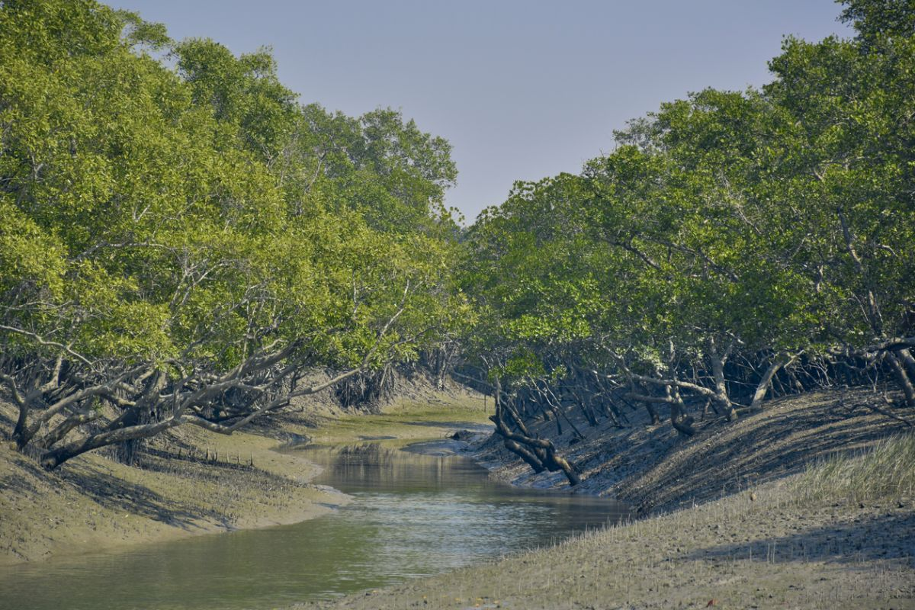

Slide 8
OUR TODAY’S LESSON
The Shat Gambuj Mosque

Slide 9
LEARNING OUTCOMES
After the end of the lesson, students will be able to…
*read and understand text through silent reading
**tell about Shat Gambuj mosque(world heritage site)
***describe another mosque

Slide 10
NEW WORDS AND MEANINGS
Heritage :
Tradition, patrimony, legacy
Outskirt :
Surrounding, edge. neighbourhood

Slide 11
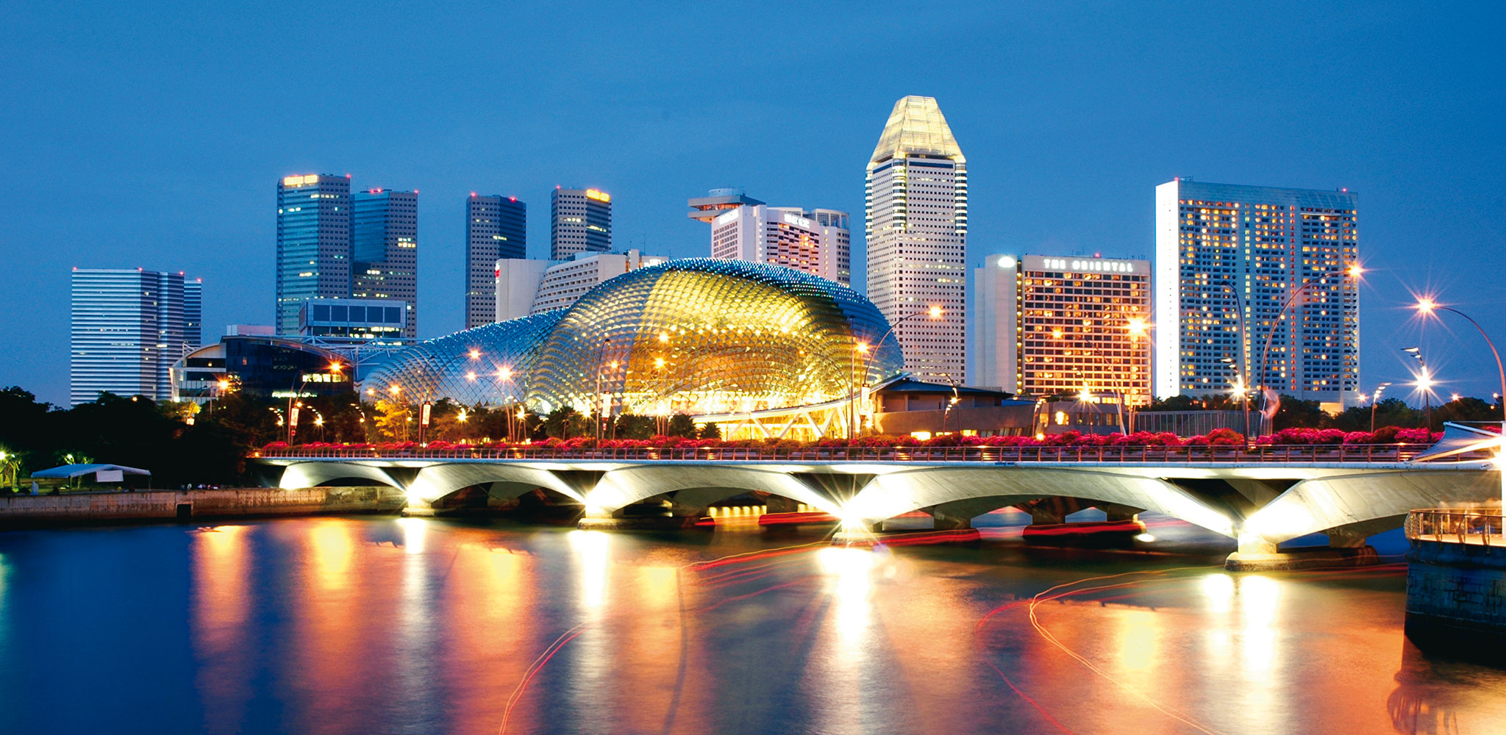
Infrastructure :
The basic physical and organizational structures and facilities(e.g: buildings, roads, power supplies)

Slide 12
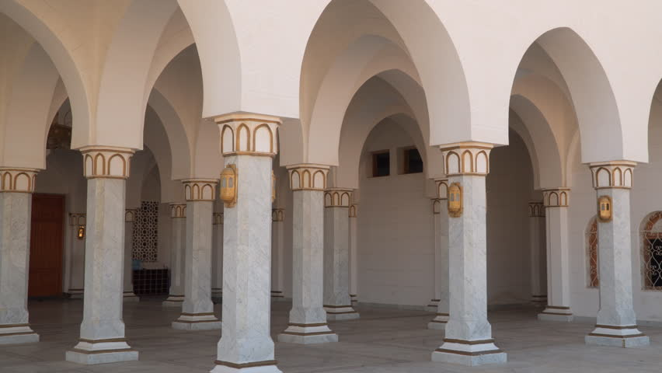
Pillar :
Post , column

Slide 13
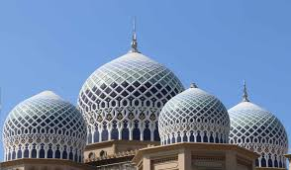
Domes :
Cupola , vault

Slide 14
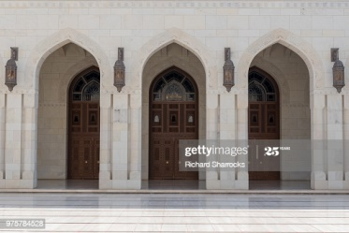
Arched :
Bent , subdued

Slide 15
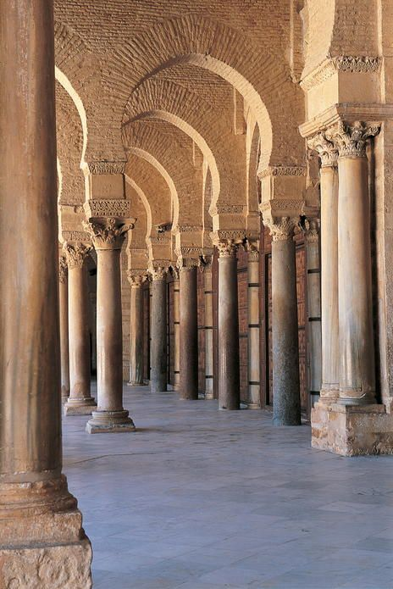
Aisles :
A passage between rows of seats in abuilding

Slide 16
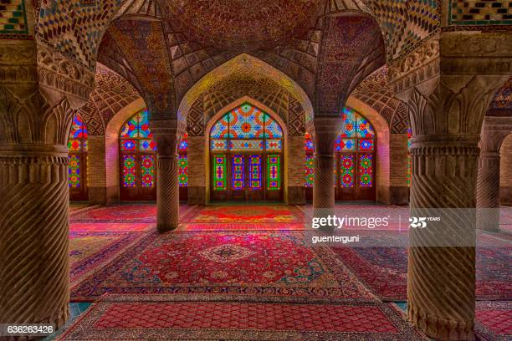
Curved :
Oblique, bended

Slide 17
Column :
Pillar , post

Slide 18
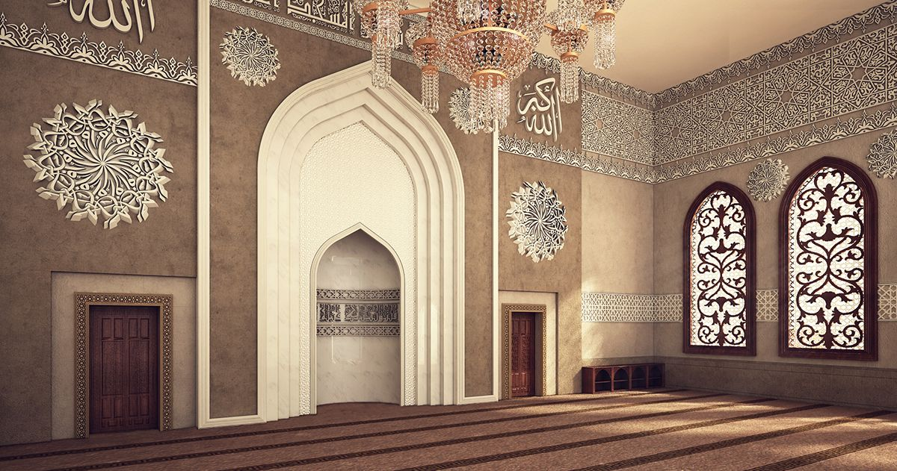
Hollow :
Hole, vug, blank

Slide 19
Let us read the text again

Slide 20
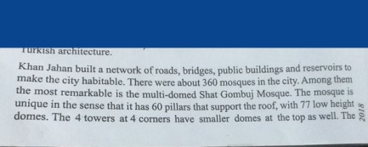

Slide 22
Shat Gambuj Mosque | Information
Founded by
When
Number of domes
Number of pillars
Arches
Thickness of the arches
Mihrabs

Slide 23
Shat Gambuj Mosque
Information

Slide 24
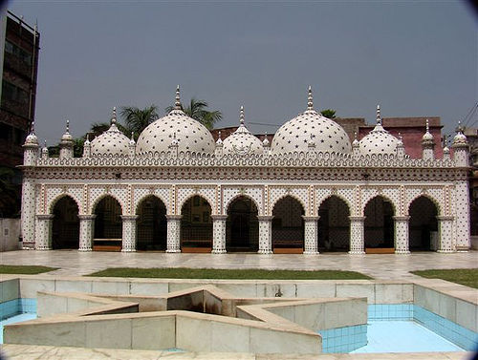
Look at the star mosque in Dhaka

Slide 25
Location : Dhaka, Abul Khairat Road
Style: Mughal
Number of domes: 5
STAR MOSQUE
Decoration: different sizes of stars on dome and outside wall
Materials used for decoration : Chinaware and white cement
Interior of the mosque: mosaic floor, floral tiles on the wall
Built by : Mirza Ghulam Pir- a respectable Zmindar of Dhaka
Time : early 18th century

Slide 26
Complete the description of the Star Mosque in Dhaka with the clues given in previous slide
The Star Mosque is located at ____________ in Dhaka . It was built following ________ style . There are _______domes of different sizes . The mosque is decorated with different sizes of ______on dome and____________.Chinaware and __________ are used for decoration . There is ________ floor and _________ tiles on the wall inside of the mosque. The Star Mosque was built by _______________ a respectable Zamindar of Dhaka in the 18th century.
Abul Khairat Road
Mughal
Five
stars
outside wall
White cement
mosaic
floral
Mirza Ghulam Pir

Slide 27
HOME WORK
Suppose you have visited a historical mosque recently. Now write ten sentences about that mosque.

Slide 28
THANK YOU

