Slide 1
WELCOME

Slide 2
MY IDENTITY
HELAL AHMED
M.A(English);B.Ed
Asst.teacher of English
Pagla Govt. Model High School & College
South sunamganj, Sunamganj
E-mail:helalenglish925 @gmail.com

Slide 3
Lesson Introduction
Class: Nine/Ten
Sub:English 1st paper
(English For Today)
Unit:Eight
Lesson:04
page: 118

Slide 4
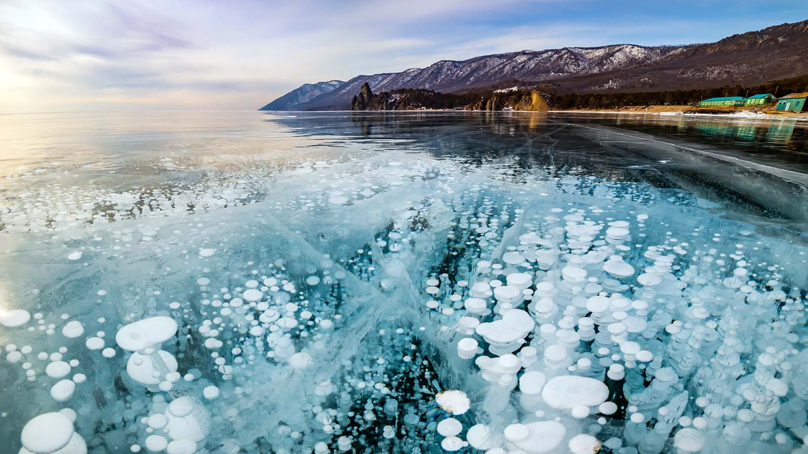
Look at some pictures and watch a video and guess about our today’s lesson

Slide 5
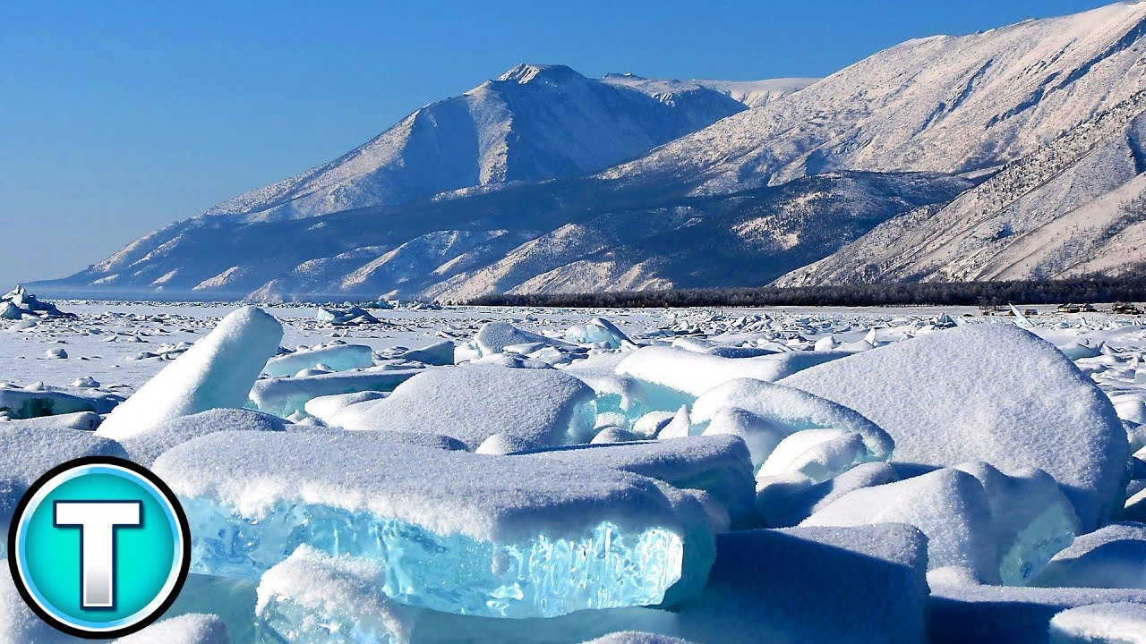

Slide 6
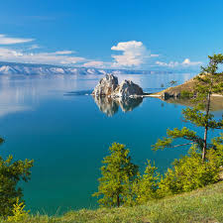
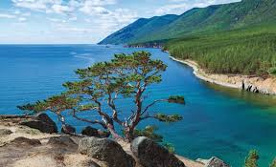

Slide 8
OUR TODAY’S LESSON ..
Lake Baikal

Slide 9
Learning Outcomes
After the end of the lesson, students will be able to…
<>read and understand text
<>tell about Lake Baikal
<>ask and answer question

Slide 10
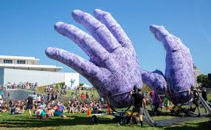
Enormous:
Plenty, abundant, huge
Miracle:
Theurgy, rattler

Slide 11
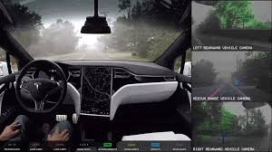
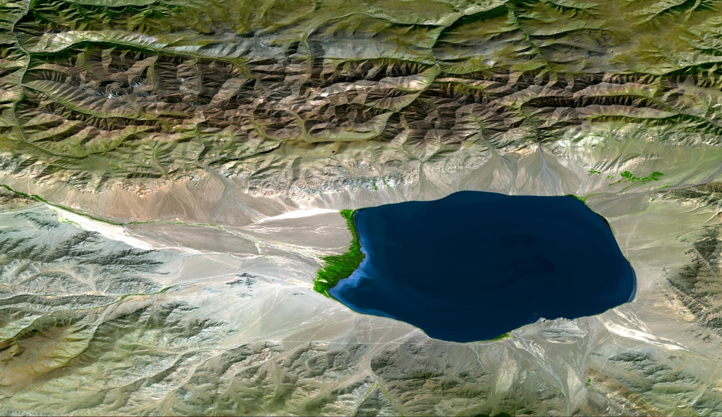
Independent, self-explanatory
Autonomous:
Basin:
Manger, tub

Slide 12
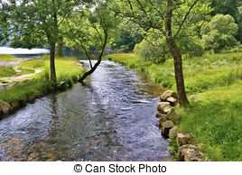
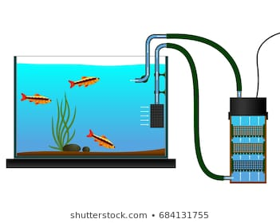
Rivulet, bourn
Brooks:
Generator:
Producer, creator

Slide 13
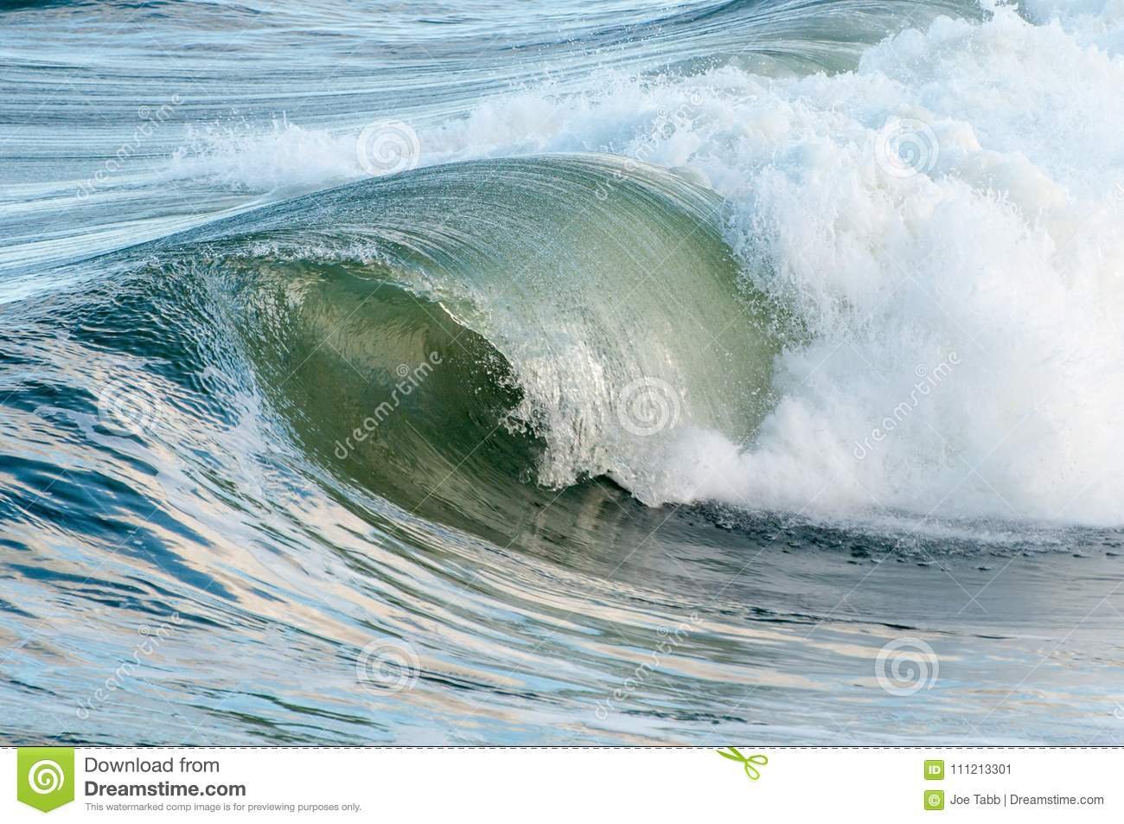
Crest:
Flame, top, bun

Slide 14
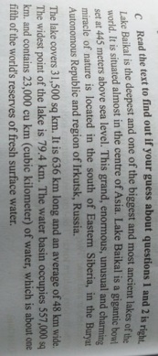
Read the text for better understanding

Slide 15
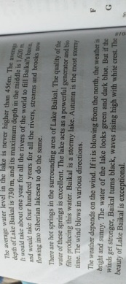

Slide 16
Match the words with the meanings
Words
Meanings
miracle
Small stream
basin
top
crest
An act believed to be caused by God
exceptional
Bowl-shaped depression filled with water

Slide 17
Solution of the matching words
An act believed to be caused by God
Bowled-shaped depression filled with water
top
outstanding

Slide 18
Read the text and complete the chart
Lake Baikal
Information
Location
Setting/placed
Length
Width
Maximum depth
Occupies an area
South of Eastern Siberia
Centre of Asia
636km
48km
1,620m
557000 sq km

Slide 19
HOME WORK
Write a list of attractive features of Lake Baikal

Slide 20
THANK YOU

