Slide 1
WELCOME

Slide 2
TEACHER IDENTITY

Slide 3
Lesson Introduction
Class : Nine/Ten
Time : 45 minutes
Subject : English 1st paper
Unit : 11
Lesson : 3
Page : 147

Slide 4
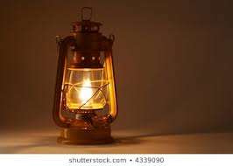
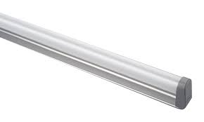
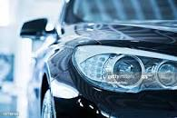
Look at the pictures and guess about our lesson

Slide 5
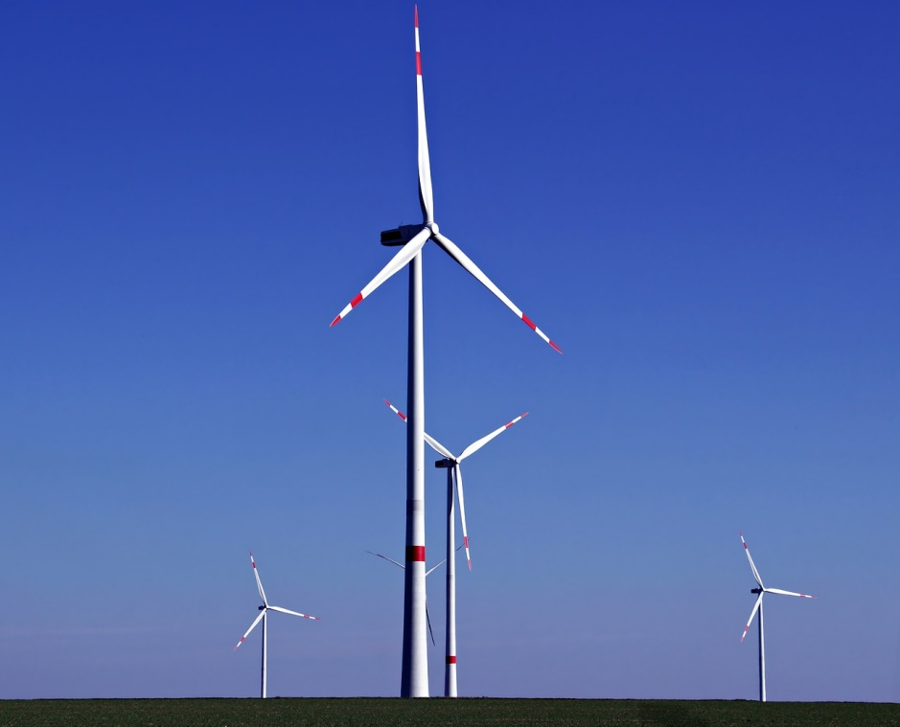
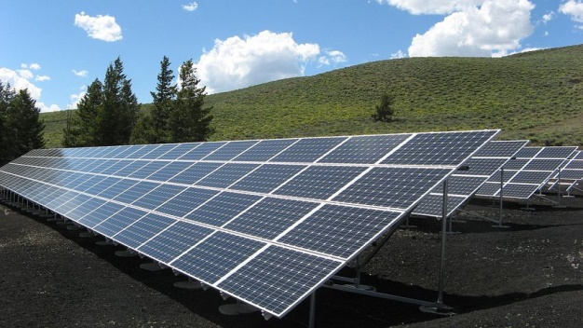

Slide 6
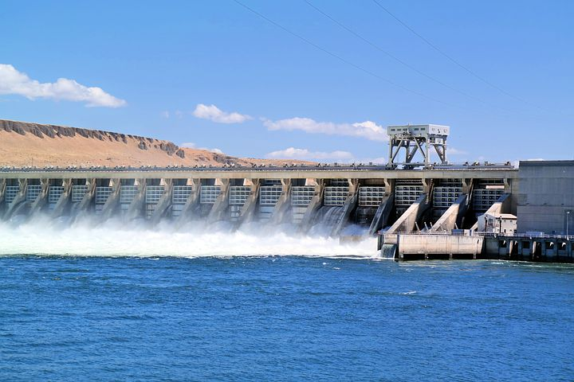

Slide 7
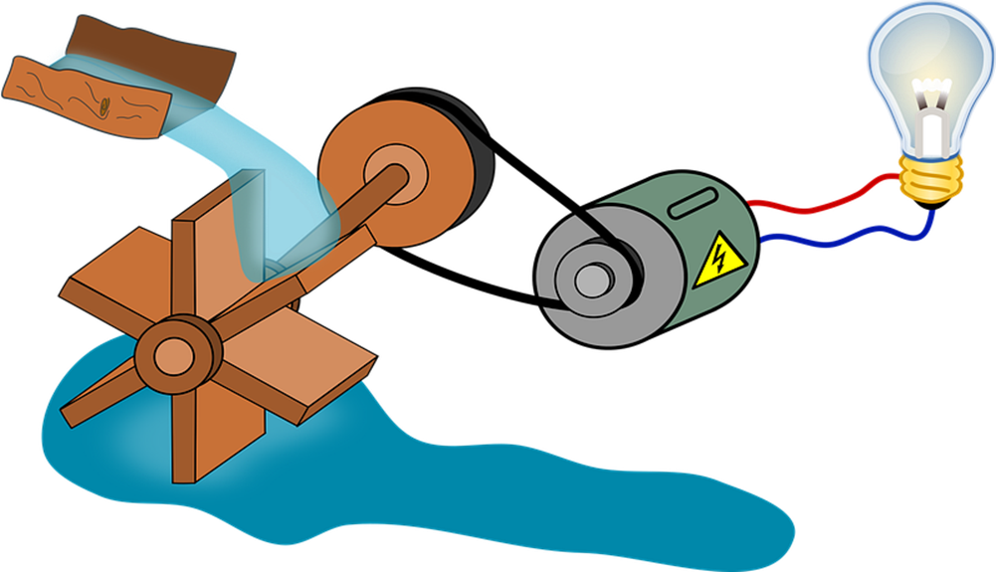

Slide 8
Our Today’s Lesson….
Renewable energy sources-3

Slide 9
LEARNING OUTCOMES
After the end of the lesson students will be able to …....
Describe familiar objects
Participate in conversation , discussion
Read intensively and extensively

Slide 10
Read the text and find out new words

Slide 11
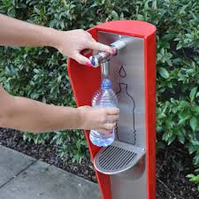
New words presentation
Reliance :
Dependence, faith
Refill, restock
Replenish :

Slide 12
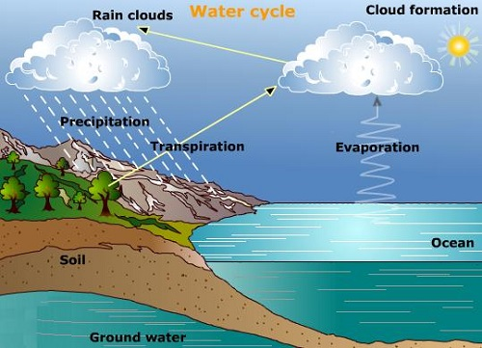
Turbine:
Wheel, rotor
Evaporate:
Turn from liquid into vapor, vaporize

Slide 13
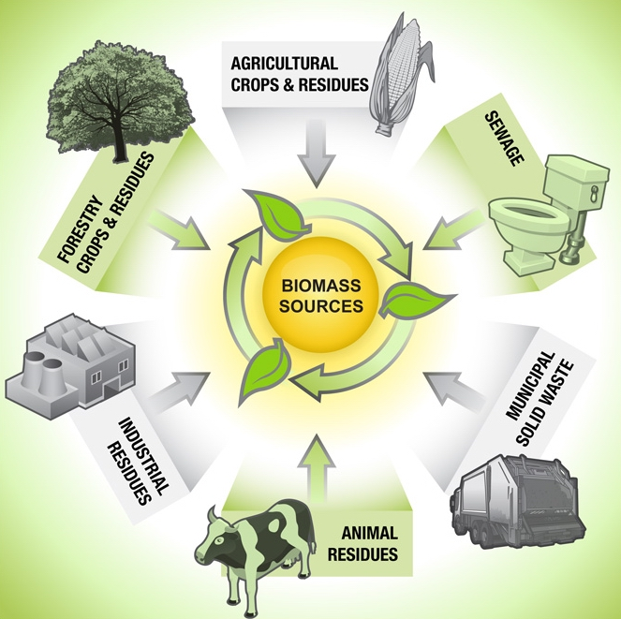
The generation of electricity using flowing water
Hydroelectric:
Biomass:
The total mass of organism

Slide 14
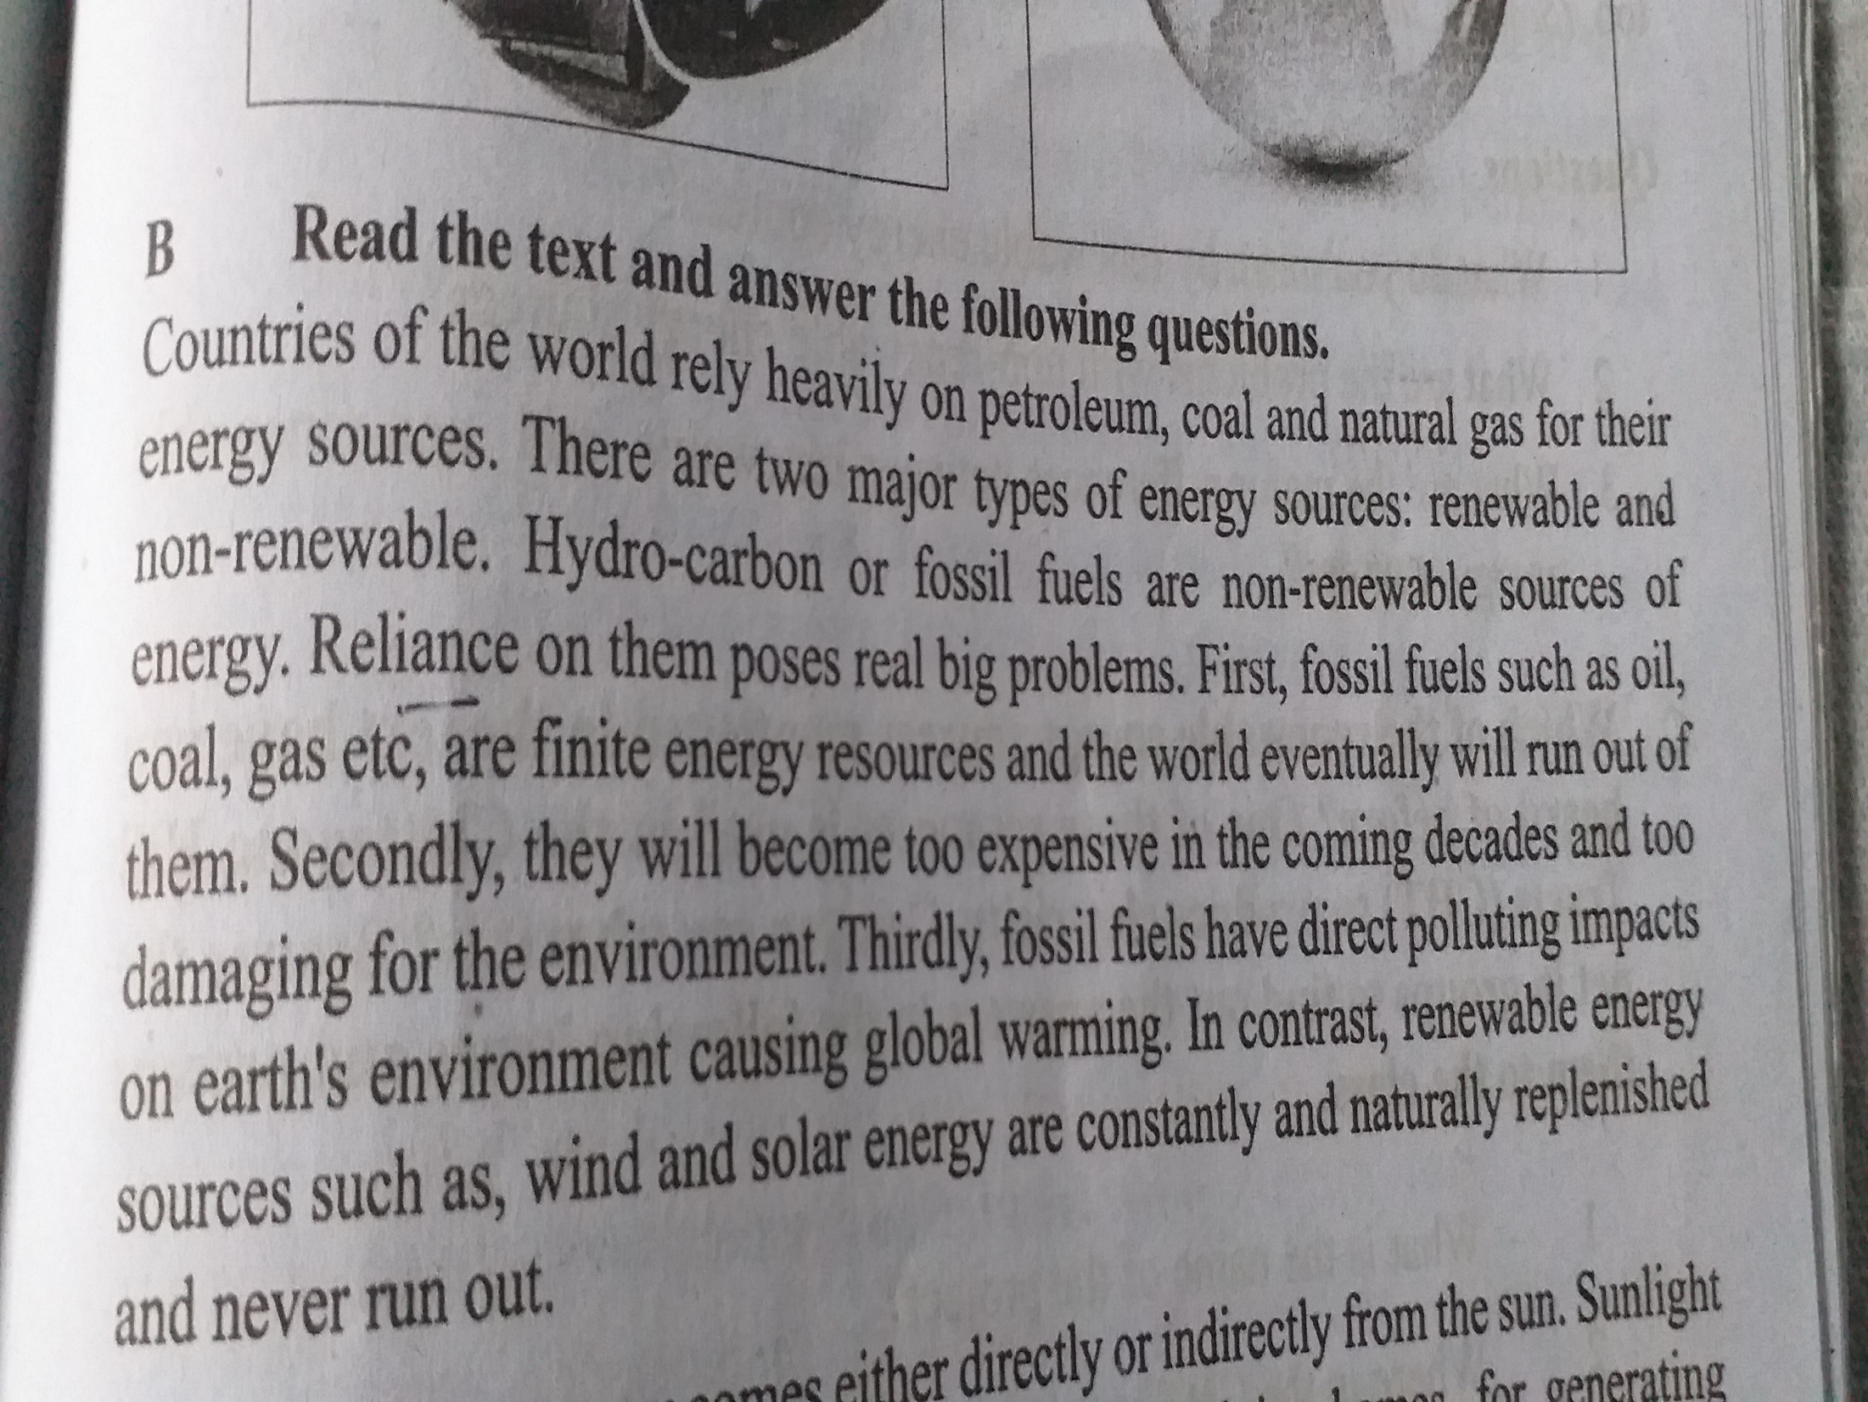

Slide 15
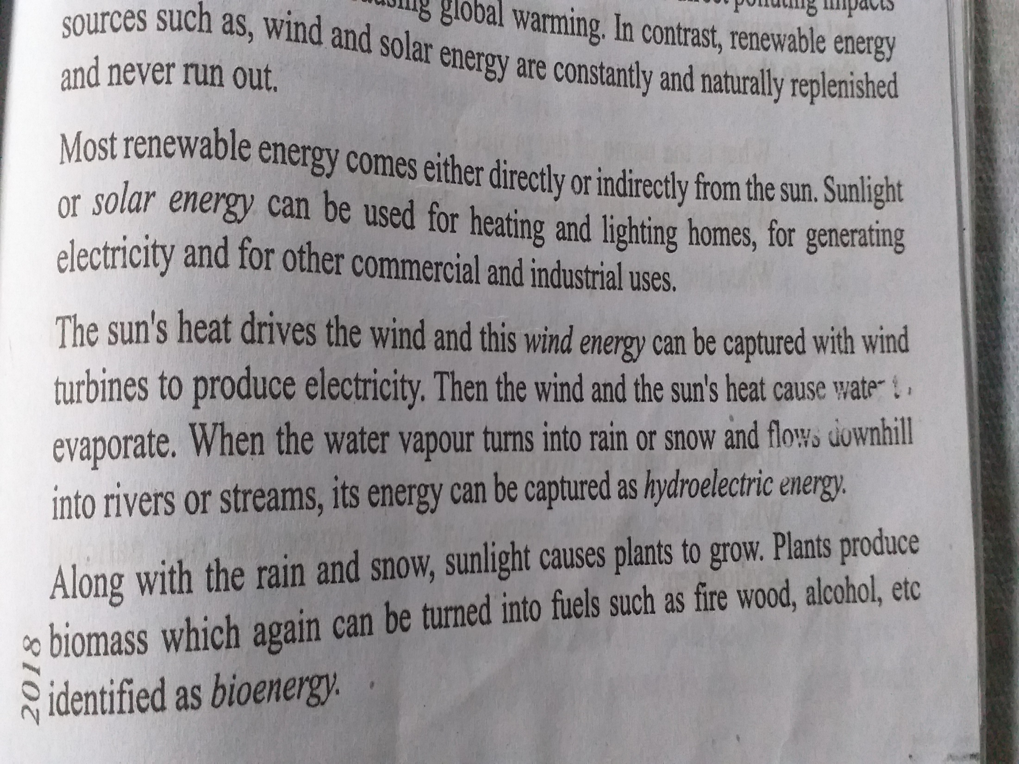

Slide 16
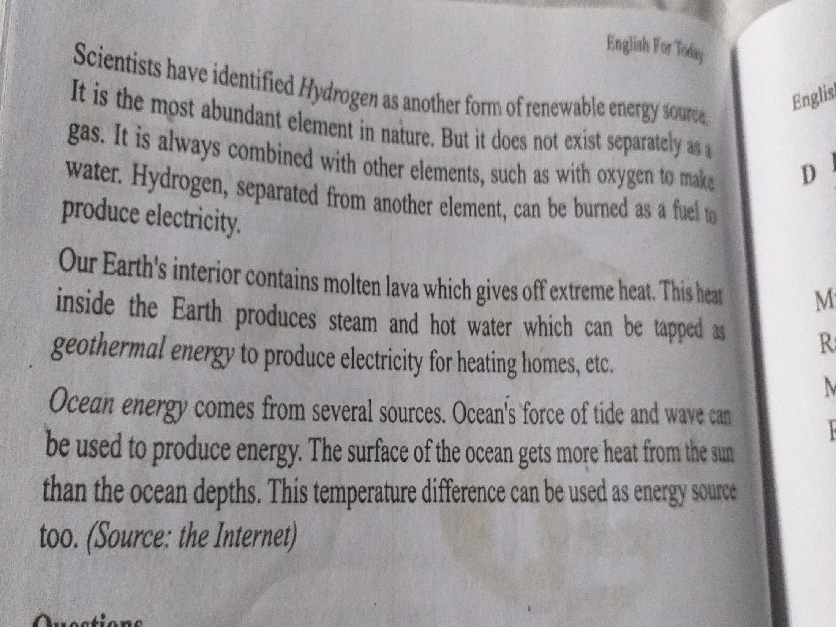

Slide 17
Read the text again and answer the following questions
1.What do you mean by renewable energy sources?
2.What are the problems with non-renewable energy sources?
3.What are the major difference between renewable and non-renewable energy sources?
4.How does wind produce electricity?
5.What does bioenergy mean?

Slide 18
Read the text once again and find out renewable and non-renewable sources
Renewable energy sources | Non-renewable energy sources

Slide 19
Read the dialogue and act it out in pairs.
A :What’s solar energy?
B :It’s one of the renewable energy sources.
A :why is it called green energy?
B :Well, it’s green energy because it helps us keep the Earth green. I mean it doesn’t emit any pollutants in the atmosphere when we produce and use it.
A :I see. Then it must be a clean source of energy.
B :Exactly. And that’s why it’s also called clean energy.

Slide 20
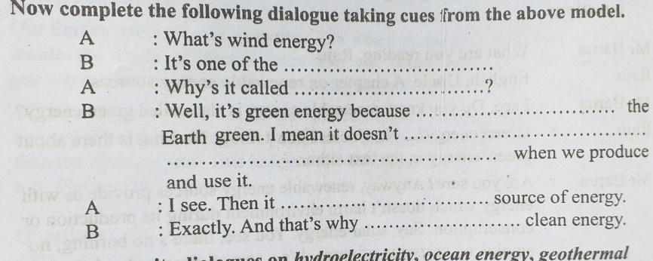
Now complete the following dialogue taking clues from previous dialogue

Slide 21
HOME WORK
Write a dialogue on hydroelectricity taking clues from previous two dialogues

Slide 22
THANK YOU

