Slide 1
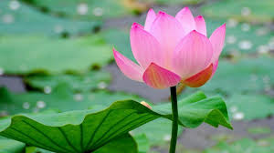
WELCOME

Slide 2
INTRODUCTION
Nishith Joardar
M.A (English), M.Ed (D.U)
M.A in ELT & Applied Linguistics (J.U)
Educator
LESSON
Class: Eight
Subject: English for Today
Unit: One
Lesson: Four
Topic: Our Ethnic Friends-2
, Date:02.03.2020

Slide 3
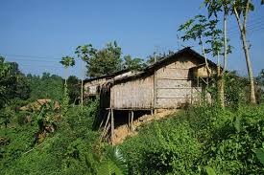
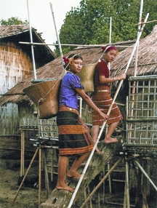
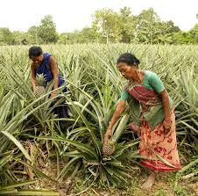
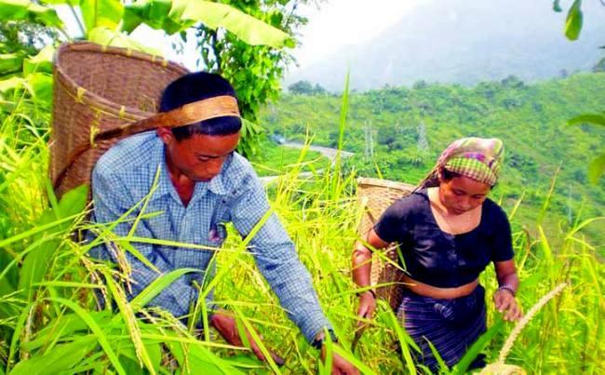
Look at the pictures and thinking about them.

Slide 4
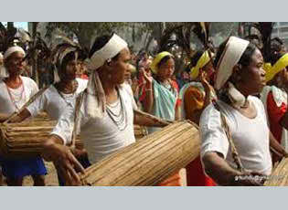
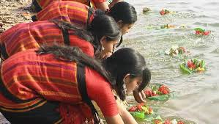
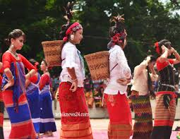
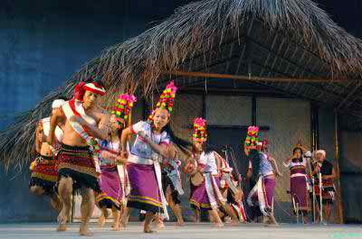
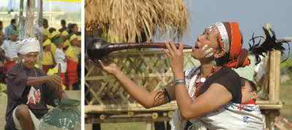
Let’s see more pictures of the same character.
Can you guess what we are going to discuss today?

Slide 5
Yes,
Today’s topic is “OUR ETHNIC FRIENDS(2)”.

Slide 6
LEARNING OUTCOMES
By the end of the lesson, students will be able to-
learn regarding the life style of ethnic People.
learn some new words.
Ask & answer the questions.
Write a paragraph on it.

Slide 7
Presentation
Read the text silently and find out the problems of the text.

Slide 8
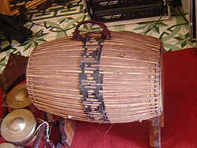
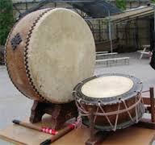
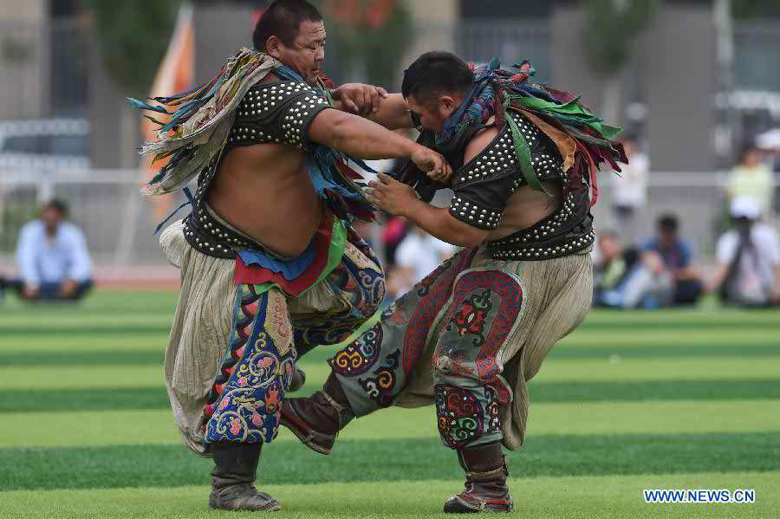
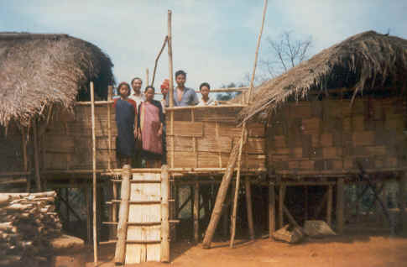
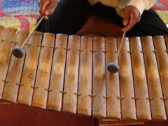
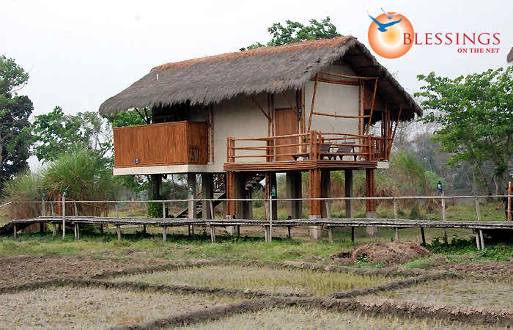
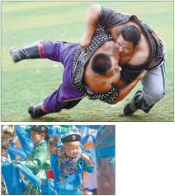
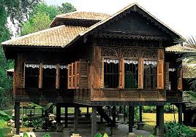
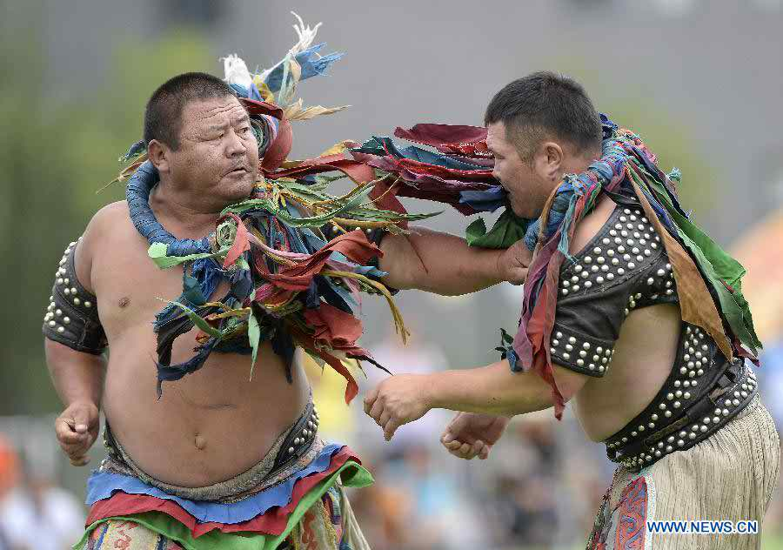
Watch some picture which is related to the topic lesson

Slide 9
Look at the following words & try to guess the meaning of the words.
Staple –
Instrument –
Pastime –
Wrestling –
5.Machang –
Main
Tool
Leisure
One kind of game
Platform

Slide 10
Pair work
Answer the following questions.
What are their favourite pastimes?
What do the men and the women wear?
Hunting & fishing.
The men wear lungis and the women wear thamis or sarongs & angis.

Slide 11
Fill in the gaps with suitable words.
Tracts
own
Santals
living
others
speak
There are some ethnic people a.------- in Bangladesh. Among the ethnic people, some of them are the Chakmas, the Marmans, the Tipperas, the Moorangs, the b.-------, the Monipuries etc. Most of them live in Chittagong Hill c.-------. D.------- live in Mymensingh, Rajshahi and Sylhet. They are Hindus, Christians or Buddhists. They e.------- their own mother tongues.

Slide 12
Group work
My dear students,
Write the main idea about the passage within 5- 6 sentences .

Slide 13
Evaluation
1. What is their main food?
2. What is a popular sport for them?
Answer : 1. Rice
2. Wrestling

Slide 14
Home work
Write a paragraph about the lifestyle of the ethnic people within 80-100 words .

Slide 15
Thank You All

