Slide 1
To
Multimedia Class

Slide 2
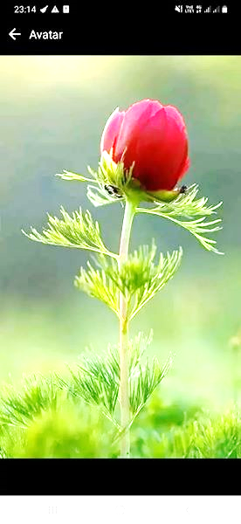
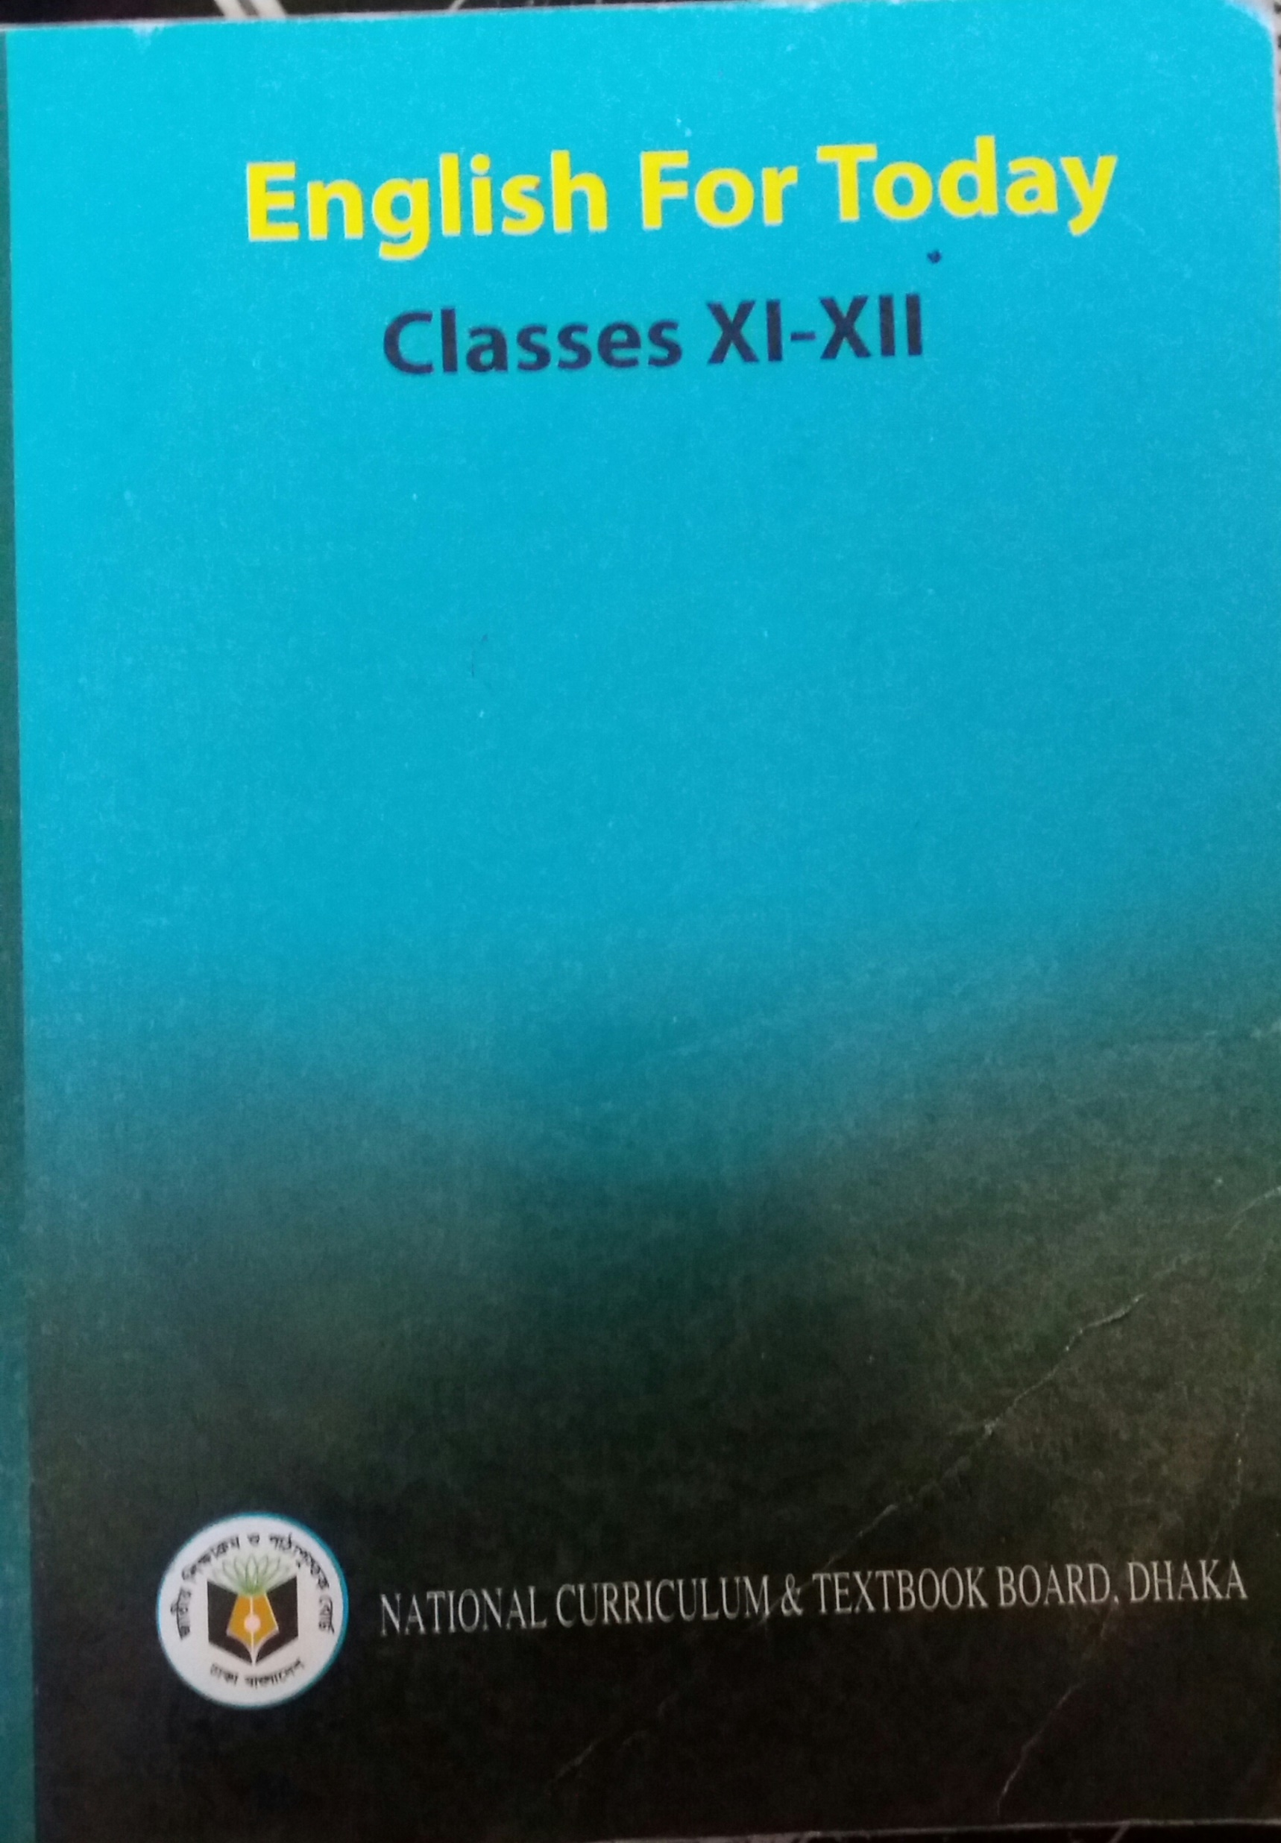
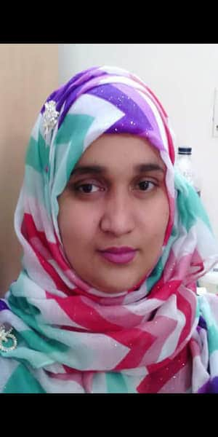
Identity
Subject : English First Paper
Unit-Fourteen : Art and Music
Lesson-Two
Class-Eleven/Twelve/Alim
Mosammat Nelufa Afrose
Lecturer in English
Khilbaisa Rahmania Fazil Madrasah
Khailbaisa, Sadar , Lakshmipur
E-mail: nelufa.afrose@gmail.com

Slide 3
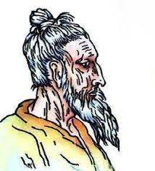
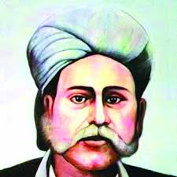
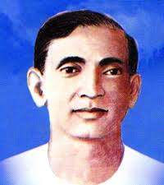
Look at the pictures below
Fakir Lalon Shah
Hasan Raja
Sha Abdul Karim
Abbus Uddin

Slide 4
Answer the following questions
1.Why are these honorable person famous for?
2. Can you sing a song of them?
3.What kind of songs do they sing?
4.Tell some present singer’s name who sing such kind of song?

Slide 5
The topics of our today class is-
Folk Music

Slide 6
By the end of the lesson students will have learnt-
The definition of Folk Music.
The varieties of folk music in Bangladesh.
The characteristics of the Music.
The folk music that prevailing in Bangladesh.
The present condition of folk music in Bangladesh.

Slide 7
What is Folk Music?
Folk music can be described that type of ancient music which springs from the heart of a community, based on their natural style of expression uninfluenced by the rules of classical music and modern classical songs.
The combination of folk song, folk dance and folk tune may be called folk music.

Slide 8
The varieties of folk music in Bangladesh
Bangladesh is known as a land of music. In Bangladesh folk music has great variety. Songs being composed on-
The culture,
The festivals,
Views of life,
Natural beauty,
Rivers,
And rural and riverine life..
These songs are also about-
Social inequality and poverty,
The material world and the supernatural.
The culture and life style of the different tribes
like the Santal, Garo, Chakma, Manipuri, Marma, Tripuri, Hajong etc have also influenced the folk music.

Slide 9
Classification
Folk music in Bangladesh can be classified many ways. Some are discussed below-
1
According to region
The Northern | The Eastern | The South-Western
Bhawaiya | Bhatiyali | Baul songs
2
According to Quantity of singer
Individually | Chorus
Baul, Bhatiyali, Murshidi, Marfati | Kabigan, Leto, Alkap, Gambhira
Yet some songs belong to religious community and some other are sung only men or, women or both men and women.

Slide 10
Some characteristics
(i) It is composed by rural folk on the basis of ancient rules transmitted orally..
(ii)These ancient rules of music have not been influenced by classical or modern music.
(iii)Folk songs may be sung in groups or individually.
(iv) No regular practice is required for folk music..
(v)It is composed and performed by illiterate and semi literate people.
(vi) It is a spontaneous expression in easy language, local dialect, and simple tune.
(vii)Both words and tune are appealing.
(viii) Despite its universal appeal it uses local dialect.
(ix) It depends upon nature and rural environment.
(x)It contains a strong emotive expression of human love and separation. Etc.

Slide 11
Different Folk Music belonging to different regions of Bangladesh.
Their name and regions are listed below:
Baul and spiritual songs : Birbhum and kushtia.
Jarigan : Dhaka, Mymensingh, Shylhet, Faridpur, Mursidabad.
Bhawaiya : Cooch Bihar, Rajshahi, Dinajpur, Rangpur, Pabna.
Gambhira : Rajshahi, Malda.
Wedding songs : all region.
Roof-beating songs : the northern regions of Bangladesh.
Sari : the lower marshy regions of Sylhet and Mymensingh.
Bhatiyali : nearly all regions of Bangladesh.
Pastoral songs : Dhaka, Mymensingh, Faridpur, Sylhet, Habiganj.

Slide 12
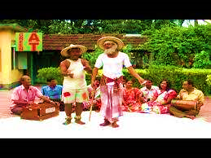
The scenery of Gambhira song

Slide 13
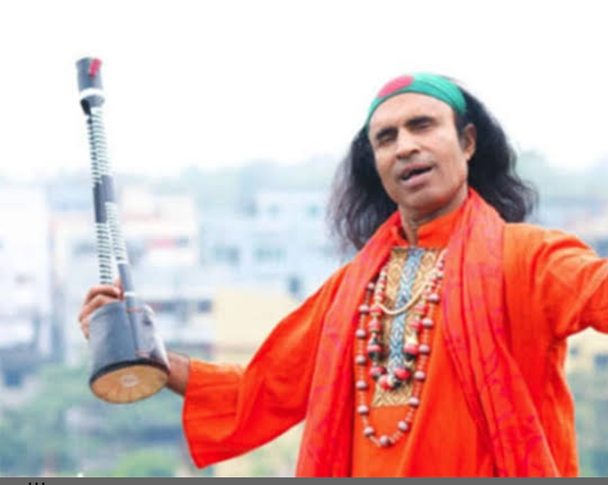
The scenery of a Baul song.

Slide 14
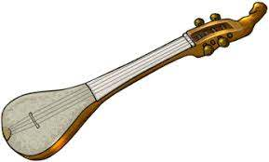
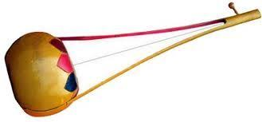
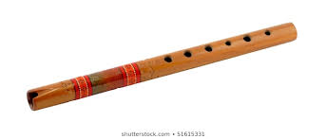
Ektara
Some musical instruments used for signing Folk Music
Dotara
Bashi
Dhole

Slide 15
The present conditions of condition of Folk Music
At present the condition of Folk Music in our country is not satisfactory.
Some reasons are given below-
New generation has lack of interest in folk music..
Now our rich traditional folk songs inevitably influenced by western music and culture.
The Folk songs are now sung in western melody.
Bad kind of remixes have been created.
Band and pop is getting popular in our country as we forget and neglect our traditional folk song.….

Slide 16
How can we regain it?
If we want to get back our golden era we have to do some special work.
We have to do a lot of concert of folk music.
We should create consciousness to our young generations that our song is the best.
Government has to take necessary steps for the development of Folk Music.
Ensure the financial stability of the folk singers.
Protecting the real lyrics and tunes.

Slide 17
Open at page no 187.
And read silently.

Slide 18
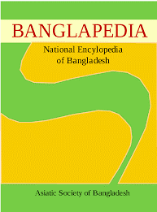
More Information
The topic is an excerpt published in Banglapedia on Bengali Folk Music written by the late Mridul Kanti Chakaravarty, an expert in music and Baul songs singer.
Banglapedia:
The first National Encyclopedia of Bangladesh was published in 2003 by Asiatic Society of Bangladesh.

Slide 19
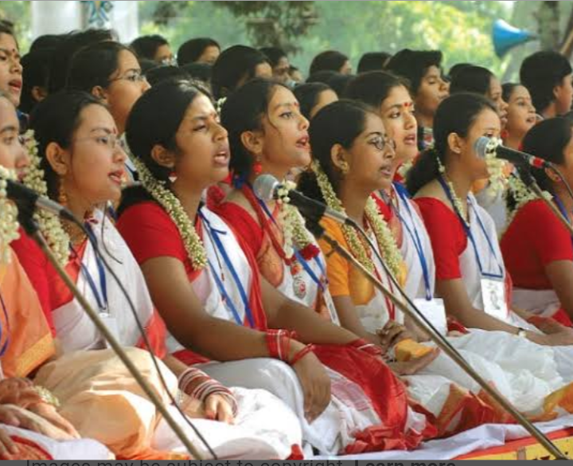
Let’s know some new words from the text-
Chorus:
A group of people who sing a song together.

Slide 20
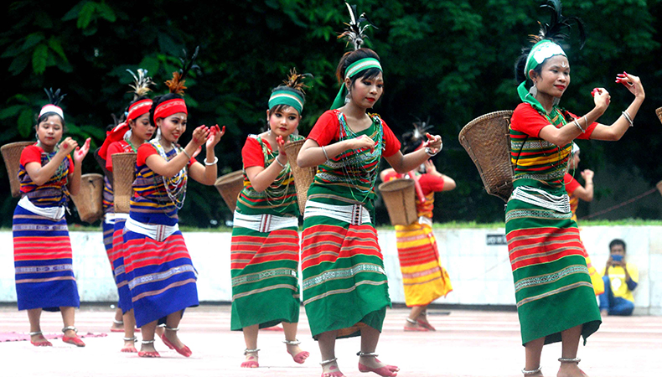
Tribe:
A social division in a traditional society consisting of families or communities. Now they are called ethnic groups.

Slide 21
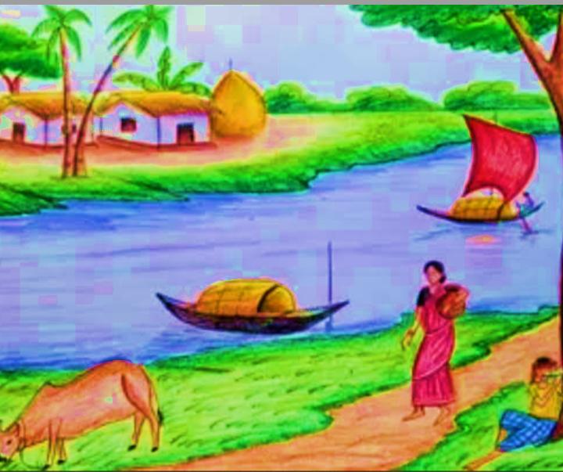
Riverine life:
The life led by people living on or beside the rivers’.

Slide 22
Pair Work
Explain briefly what the following terms mean.
1.Classical music
2.Life style.

Slide 23
Individual Work
Write a brief assessment of the Folk Music which are you familiar with.

Slide 24
Evaluation
Fill in the blanks with an appropriate word in each gap.
Bangladesh is a country that has very (a) _ traditional musical (b) _ work. Folk music is an expression of life of people in a(c) _ . This music transmitted (d) _ with unknown composers. Most of the folk song are composed based on (e) _ people, culture and environment.

Slide 25
Home Work
Write a Paragraph on” Folk Music” in about 200 words based on the answers to the questions:
(a).What is Folk Music?
(b). What is the history folk music?
(c). Mention the names of some folk music in Bangladesh.
(d).Who are the contributors to folk music in Bangladesh?
(e) What is the present condition of folk music in Bangladesh?

