Slide 1
Welcome to my session

Slide 2
TEACHER’S INTRODUCTION
Mst:fatama begum Head teagher
Chalarchor Govt.Primary School.
Chatak, Sunamgong…

Slide 3
Lesson introduction:
Subject: English
Class: iv , Unit 14, Lesson:1-2
Lesson Title: Mita’s day
Time: 40 minutes

Slide 4
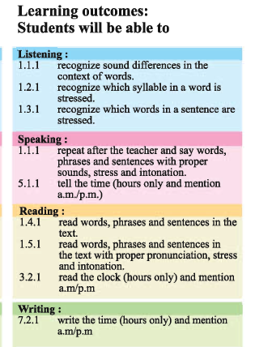

Slide 5
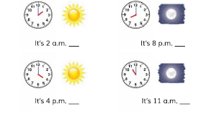
Show the picture

Slide 6
Pre-knowledge checking: Watch this video

Slide 7
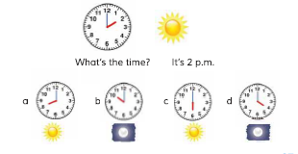
Today’s Lesson: Mita’s Day

Slide 8
Group work
Group Work
“B” Write two sentences answering time.
“C” Write two sentences mention am.
“D” Write two sentences mention pm.
“A” Write two sentences asking time.

Slide 9
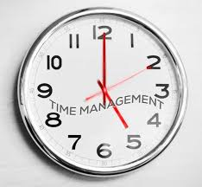
Group-“A” Match your answer
#What’s the time?
# What’s the time by your watch now?

Slide 10
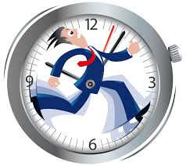
Group-“B” Match your answer
#It is five am.
#It is ten pm.

Slide 11
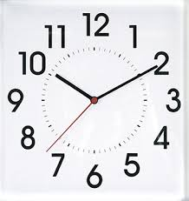
Group-“C” Match your answer
#It is 5 am.
#It is 11 am.

Slide 12
Group-“D” Match your answer

Slide 13
Concentration in the text book: Read the passage silently

Slide 14
Checking Learning:
Write two sentences on o’clock.

Slide 15
Evaluation
He is walking up
She is sleeping

Slide 16
Home Work:
Make a list of your time on daily activities.

Slide 17
Thanks

