Slide 2
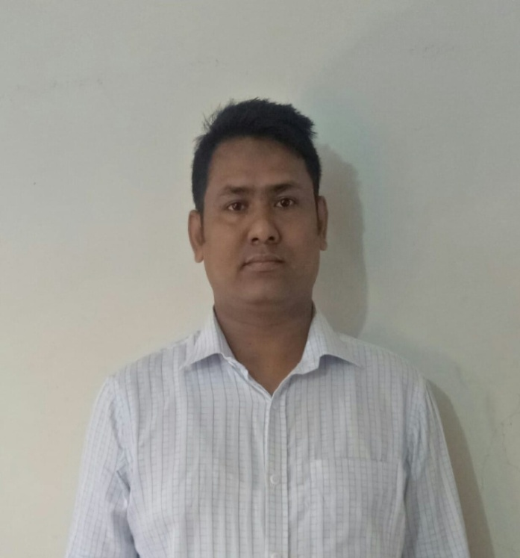
Md.Zuel Hossain
Assistant Teacher ( English) Itbaria UCK High School Pukurjana ,Patuakhali.
Email:mdzuelhossain248@gmail.com
Mobile:01728591706

Slide 3
English SecondPaper
Speech /Narration
Class: Eight/Nine/Ten
Time:50 minutes
Md.Zuel Hossain,Assistant Teacher (English),Itbaria UCK High School,Patuakhali

Slide 4
Let’s see some image and texts to guess something.

Slide 5
They said, “ We are happy.”
They said that they were happy.

Slide 6
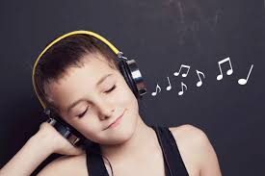
He says, “ I love music.”
He says that he loves music.

Slide 7
What have you guessed by
the images and texts?
Direct and indirect speech

Slide 8
Our Today’s lesson is-
Direct and indirect speech/
Narration (Part-1)

Slide 9
Learning outcomes
After we have studied this lesson,we will
be able to---
define speech
identify the classification of speech
change speech from direct to indirect
Md.Zuel Hossain,Assistant Teacher (English),Itbaria UCK High School,Patuakhali

Slide 11
Speech /Narration(In Short)
The way of reporting the speech of a speaker
is called narration.

Slide 12
Let us know the basics of
Speech / Narration.

Slide 13
Speech spoken directly by the speaker is direct speech.
Speech spoken indirectly by another is indirect speech.

Slide 14
Sumon said, “I will meet you tomorrow.”
Direct speech
Indirect speech
Sumon said/told that he would meet me the next day.

Slide 15
She said to me, “ I was ill.”
Direct speech
Indirect speech
She told me that she had been ill.

Slide 16
He said to me, “You are my best friend.”
There are two parts of a direct speech.
He said to me,
“ You are my best friend.”
Reported speech
Reporting verb
Out of inverted comma.
Inside of inverted comma.

Slide 17
Steps For changing Narration .

Slide 18
Linker & Reporting verb change
Sentence
Usage of Rteporting Verbs
Linker
Assertive Sentence
Say/Said/(told+obj)
That
Wh (word)/If/ Wheather
Interrogative Sentence
Asked

Slide 19
Sentence
Usage of Rteporting Verbs
Linker
Ordered
Requested
Advised
forbade
Imperative Sentence
To /not to
Optative Sentence
Wished/Prayed
That
Exclamatory Sentence
Exclaimed
That

Slide 20
Person Change In Narration

Slide 21
How to change ‘verbs’ from Direct to Indirect speech.
Direct | Indirect
am/is/are
was/were
shall/will
have/has/ had | had
can/may
must/have to/has to/ought to
Present indefinite
Past indefinite
was/were
had been
should/would
could/might
had to
Past indefinite
Past perfect+v₃

Slide 22
How to change ‘Adverb’.
DIRECT | INDIRECT
now
tomorrow
tonight
today
yesterday
last night
last week
here
this
these
then
the next day
that night
that day
the previous day
the previous night
the previous week
there
that
those

Slide 23
How to convert assertive sentence into indirect speech.
Sub + said to + object
Sub +told + object
that
Verb Change
Reported speech with desirable change
He said to me, “I am well.”
He told me that he was well.

Slide 24
1.He said to me, “ I have done my job.”
He told me that he had done his job.
2.He said to me “Mr. Bean did the best last night.”
He told that Mr. Bean had done the best the previous night.
3.The student says, “ I have completed my home work.”
The student says that he has completed his home work.

Slide 25
4.She said to me “I visited London in 2005”
She told me that she had visited London in 2005
Remember
Universal truth will not be changed in indirect speech.
My father said, “Evil always remains in evil.”
My father told that evil always remains in evil.

Slide 26
Home work
Change the following speech from direct to indirect—
The teacher said to me, “The earth moves round the sun.”
Father said to his son, ”I want to make you a man of truth.”
He said to me,” I was there in 1990.”
“Practice makes a man perfect.”
“Newspaper is a store house of knowledge,” said the Principal.

