Slide 1
Welcome to Chuadanga Krishnanagor high School

Slide 2
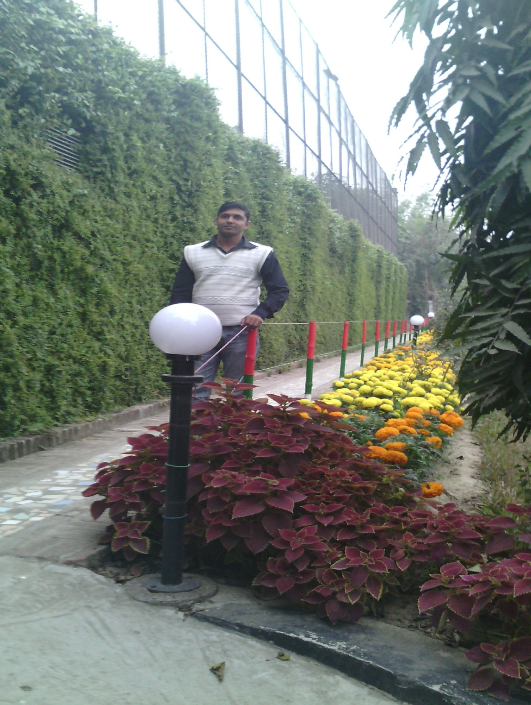
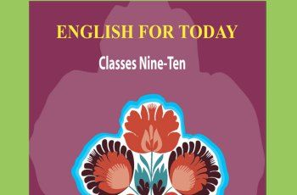
Ujjal Kumar Ghosh
Assistant Teacher (English)
Chuadanga Krishnanagor high School
Panjia Keshabpur Jassore
Email-ujjalkumar106@gmail.com

Slide 3
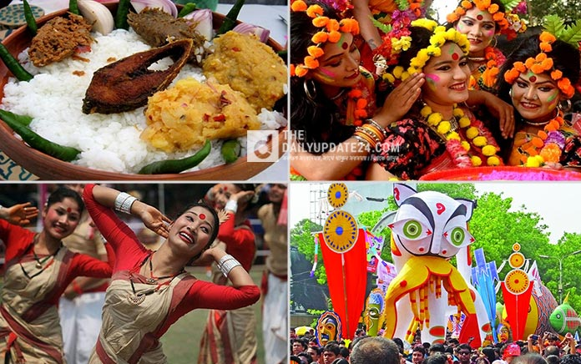
What’s the picture about?
Bangalee culture

Slide 4
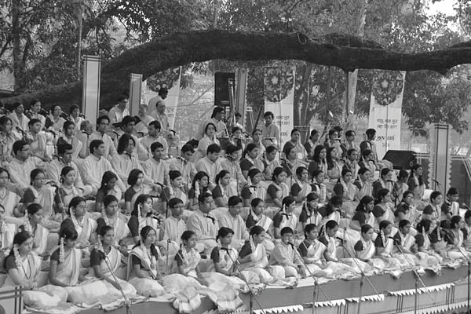
Where do you think it is?
the cultural function at Ramna Batamul organised by Chhyanata

Slide 5
Today,s Lesson is------
Pahela Boishakh
Unit Three
Lesson- 6
Page number -44

Slide 6
Learning outcomes
By the end of the lesson learning will be able to
Talk about the picture.
Use new words and make sentences.
Ask and answer questions.
Complete the passage with suitable words
Describe about cultural or religious festival
Write a dialogue.

Slide 7
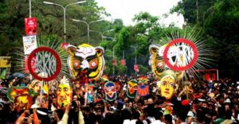
culture
Culture means Customs, traditions, heritage
Pahela Boishakh’ is a part of Bangalee culture

Slide 8
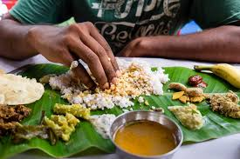
traditional
Traditional means Conventional, customary
It is a day when people love eating traditional food.

Slide 9
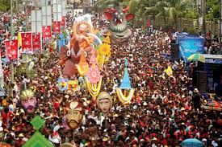
processions
Procession means Parade, march, march-past
The Pahela Boishakh’s procession usually displays the traditional practices of Bangalee culture.

Slide 10
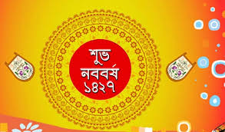

Slide 11
Reading Test
‘Pahela Boishakh’ is the first day of Bangla new year. The day is a public holiday . This day has a special significance for us as it forms a part of Bangalee culture and tradition. People from all walks of life, irrespective of their ethnic identity or religious beliefs, celebrate the day with traditional festivities. On this day, the whole of Bangladesh is in a festive mood. The day inspires people to start life with renewed hopes and inspirations.

Slide 13
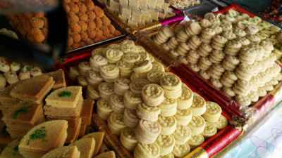

Slide 14
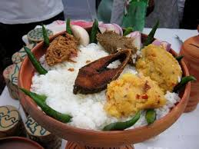

Slide 15
Every year the day is celebrated traditionally. People wake up early in the morning, have a bath and wear their traditional clothes.Women wear white saris with red borders and adorn themselves with colourful churis and flowers, while men dress themselves with pajamas and punjabis. It is a day when people love eating traditional food.

Slide 16
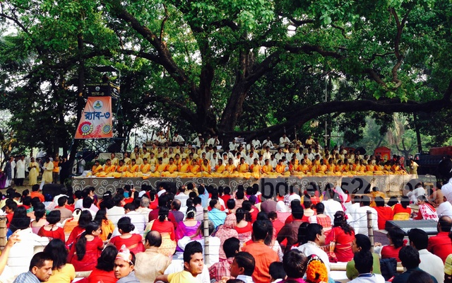

Slide 17
This day the most colourful event is held in Dhaka. Early in the morning, people in hundreds and thousands pour in from all directions to attend the cultural function at Ramna Batamul organised by Chhyanata. The cultural programme begins just with sunrise and the renowned artists of the country take part in the program that starts with the famous Tagore-song Esho-he-Boishakh, Esho Esho ........ . Artists also sing traditional folk songs, and display classical dances with the rhythm of musical
instruments.

Slide 18
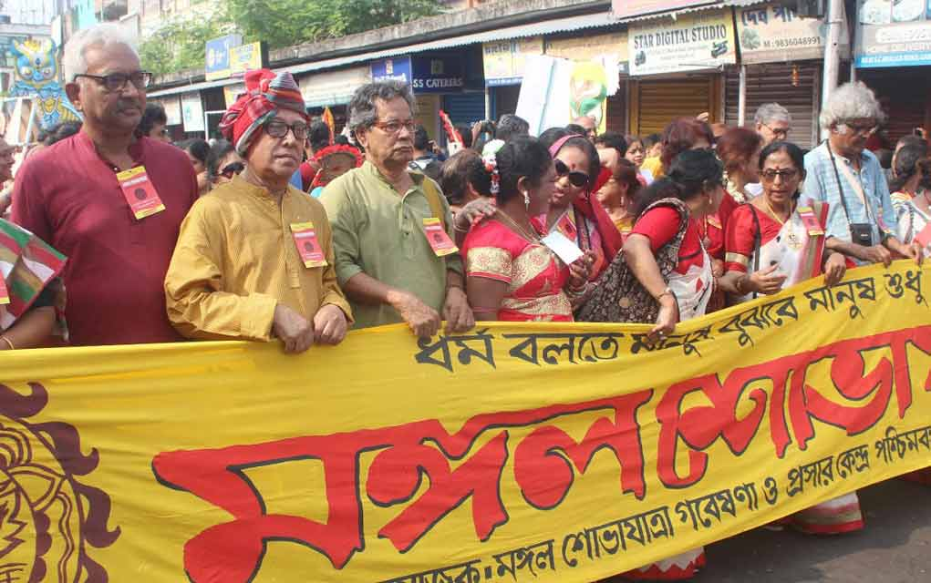

Slide 20
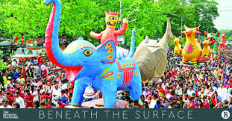

Slide 21
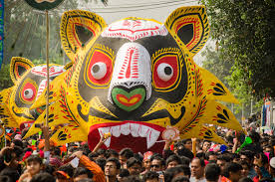

Slide 22
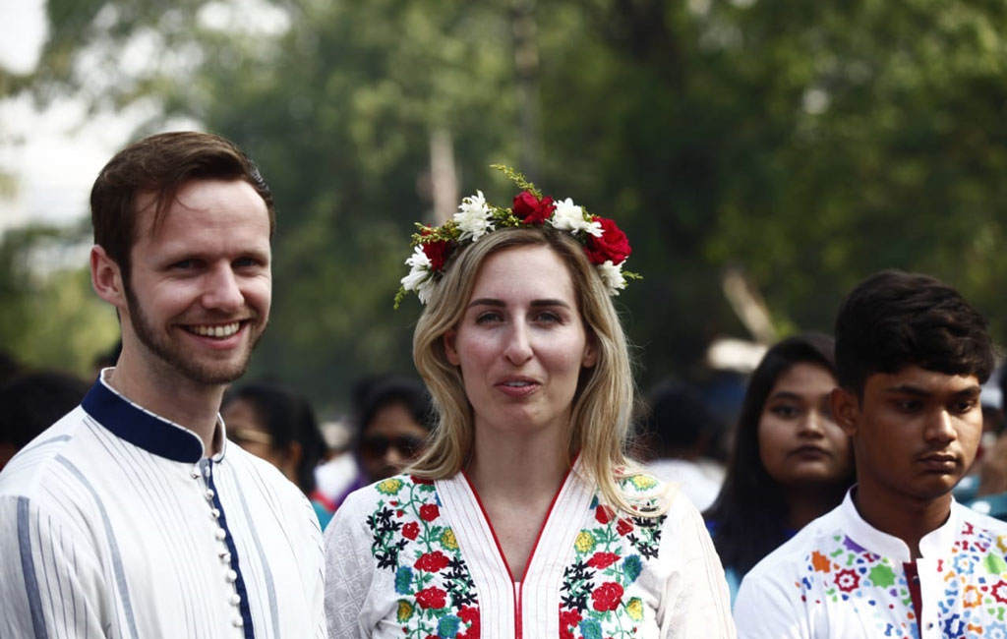

Slide 23
People also come to join the colourful processions, the biggest carnival of the country, organised by the Fine Arts students of Dhaka University. The procession usually displays the traditional practices of Bangalee culture. The masks and wreaths worn by the people are so fascinating! Often they symbolise contemporary worries or happiness in the national life. It attracts increasing number of foreign tourists every year.

Slide 24
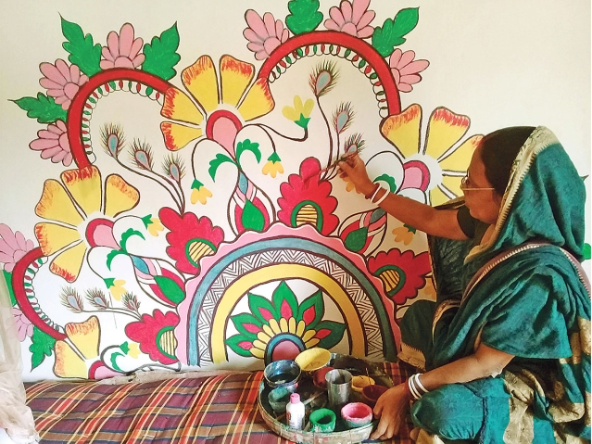

Slide 25
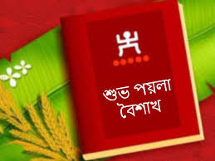

Slide 26
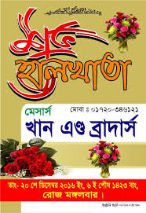

Slide 27
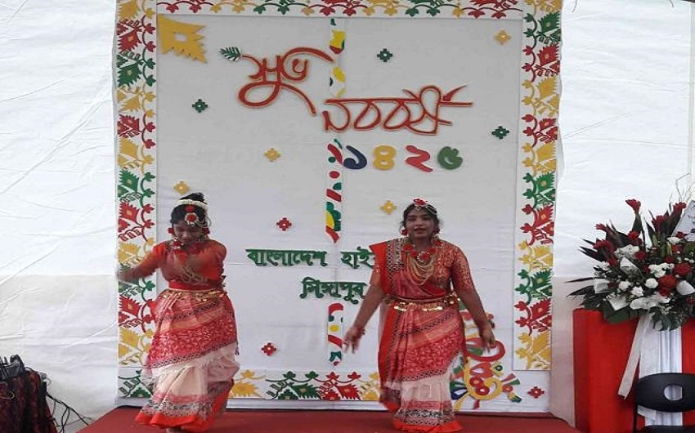

Slide 28
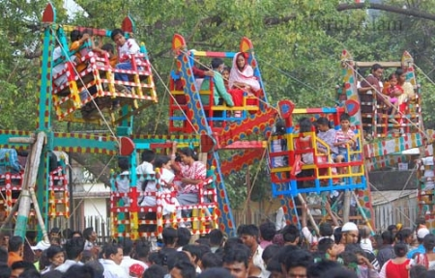

Slide 29
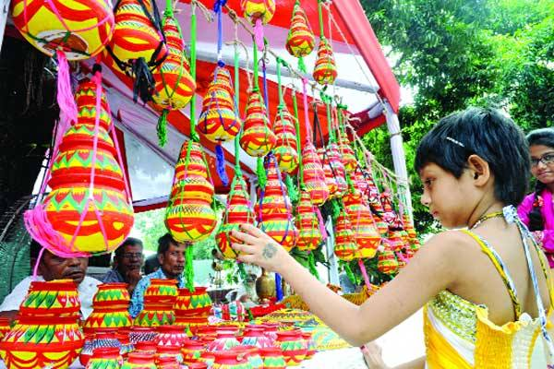

Slide 30
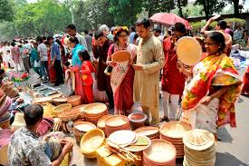

Slide 31
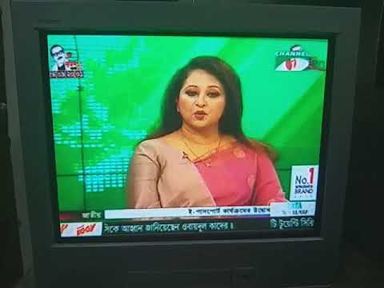

Slide 33
The day is also observed all over the country. Different social and cultural organisations and educational institutions celebrate the day with their own cultural programmes. On this day, newspapers bring out special supplements. There are also special programmes on the radio and television channels. The celebration of Pahela Boishakh marks a day of cultural unity for the whole nation irrespective of caste and creed.

Slide 34
Pair work
C Ask and answer these questions in pairs.
1 Do you go out in the morning of Pahela Boishakh? If you do, where do
you go? If not, what do you do?
2 What kind of food do you eat in the morning of Pahela Boishakh?
3 Do you wear any special clothes on this occasion?

Slide 35
Group work
D Complete the passage with suitable words.
The word Pahela means the first and Boishakh is the _____ month of Bangla calendar. The day is observed not _____ in Bangladesh but _____ in some other parts of the world. It is celebrated in West Bengal, Assam and Tripura. It is also ______ in Australia and the UK. In Australia, the largest ______ for Bangla new year is the Sydney Boishakhi Mela held ______ Sydney Olympic Park. In England, the
Bangalees ______ celebrate the day with a street ________ in London. It is the ______ Asian festival in Europe, _______ Bangladesh and West Bengal.

Slide 36
Individual work
E Describe your own cultural or religious festival that you celebrate. You can use the following words. You can also use other words relevant to the festival.
Colourful, special, traditional ,religious, dance,
Cultural, flowers, food, songs, festive.

Slide 37
Homework
Write a dialogue between two friends about Bangla new year.

Slide 38
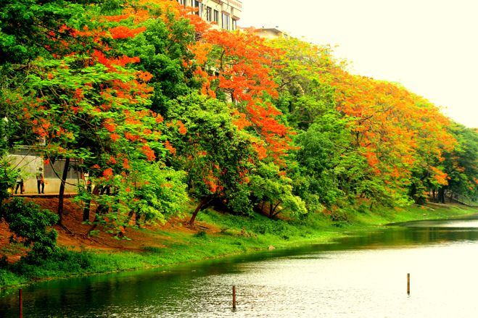
Goodbye

