Slide 1
WELCOME DEAR STUDENTS

Slide 2
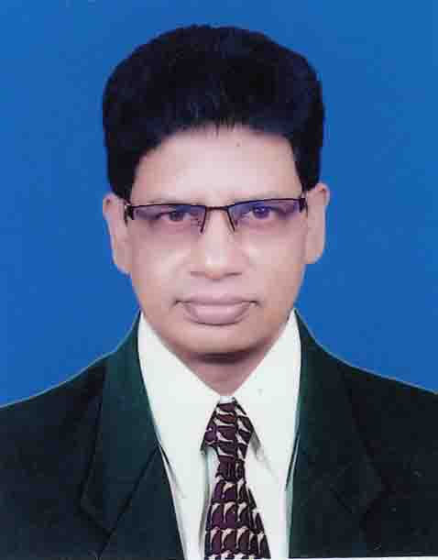
Presenter
Borun Chandra Sarker
Assistant Teacher (English)
Govt.Jajira Mohar Ali Model High School,
Jajira , Shariatpur.
Presentation English 2nd paper
Class- VI- 1X

Slide 3
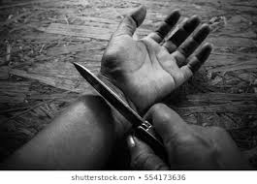
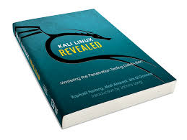
Look at the images
Buy me a shirt..
He hurt himself.
Let a shirt be bought for me.
He was hurt by himself.
Open the door.
Pluck me a flower.
Let the door be opened
Let a flower be plucked for me.

Slide 4
Let's discuss the Voice Change of Imperative Sentence &Reflexive object in today's class.
Voice Change
Part -2

Slide 5
Learning outcomes
After end of the lesson, we will be able to---
define of Imperative sentence
Identify the structure of Reflex object
Change into active to passive

Slide 6
Definition of Imperative sentence: A sentence that expresses an order, advice or request is called an Imperative Sentence.
Do the work. (order)
Never tell a lie .(advice)
Please give me a pen. (request)

Slide 7
Passive voice of Imperative Sentences
If the verb in Active Voice expresses orders ,requests, advice---
the structure will be-let+ Sub of obj+be+v3+ (by you)
Active: Shut the door
Passive: Let the door be shut.
Active: Open your book
Passive : Let your book be opened..

Slide 8
Active : Do not tease the boy.
Passive : Let not the boy be teased (by You)
Practice
: (a) Do not beat the dog. (b) Do not eat this banana
.
(c) Do not laugh at the poor. (d) Do not play football at noon.
Negative Imperative
Structure: Let not+ obj +be+v3+ (by+you)
Sub

Slide 9
Active: Let me do the work.
Passive: Let the work be done by me.
Active: Let him do the work.
Passive: Let the work be done by him.
Practice :
(a)Let the girl sing a song. (b)Let us play cricket.
(c) Let him do it. (d) Let her eat rice.
If the imperative sentence starts with (Let+ personal object---me, us. you, him, her, them) --the structure will be: Let + Object+be+v3+by + personal object

Slide 10
Active: Buy me a shirt.
Passive: Let a shirt be bought for me.
Active: Give them the book.
Passive: Let the book be given for them.
Practice
(a)Pluck me a flower.(b)Bring him a pen.
(c) Buy me a computer.(d) Give me the pen.
If the imperative sentence starts with ---(main verb+ personal object)
the Structure will be-- Let + Object+be+v3+for + personal object

Slide 11
If the imperative sentence starts with “Never”
the structure: Let +never+object+be +v3
Active: Never tell a lie.
Passive : let never a lie be told.
Active : Never drive a car recklessly.
Passive : Let never a car be driven recklessly.
Active : Never disobey your teachers.
Passive : let never your teachers be disobeyed.

Slide 12
If the imperative sentence starts with “please”
Structure will be-- You are requested to+ “please”is omited +Extension
Active: please do this work.
Passive: You are requested to do this work.
Active: Please come here.
Passive: You are requested to come here
Active.Please give me a glass of water.
Passive:You are requested to give me a glass of water.

Slide 13
Active: He killed himself.
Passive: He was killed by himself.
Active: She fans herself.
Passive: She is fanned by herself.
Reflexive objects: The object which is formed with “self”
If the active voice is with reflexive object, the Structure will be- Sub(no change) +AV+V3+by+ Reflexive object (Obj cannot be changed into Sub)

Slide 14
(a)Let this work be done.
(b)Let the door be shut.
(c)You are requested to go home.
(d) Let it be done .
(e) Let this book be read.
(f) He Was praised by himself.
Home task
Re-write the following sentences using the Active Voice.

Slide 15
Thanks to all
Stay at home
Stay safe and sound

