Slide 1
welcome
Kh. Mostafa kamal
Assistant teacher
Chor konabari GPS

Slide 2
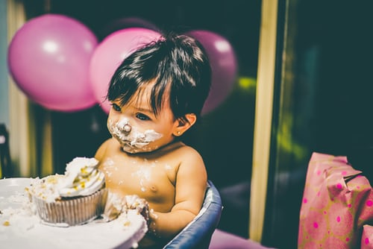

Slide 3
Class-5
subject: English

Slide 4
Birthday party

Slide 5
Unit-15
Lesson-1
Time:45

Slide 6
Learning outcomes

Slide 7
1
1. To recognize which words in a sentence are stressed.
2. To recognize and use intonation patterns for Whand yes/No questions, greetings and statements.
To under stand questions asked by the teacher about the students.
Students should be able to-

Slide 8
Evaluation
1.What can you see the picture?
What is happing in the picture?
3. Who are there in the picture?
What are they doing?
What is written on the top of the picture?

Slide 9
Home work
How to celebratate your ‘birth day’ about fiv.e sentences.

Slide 10
thanks

