Slide 1
Special Notes
Dear colleagues,
Take my salam first. I have made this content only for the exercise of the students of class ten so that they can prepare well for the SSC examination during this Covid-19 pandemic all over the world. For this reason my content is not like the conventional contents. Please use the content just to help the students to prepare for the examination. My heartiest thanks to all the respected and honorable teachers. Yours’ valuable advice is badly needed to me to go ahead. I strongly hope that you have kind hearts enough to advise me.
Yours faithfully
Md. Abdul Motalab
Senior teacher
Police Lines School and College, Rangpur.
Notes:
This option is very imporant. If you want to make the class fruitful, please follow the instructions in this option carefully before present it in the class.

Slide 2
Welcome
Notes:
Welcome slide.

Slide 3
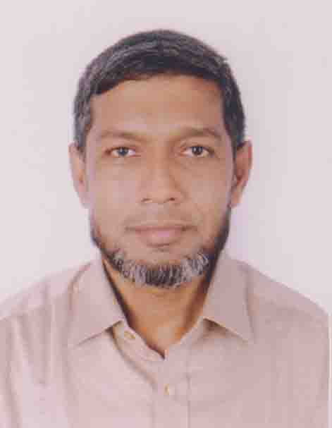
Identity
Md. Abdul Motalab
ENGLISH
Police Lines School and College, Rangpur

Slide 4
WHAT ARE THE STUDENTS DOING HERE?

Slide 5
Our Topic is
Exercise on Cloze test without clues

Slide 6
Learning outcomes
After completing this lesson, we will be able to –
prepare for the S.S.C examination
Notes:
Aim of this lesson.

Slide 7
1. Fill in the blanks with suitable words. .5×10=5
An early (a) ---can enjoy (b) ---fresh air and oxygen (c) ---the morning which refreshes both his body and mind. Moreover, he can finish his work early and as such he finds enough time to (d) ---his work properly. (e) ---the other hand, too much sleep makes (f) ---man dull and lazy. A man who gets up late, wastes a lot of time (g) ---sleep and idleness. He does not utilize time (h) ---doing his work properly. So everyone should make (i) ---habit of early (j) ---.

Slide 8
Answer to the question no-1
riser
b) the
c) in
d) finish/complete/do
e) on
f) a
g) in
h) by
i) the
j) rising

Slide 9
2. Fill in the blanks with suitable words. .5×10=5
The National Memorial (a) --- Savar is a symbol of the nation’s respect (b) --- the martyrs of (c) --- War of Liberation. It is built (d) --- concrete but made (e) --- blood. Going there, the people show respect and pay homage (f) --- the martyrs of the liberation (g) ---. The National Memorial’s plant includes 126 acres of land with a mosque, a library and (h) --- excellent museum. The (i) --- touching sight to the visitors is the several graves (j) --- the martyrs of the liberation war who are resting there in peace.

Slide 10
Answer to the question no-2
b) at
b) for
c) the
d) with
e) of
f) for
g) war
h) an
i) most
j) of

Slide 11
3. Fill in the blanks with suitable words. .5×10=5
Poverty is (a)---- great problem (b) --- our country. But we hardly realize that his miserable condition is our own (c) ---. Many do not try (d) --- better their conditions by means (e) --- hard profitable business. They only bemoan their miserable lot and curse their fate. We must shake (f) --- this lethargy and aversion (g) --- physical labour. Man is (h) --- architect of his own fortune. If we remember this wise saying and advance in this way (i) --- life with firm steps, our poverty and misery will disappear. Otherwise, it will be impossible (j) --- survive in this competitive world.

Slide 12
Answer to the question no-3
a) a
b) in
c) creation
d) to
e) of
f) off
g) to
h) the
i) of
j) to

Slide 13
4. Fill in the blanks with suitable words. .5×10=5
We live (a) --- the age of science. Science has presented us (b) --- nice gifts. It is a blessing for mankind. But it is not (c) --- unmixed blessing because it has invented (d) --- things that create disturbance (e) ---the people. Sound pollution is such (f) --- example that affects our mental faculty. Today people of the world are suffering (g) --- this phenomena. We are responsible (h) --- creating this problem. (i) --- we are conscious, we can check this problem (j) --- a great extent.

Slide 14
Answer to the question no-4
a) in
b) with/many
c) an
d) the
e) to
f) an
g) from
h) for
i) if
j) at

Slide 15
5. Fill in the blanks with suitable words. .5×10=5
Books are man’s best companions (a) --- life. You may have very good friends (b) --- you may not get them (c) --- time of need. They may not behave gently (d) --- you. One or two may prove (e) --- be betrayers and do you much (f) ---. But books are always there (g) --- you. Some books may (h) --- you laugh, some books may give you much pleasure and some again may provide you (i) --- new knowledge and new ideas. They remain your friends (j) --- your life.

Slide 16
Answer to the question no-5
a) in
b) but
c) in
d) with
e) to
f) harm
g) beside
h) make
i) with
j) throughout

Slide 17
6. Fill in the blanks with suitable words. .5×10=5
Water is essential (a) --- animal and plant life. It is next (b) --- air. Clean water is safe and unclean water is unsafe (c) --- man. Water can be used (d) --- many ways. Mills and factories throw their (e) --- materials into the rivers and canals and thus pollute (f) ---. Steamers, launches and boats also pollute water (g) --- throwing oil and other wastes into (h) --- rivers and canals. Steps should be taken to prevent water (i) ---. The importance (j) --- water cannot be described in words.

Slide 18
Answer to the question no-6
a) for
b) to
c) for
d) in
e) waste
f) water
g) by
h) the
i) pollution
j) of

Slide 19
7. Fill in the blanks with suitable words. .5×10=5
(a) --- dictionary is a collection of words in one or more specific languages. It is a very systematic book mainly (b) --- the students. It is called a study guide. Meanings (c) --- the words are the main (d) --- of a dictionary. It also includes correct spelling, definitions, usages, pronunciation, phonetics and some other important information of (e) --- words. In a dictionary, the words are often listed (f) --- alphabetical order. Alphabetical order means something arranged according (g) --- the order of the alphabet such (h) --- a, b, d, d, e. According to the alphabetic order, D will be placed (i) --- E and after C. E will be placed before F and (j) --- D.

Slide 20
Answer to the question no-7
a) A
b) for
c) of
d) theme
e) the
f) in
g) to
h) as
i) before
j) after

Slide 21
8. Fill in the blanks with suitable words. .5×10=5
A true friend is (a) ------ asset. He stands (b) ------ his friends in time (c) ------ danger. He is not (d) ------ greedy person. He (e) ------wishes for the welfare of (f) ------friend. But it is a matter (g) ------regret that a true friend is very (h) ------today. A selfish man cannot be a (i) ------friend. He always thinks of his (j) ------interest.

Slide 22
Answer to the question no-8
a) an
b) by
c) of
d) a
e) always
f) his
g) of
h) rare
i) good
j) own

Slide 23
9. Fill in the blanks with suitable words. .5×10=5
The (a) ----pursuit of student is to study and the (b) ----- of qualities that will make him (c) ----- for the life (d) ----- a head. But when the country is (e) ---- with a natural calamity like flood, famine etc, they should (f) ----- forward and stand (g) ------ the suffering humanity. Even in normal times they should (h) ----- in many acts of social service with (i) ------ view to (j) ----- their fellowmen.

Slide 24
Answer to the question no-9
a) main
b)obtaining/gaining
c) prepared
d) to go
e) faced
f) come
g) by
h) involve
i) a
j) helping

Slide 25
10. Fill in the blanks with suitable words. .5×10=5
Punctuality is of (a) -----value to a student. An unpunctual (b) -----who is (c) -----in the class will miss a part of his/her lesson and (d) -----lag behind. But (e) -----punctual student will learn his /her lesson in time and do (f) -----in the examination. Punctuality is (g) -----key (h) -----success. We all (i) -----be punctual (j) -----our day to day life.

Slide 26
Answer to the question no-10
a) great
b) student
c)late/irregular
d) will
e) a
f) well
g) the
h) to
i) should
j) in

Slide 27
Thank You
Notes:
Ending slide.

