Slide 1
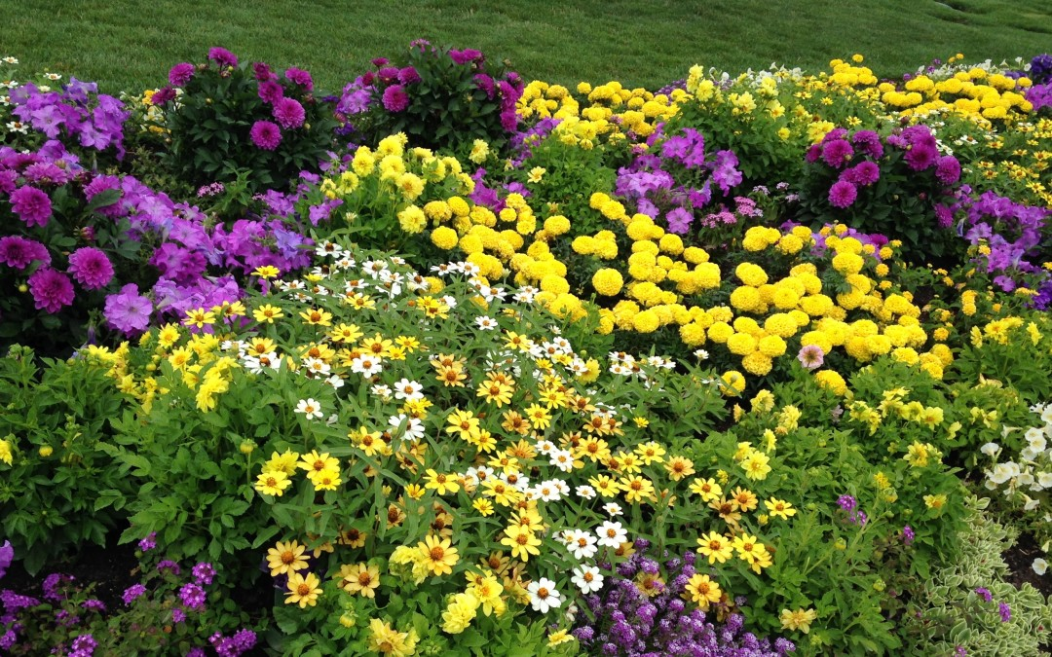
WELCOME

Slide 2
Teacher,s Identity
Mst. Arifa Khatun
Assist: Teacher (Eng)
Chand Sultana Secondary Girls School
Kushtia Sadar, Kushtia.

Slide 3
Lesson Identity
Class:Nine
Sub:Eng:First Paper
Unit:Three
Less:Six
Time:50 Minutes

Slide 4
Learning Outcomes
After finished this lesson the Ss will be able to
Vocabulary understand.
Read and understand the text.
Ask and answer question.
Know about festival.

Slide 5
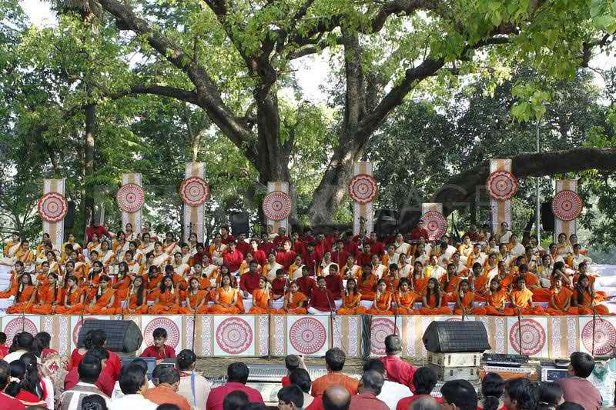
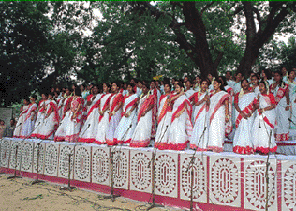
Look at the pictures.Then ask answer the questions about it.
What,s the picture about?
What are the people doing?

Slide 6
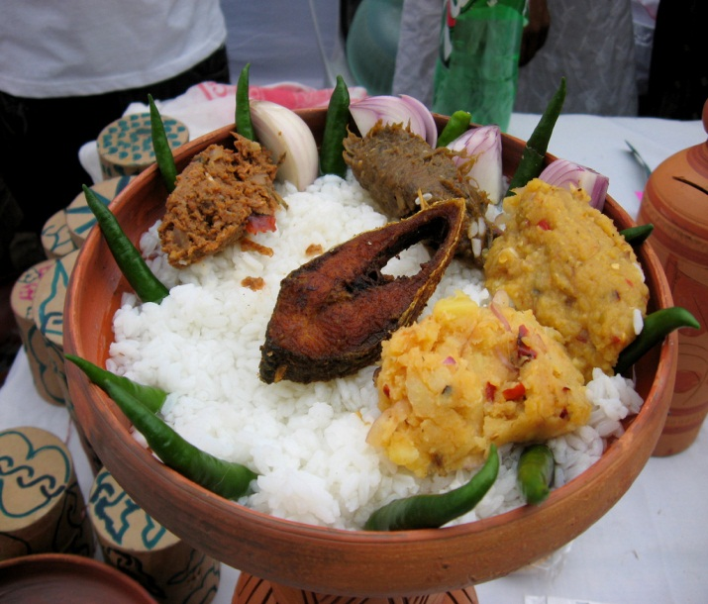
Todays Lesson is
Pahela Boishakh

Slide 7
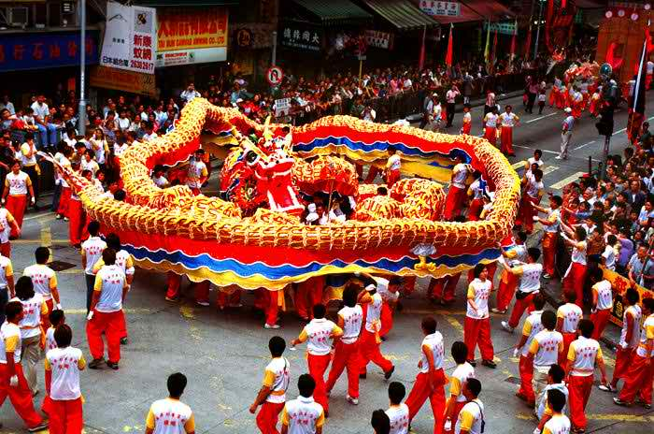
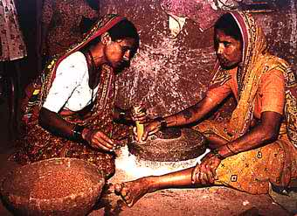
Vocabulary
Culture
Attitudes
Customs
Tradition

Slide 8
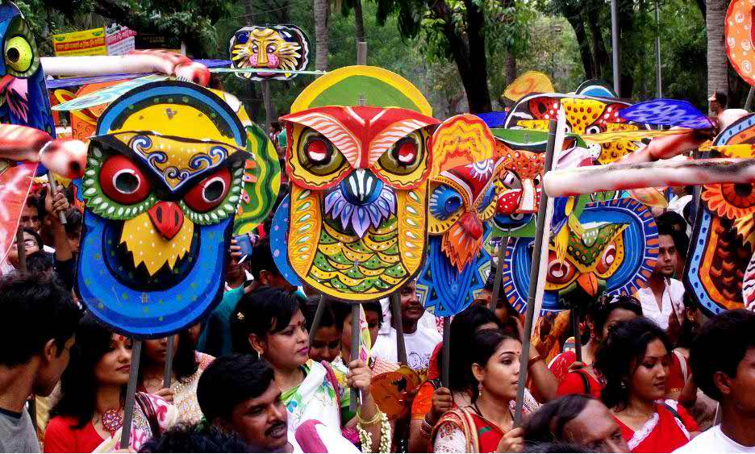
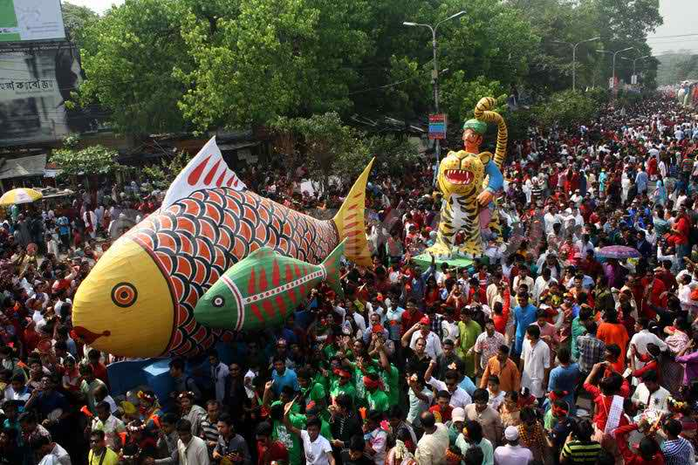
Celebrated
Observed
Assembley
Processions

Slide 9
Read the text silently(5 Minutes)
‘ Pahela Boishakh’ is the first day……….
Traditional food.

Slide 10
Individual Work (7 Minutes)
The word Pahela means the first and Boishakh is the---- month of
Bangla calendar.The day is observed not---- in bangladesh but----
in some other parts of the world.It is celebrated in West Bengal, Assam and
Tripura.It is also---- in Australia and UK.In Australia, the largest----
For Bangla new year is the Sydney Boishakhi Mela held----Sydney
Olympic Park.In England, the Banglees---- celebrate the day with
A street----in London.It is the---- Asian festival in Europe,----
Bangladesh and West Bengal.

Slide 11
Answer
First,only,also,observed,festival,
In,usually,show,only,celebrate.

Slide 12
Read the text silently(8 Minutes)
One of the…………………………………..
Caste and creed.

Slide 13
Pair Work
What kind of food do you eat in the morning of Pahela Boishakh?

Slide 14
Evaluation
What is Pahela Boishakh?
What is culture?
What is procession?
What is the special food of the day?
What women wear on the day?

Slide 15
Home Task
Write a paragraph on ‘EID DAY’ that you observe every year.
Only 10 sentences.

Slide 16
Thanks Everybody.

