Slide 2
Sabuj Kumar Das
Assistant Teacher, English
Attaka K. Ali Pilot High School
Fakirhat, Bagerhat
sabujeti2000@gmail.com

Slide 3
Lesson’s Identity
Class: Eight
Subject: English 1st Paper
Unit: 09
Lesson: 03
Title: The High Speed Train

Slide 4
By the end of the lesson SS will ---
ask and answer questions
describe pictures
write paragraph
Objectives:

Slide 5
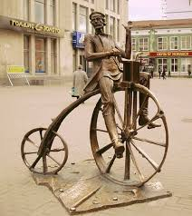
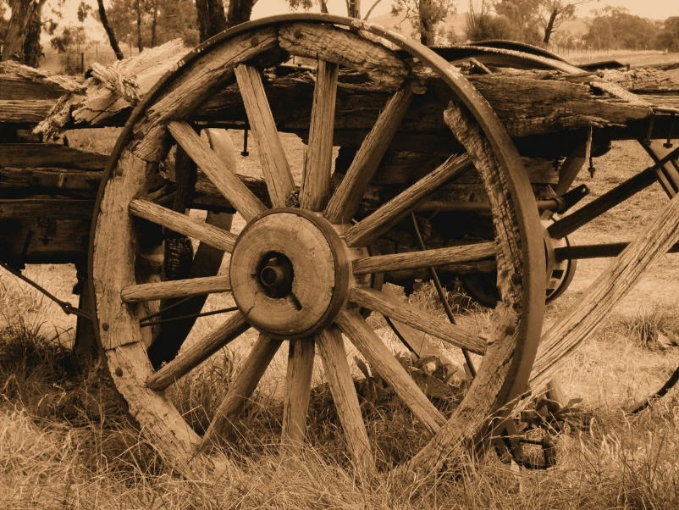
Look at The Pictures

Slide 6
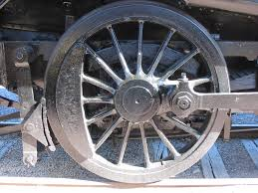
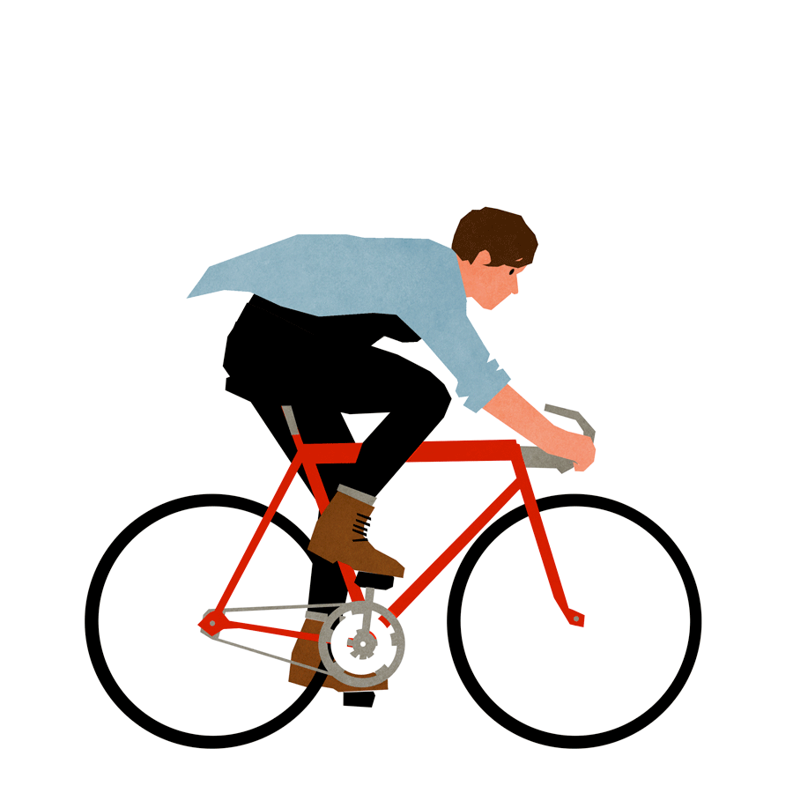
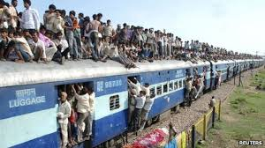

Slide 7
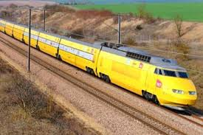

Slide 8
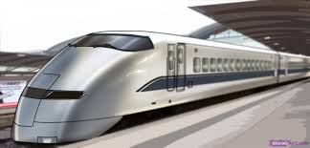
Our Today’s Topic
The High Speed Train

Slide 9
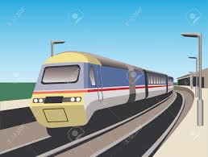
Vocabulary
Traditional/Customary.
Conventional

Slide 10
Engaged in commerce.
Commercial

Slide 11
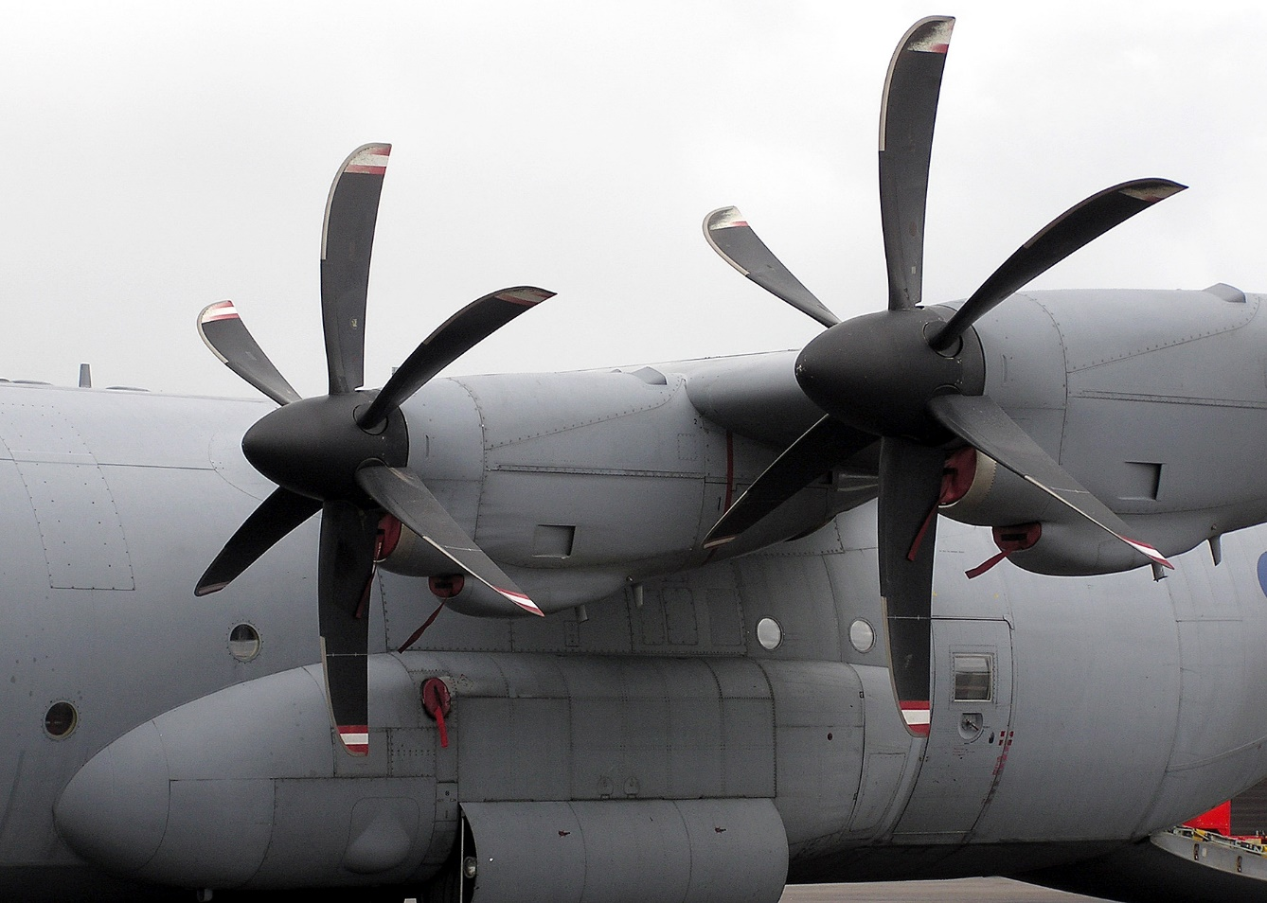
Turbine
A type of machine having a special wheel to generate power.

Slide 12
Look at the pictures
A traditional wheel

Slide 13
Conventional passengers’ train.

Slide 14
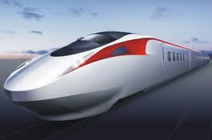
Unconventional magnetic train

Slide 15
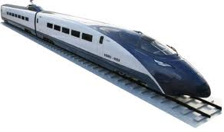
The TGV

Slide 16
Pair Work:
Write five short notes about these four pictures.

Slide 17
Group Work
Write ten sentences about the TGV & the Bullet train.

Slide 18
:
Home Work
Write a paragraph on ‘The Metro Rail in Bangladesh’.

Slide 19
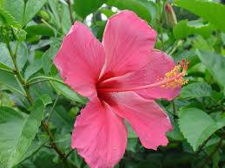
Thanks

