Slide 1
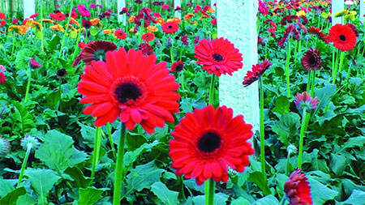
Welcome

Slide 2
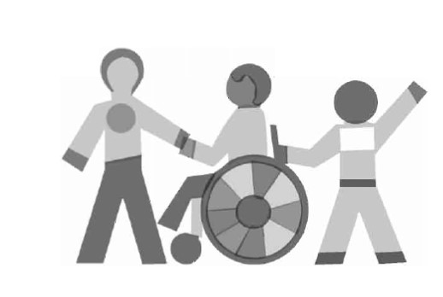
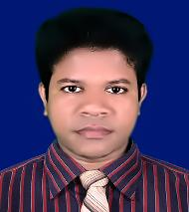
IDENTITY
Class - ix
Unit – One
Good citizen
50 mins
31/9/2020
Azizul Fakir
Assistant teacher
Dighirjan Secondary School
Nazirpur, Pirojpur.
Email: azizul.nk@gmail.com
Mobile: 01710745128

Slide 3
What do you know from the video?
Making ors saline
Lets watch a video
What does it mean to know something?
Do you know how to make ors saline?
What does it mean to be able to do something by applying knowledge?
It is knowledge.
Skills
So, what else is needed to do something more beautiful using knowledge and skills?
So, here are three things we need to do to get a job done beautifully
Attitudes
Knowledge, skills and attitudes.

Slide 4
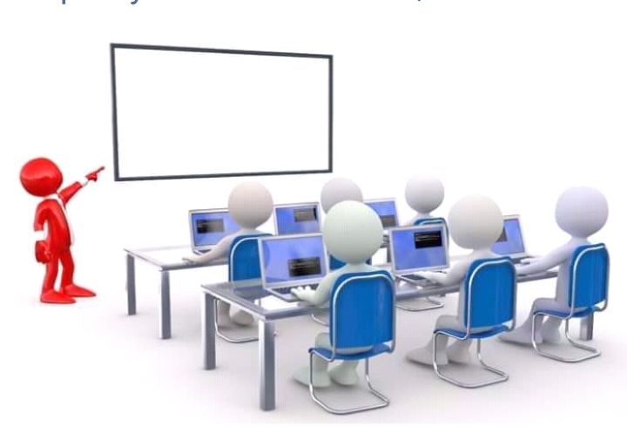
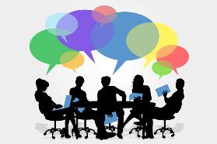
So our today’s topic is
“Knowledge, skills and attitudes
Unit – 1
Lesson - 1

Slide 5
Learning outcomes
After completing the lesson we will be able to
1
infer meaning from the context
2
talk about the pictures
3
write answers to the questions.
4
tick the best answers from the alternative
5
listen for information to the CD

Slide 6
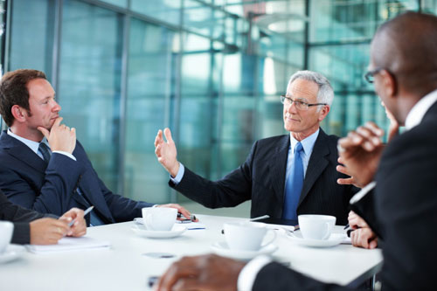
Keyword
Part of speech
Meaning
Synonym
The system of laws and basic principles to govern a country.
Constitution -
noun
code
the part of a government responsible for putting laws in to effect.
Executive -
adjective
governing
the part of a government responsible for putting laws in to effect.

Slide 7
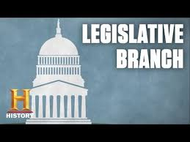
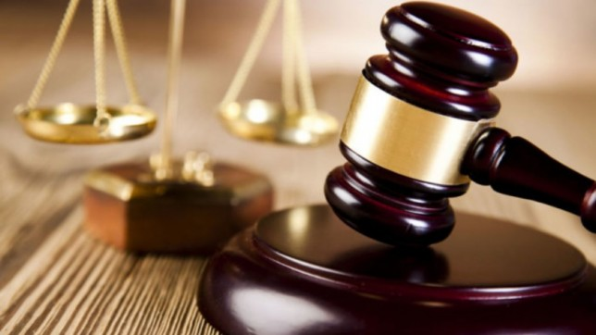
Keyword
Part of speech
Meaning
Synonym
law making judicial.
having the power to make law.
legislative -
adjective
relating to the administration of justice.
Judicial -
noun
legal

Slide 8
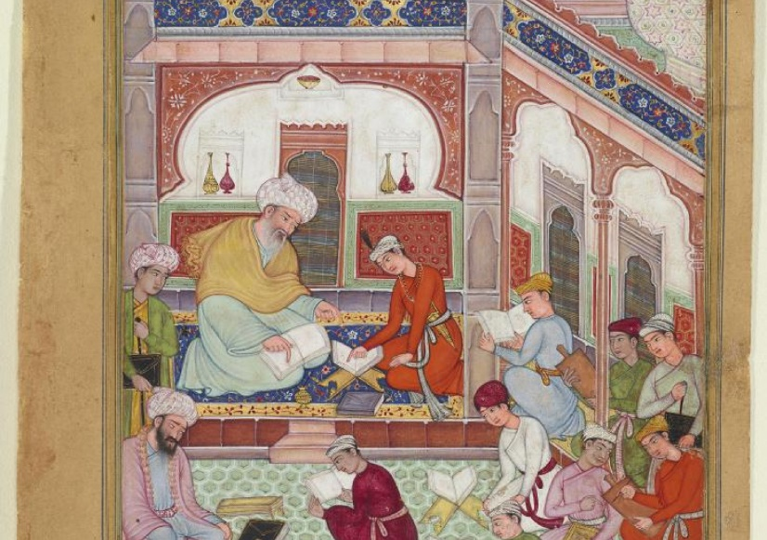
Keyword
Part of speech
Meaning
Synonym
Culture -
life style
noun
the way of life
heritage
Tradition -
noun
a set of beliefs of customs

Slide 9
Open at page 06 in your text book and read the passage carefully.
To be a good citizen you have to prepare yourself to do work in society. Well, then how can you prepare yourself?
First, you need knowledge. Today's society is knowledge-based. Without having knowledge of modern sciences, technologies including ICT and other necessary subjects, you will have difficulty living a good life. The other areas you, as a good citizen, should have knowledge about are:
our country, its constitutions, geography and people
our state, its executive and legislative powers
our judicial system
our government and its structure and functions
our history, cultures, traditions, literature, moral values and religions
our socio economic activities and educational system

Slide 10
Second, you need skills to do things. Knowledge is not enough. You must be able to apply your knowledge to do things practically.
Finally, knowing and doing things will bring about a change in your behaviour towards others. This behavioral change will show your attitudes towards others, that is, it will show how you think and feel about a person or thing.
Let’s take an example. Suppose you, as a student, need to know about ‘group work’ in the classroom. So you ask yourself or your teacher or anyone else, “What is group work?” Or you may find about it in a book. In this way, you may know, or you may have the knowledge about group work. To do group work, the class has to be divided into groups. Each group is to do some tasks given by the teacher or in the textbook. The group members will discuss and share ideas and points, and finally one member will write the answers

Slide 11
Then you start working in groups. In each group you take turns discussing points and answering questions. In this way you can actually do the task. Your teacher may monitor and help you to do the work.
Lastly, through regular group work it is expected that there will be noticeable changes in your behaviour. Possible changes are:
you will develop the skill of speaking freely in English with your classmates and teacher.
your shyness will gradually disappear.
you will develop the attitude of helping and cooperating with each other.
you will learn to behave in a democratic way.
Most importantly, this behavioral changes taking place in new inside the classroom will be carried over outside the classroom in real-life situations.

Slide 12
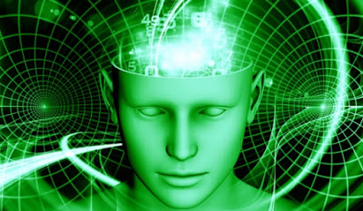
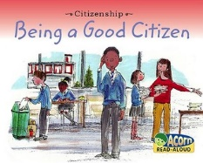
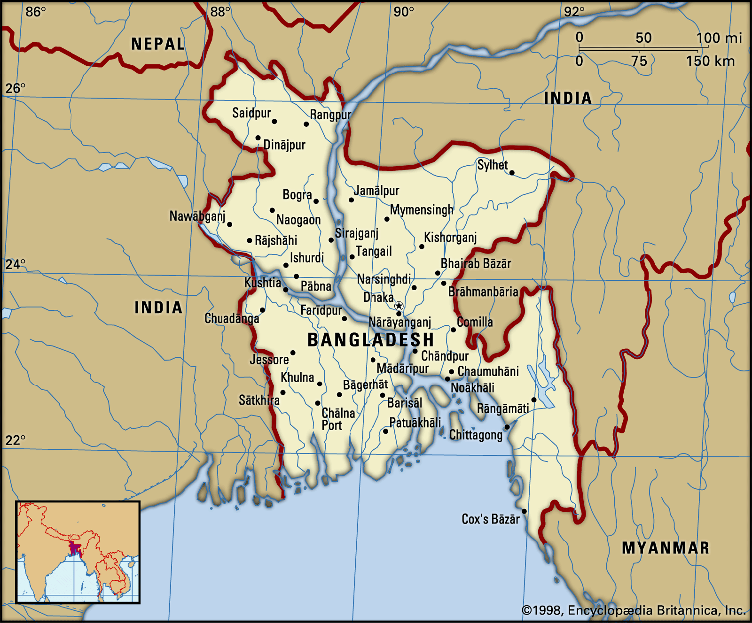
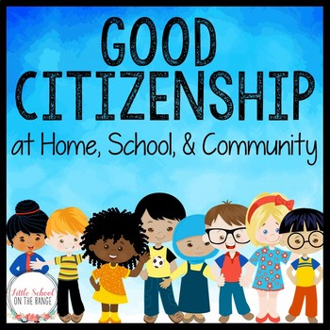
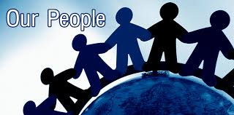
To be a good citizen you have to prepare yourself to do work in society. Well, then how can you prepare yourself?
First, you need knowledge.
Today's society is knowledge-based. Without having knowledge of modern sciences, technologies including ICT and other necessary subjects, you will have difficulty living a good life.
The other areas you, as a good citizen, should have knowledge about are:
Executive
our country, its constitutions, geography and people
our state, its executive and legislative powers
our judicial system
our government and its structure and functions
our history, cultures, traditions, literature, moral values and religions
our socio economic activities and educational system

Slide 13
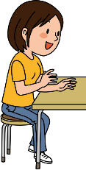
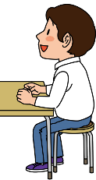
Time 3mins
12
1
11
10
2
9
3
Individual works
8
4
7
5
6
Answer the following question
Q1. What is first condition to be a good citizen? Explain.

Slide 14
You may check your answers
Ans1: Knowledge is the first condition to be a good citizen. Today's knowledge
based society demands only up-to-date persons. To be so, we need to
know about science and technologies, politics, government, economics,
history and so on.

Slide 15
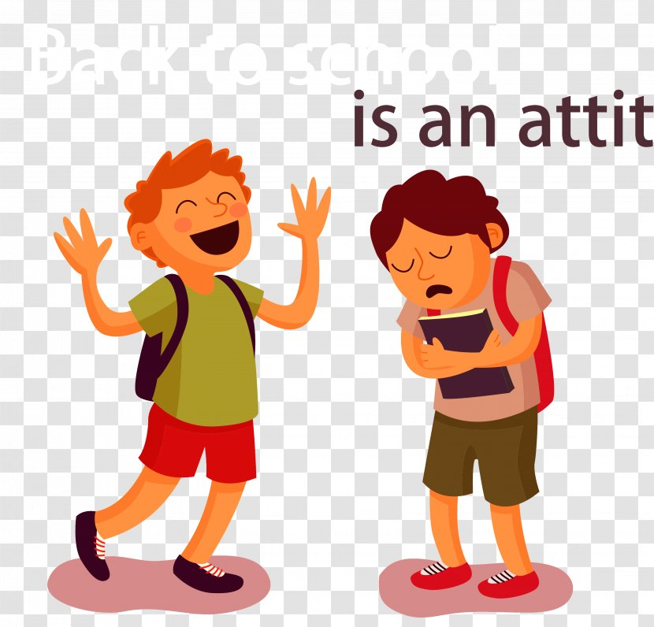
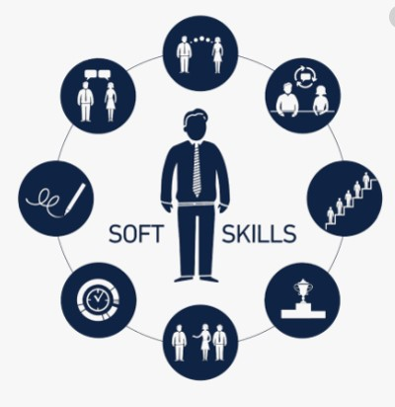
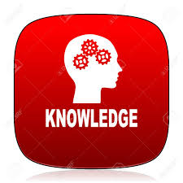
You need skills to do things. Knowledge is not enough. You must be able to apply your knowledge to do things practically.
Finally, knowing and doing things will bring about a change in your behavior towards others. This behavioral change will show your attitudes towards others, that is, it will show how you think and feel about a person or thing.

Slide 16
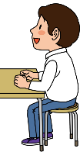
Pair works
Answer the following questions
Q1. What is the necessity of skills?
Q2. Is knowledge enough to be a good citizen? Explain in 2/3 sentences.
12
1
11
10
2
5mins
9
3
8
4
7
5
6

Slide 17
You may check your answers
Ans1: There is a necessity of skills to apply our knowledge in practical situation.
Ans2: It is true that we can’t be good citizens without knowledge. But we need skills as
well in order to use our required knowledge. So, to do things practically, we need
knowledge and also need to know how to apply this knowledge.

Slide 18
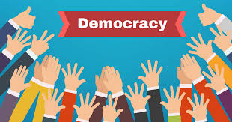
We should learn democratic way in every step of life.
We should show democracy by our behavior, our sincerity, our positive attitude towards others and tolerance to others’ opinions, views and ideas as well as the mentality of working and living together with all peacefully. Besides, to live a good life, we should have knowledge about modern sciences, technologies including ICT and other necessary subjects.
Technology

Slide 19
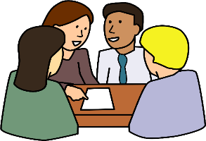
Time 6mins
12
1
Group works
11
10
2
9
3
8
4
Answer the following questions
7
5
6
Q1. What do you understand by “the democratic way of behavior?”
Q2. What knowledge should we have to live a good life?

Slide 20
You may check your answers
Ans1: By democratic way of behavior, I mean positive attitude towards
others and tolerance to others’ opinions, views and ideas as well as
the mentality of working and living together with all peacefully.
Ans2: To live a good life, we should have knowledge about modern sciences,
technologies including ICT and other necessary subjects.

Slide 21
The appropriate antonym of democratic is ===
i. self-governing ii. independent iii. autonomous v. autocratic
(b) What does ‘apply’ mean?
I. use ii. assist . iii. request iv. affect
(c) A remarkable change starts to develop in your ---
i. mind ii. heart iii. behavior iv. brain
(d) We have to have ----- to become a good citizen.
i. knowledge ii. skill iii. behavioral change iv. all of them
(e) The word ‘necessary’ is similar to ---
i. trivial iii. essential iv. required iv. important
(f) Knowledge is to ---
i. do good job ii. know something iii. ask questions iv. read books
(g) The word ‘practically’ refers to ---
i. idealism ii. pragmatism iii theism iv. atheism
Tick the best answer
$$$$
$$$$
$$$$
$$$$
$$$$
$$$$
$$$$

Slide 22
Listen to the CD
Evaluation
Now fill the passage from your listening.
For becoming a (a) ---- citizen, one (b) ---- knowledge, because today’s (c) ---- is knowledge based. A good citizen must have knowledge about modern science, technologies, country, constitution etc.. Besides, a good citizen must have (d) ----. Knowledge together with skills brings about behavioral change towards others, who is called (e) -----

Slide 23
Check your answers
For becoming a (a) good citizen, one (b) needs knowledge, because today’s (c) society is knowledge based. A good citizen must have knowledge about modern science, technologies, country, constitution etc.. Besides, a good citizen must have (d) skills. Knowledge together with skills brings about behavioral change towards others, who is called (e) attitude.

Slide 24
Homework
Stay home
Stay safe
Q1. What is necessity of skills?
Q2. Define group work in your own words.
Q3. What does group work most noticeably result in?

Slide 25
Thanks

