Slide 1
W
E
L
C
O
L
E

Slide 2
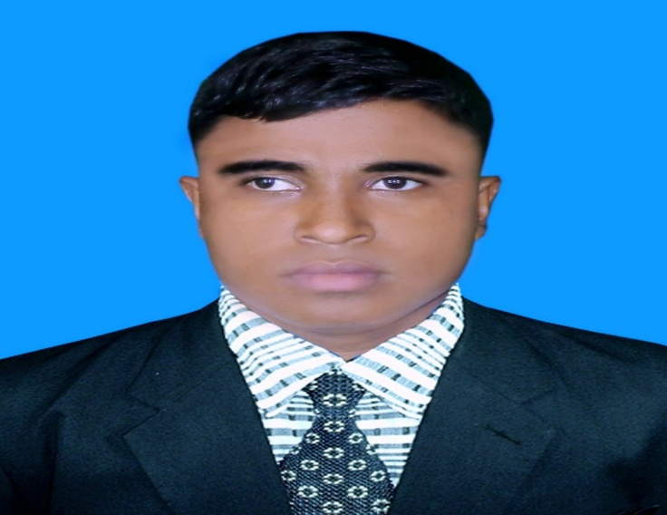
Teacher’s Identity A. Sukur Ali Khan B.A hons.M.A In English Assistant Teacher(English)
Naldha Secondary School
Naldha,Fakirhat,Bagerhat.
Email : sukur360720@gmail.com Mobile no-01922-360720
Class Introducing
Class : Eight
Unit : 03
Lesson :06

Slide 3
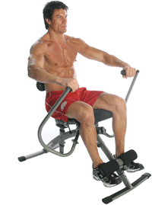
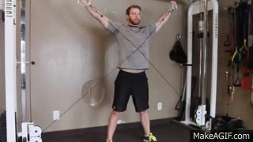
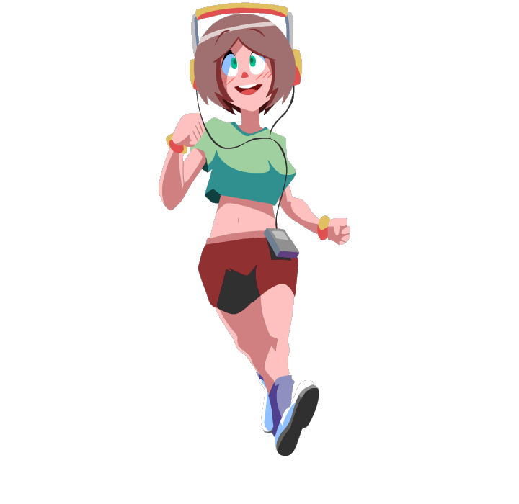
Look at the pictures and think over these.
1.What do you see in the pictures ?
2.What are the people doing?

Slide 4
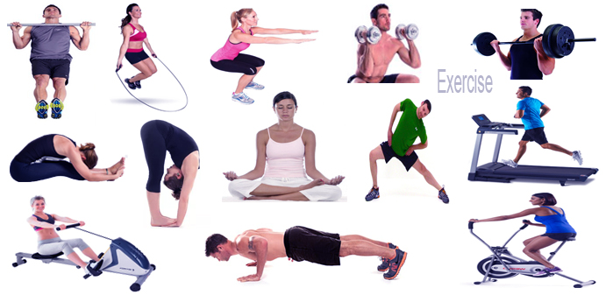
3.Do you do it ?
3.Can you tell me what it is called?

Slide 5
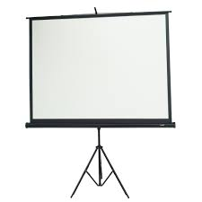
Physical Exercise
So our today’s topic is…………..?
Dear students write down the lesson’s headline.

Slide 6
Learning outcomes
After completing this lesson, students will be able to …..
Know about physical exercise.
Read and understand text through silent reading.
Learn some new words.
choose the correct answer.
Fill in the blank .
Ask and answer questions.
Write a paragraph.

Slide 7
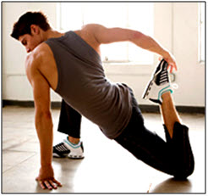
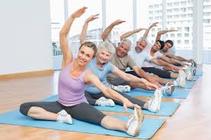
What do you mean by physical exercise?
Physical exercise means the movement of the limbs of our body according to rules.

Slide 8
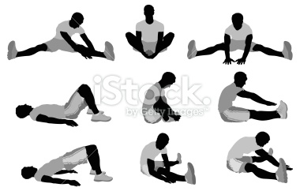
Introduce with new word
u.k.
u.s.
distend
widen,
Stretch
to lengthen
to lengthen, widen, or distend shape
Notes:
The teacher can ask the students to prono

Slide 9
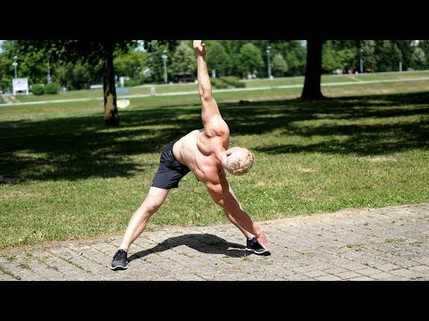
Benefit
Getting advantages by doing something.

Slide 10
Cheerful
Enjoyable moment

Slide 11
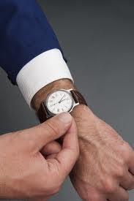
Punctuality
orderliness, being on time

Slide 12
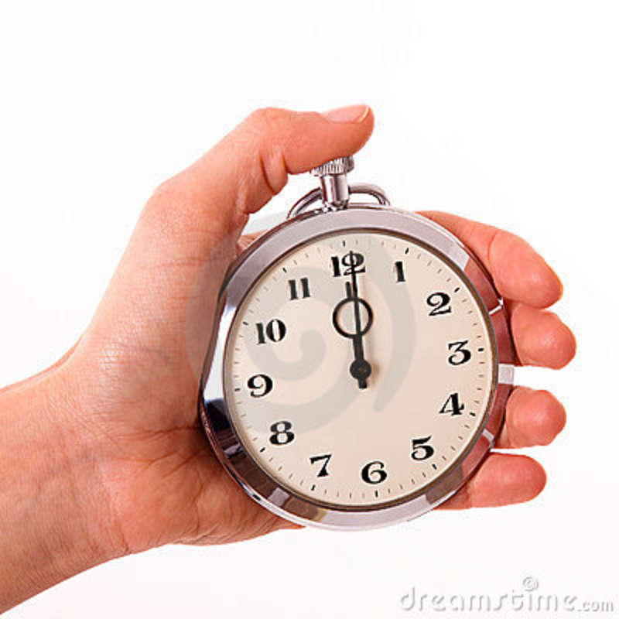
regularity
The state or quality of being regular

Slide 13
Read the passage carefully and answer the following questions
Mr Pronoy Larma, the physical teacher of Roopur High School is talking about health to his students.
“What things are necessary for good health?” he asks the students.
We need a lot of things, teacher,” says Rushad. “We need healthy food, proper rest and sleep. We also have to be clean and tidy.” “Good!” says Mr Larma. “These are the things you need for good health. But another thing that you also need is regular physical exercise.”
“What types of physical exercise can we do teacher?” asked Rayeed. Well,” says Mr Larma. “These are different kinds of physical exercise. You can do then indoors as well as out doors. In the house you can do some freehand exercises. That is, you can stretch different parts of your body. Outside, you can play, swim or simply walk. Why do we need physical exercise, teacher?” asks Ranjan.
“Well” , says Mr Larma, “The benefits of physical exercise are many. The greatest of them is that it keeps you fit for work. It also gives you energy, and makes you strong and cheerful. It teaches you regularly and discipline as well.”

Slide 14
Choose the best answer from the alternatives. Time: 7 minutes
Individual work
What does the word ‘necessary’ mean?
i. valueless ii. Expensive iii. urgent iv. Desired
(b) Which one is a indoor physical exercise?
i. foot ball ii. cricket iii. hockey iv. table tennis
(c) What is needed to work?
i. strength ii. Smartness iii. Cleanliness iv. dress
(d) The word ‘proper’ means ----
i. accurate ii. local iii. global iv. rare
(e) People need regular exercise. ‘Regular’ is the opposite of ---
i. irregular iii. iregular iv. Irregularity iv. unregular
(f) What does the word ‘tidy’ refer to?
i. dirt-free ii. dirty iii. bright iv. dark
(g) What kind of food should we eat?
i. healthy food ii. adulterated food iii. fast food iv. junk food

Slide 15
Fill in the blanks with suitable words from the box.
Use one words only each blank. Time-10 minutes
Pair Work
The | body | sound | strong | In
can | Helps | For | Of | Makes
the
Physical exercise means (a)………….. Movement of the limbs of our body according to rules. There are different kinds of physical exercise. We (b)………….. do them indoors and outdoors. (c)……….. the house we can do some free-hand exercise. Yoga, weight lifting, gymnastics etc are good (d)……………. health. Out side home, we can play, swimming. Walking, running, ridding bicycle, ridding horse etc. Physical exercise (e)……………….. Our body active and (f)…………………… .It also improves our power (g)……....digestion and blood circulation. Physical exercise (h)………………us to keep away from diseases. So, it is necessary for a (i)………………….. Mind and sound (j)………………… .
can
In
for
makes
strong
of
helps
sound
body

Slide 16
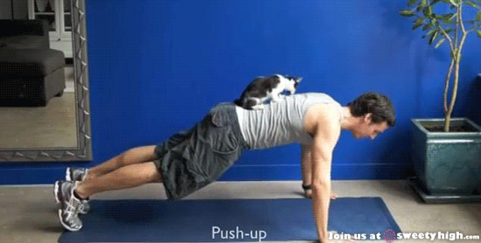
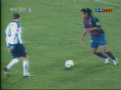
Two types of physical exercise.
Indoors game.
outdoors game.

Slide 17
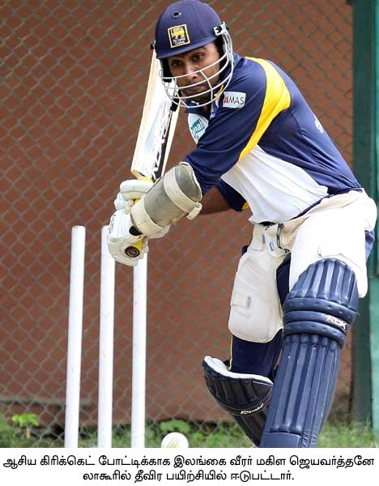
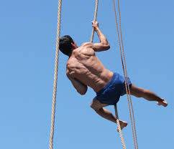
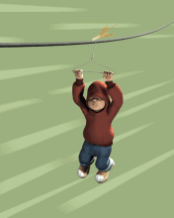
Indoors game.
outdoors game.
Yoga, weight lift, gymnastic.
Swimming, to play cricket, football etc.

Slide 18
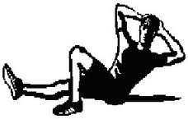
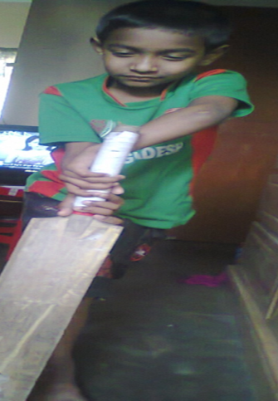
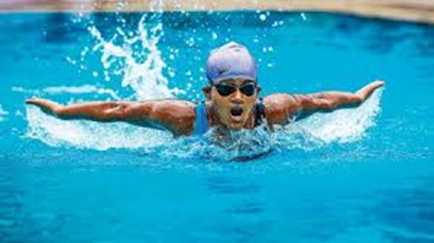
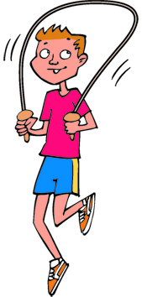
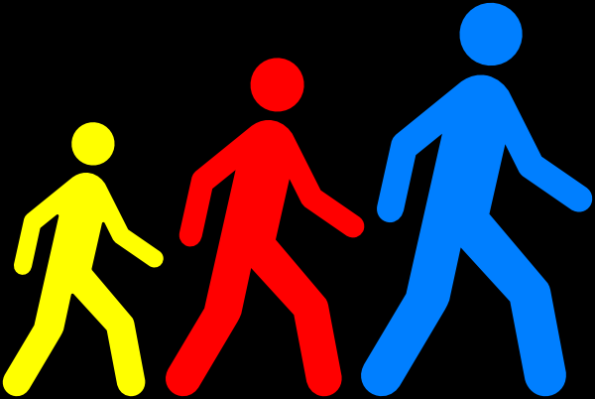
C. A list of indoor and outdoor exercises, Now go to board and write which ones are indoor and outdoor games
1.Playing sports
2.Swimming
3.Skipping
4.Jogging
5.walking
6.stretching

Slide 19
Group Work
Time : 10 minutes.
Here a is list of some physical exercises.
1. Playing
2. Swimming
3. Skipping
7. resting
9. Rowing
4. Jogging
5. Walking
6. Stretching
8. Running
10. Hiking
Activity of group-A: Find out which ones are indoor exercises and which ones can be done both indoors and outdoors from the above list. Tell which one/ones you like and why.
Activity of group-B: Find out which ones are outdoor exercises and which ones can be done both indoors and outdoors from the above list. Tell which one/ones you like and why.
Notes:
The teacher will divide all the students into two groups. Group: A and Group: B. Then he will give them direction what are to do.

Slide 20
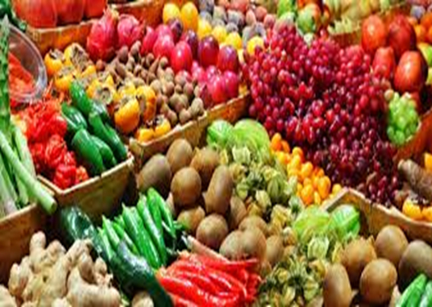
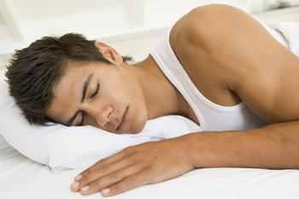
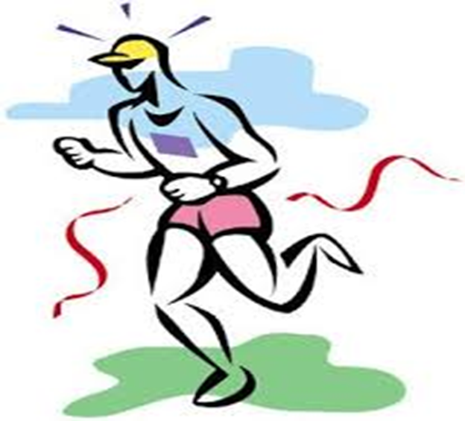
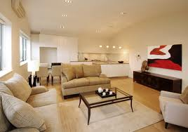
PROPER REST AND SLEEP
Being/keeping
Regular physical exercise

Slide 21
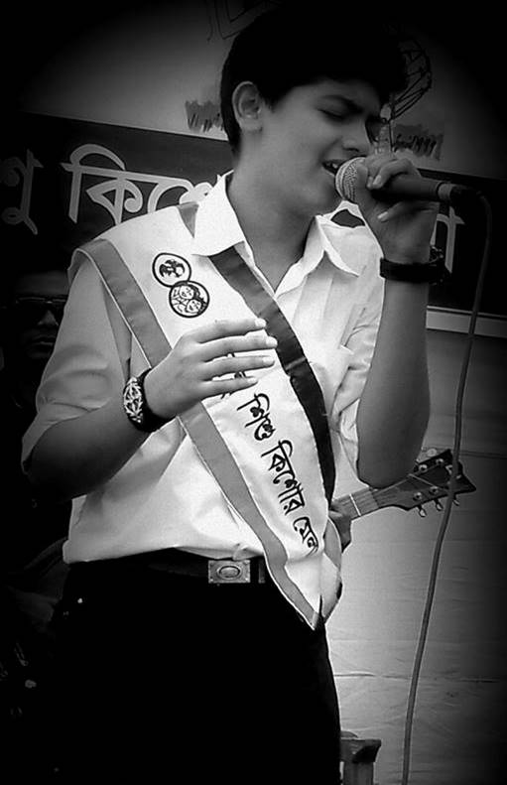
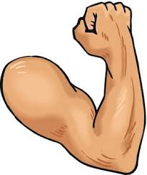
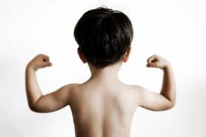
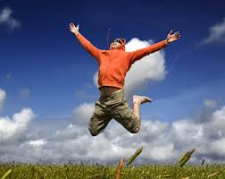
Why do we need physical exercise ?
to be
strong
to be cheerful

Slide 22
Evaluation
Answer the following questions.
1.Which things are necessary for good health?
Ans. Physical Exercise
2. How many types of physical exercise are there?
Ans. Two types.
3. What does Physical exercise do our body?
Ans. It keeps us fit for work, gives energy and makes us strong.

Slide 23
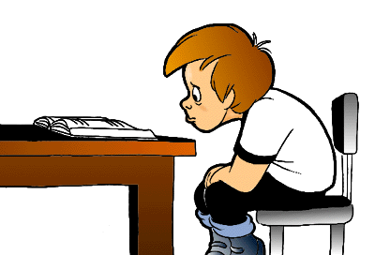
Home Work
Write a paragraph about “ Physical Exercise”

Slide 24
THANK YOU ALL

