Slide 2
WELCOME TO MY MULTIMEDIA GRAMMAR CLASS.

Slide 3
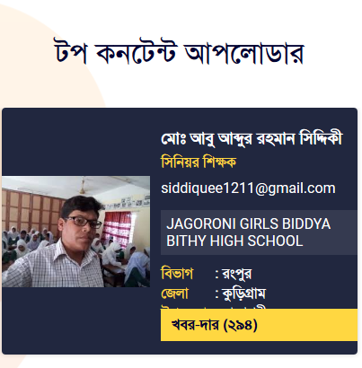
IDENTITY OF THE TEACHER
Md. Abu Abdur Rahman Siddiquee
(M. A, B. Ed)
Senior Teacher (English)
Jagoroni M. L Girls’ High School
Newashi, Nageswari, Kurigram.
Master Trainer, UITRCE, BANBEIS.
E-mail: siddiquee1211@gmail.com
Contact No. 01743943113

Slide 4
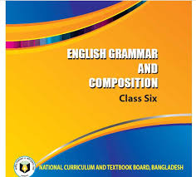
IDENTITY OF THE SUBJECT
English 2nd paper (Grammar)
Class : 6
Duration: 50 Minutes
Date: 04/09/2020

Slide 5
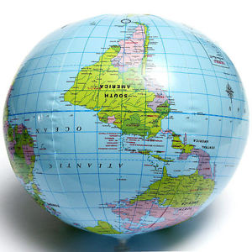
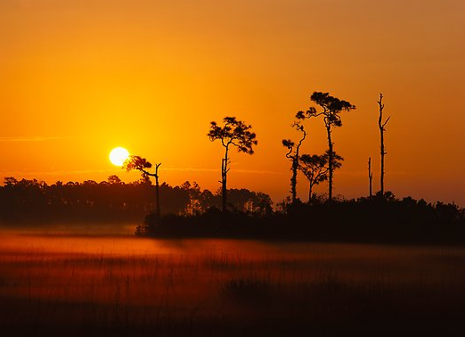
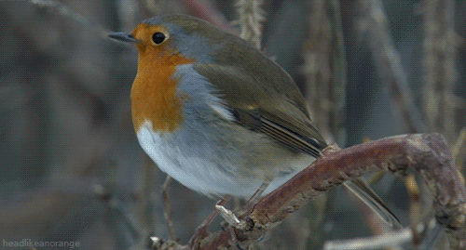
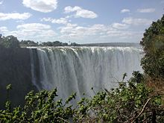
Look at the pictures and try to guess the sentences:
The sun rises in the east.
The earth is round.
The bird dances.
Water rolls downwards.

Slide 6
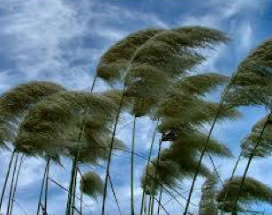
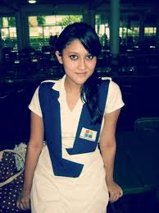
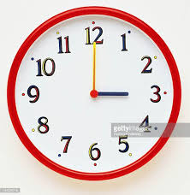
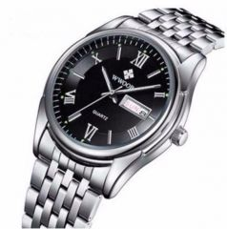
Look at the pictures and guess the sentences:
The wind blows violently.
The girl looks beautiful.
It is 3 o’clock.
He goes to bed at 10 o’clock daily.
Can you realize what’s our today’s lesson?

Slide 7
Today’s lesson is-
Present Simple / Indefinite Tense
Unit: 2, Lesson: 2

Slide 8
LEARNING OUTCOMES
After completing the lesson, students will be able to…
define present indefinite tense.
identify present indefinite tense.
make sentences with present indefinite tense.

Slide 10
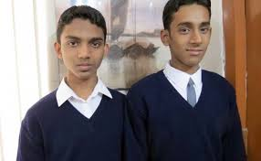
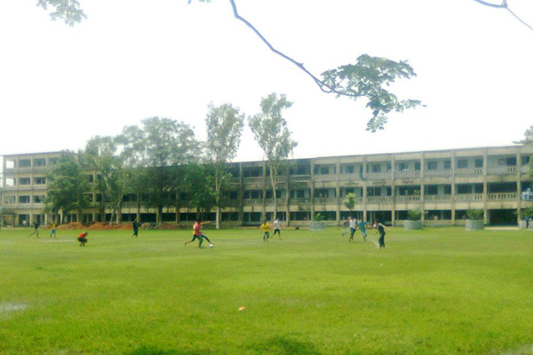
Read the following passage and notice the forms of verbs:
I am a student. Alam is my classmate. We two are good friends. We go to school together. We attend classes regularly. We often play together after school. We return home together. Alam lives in a house close to ours.

Slide 11
Common Verbs in the Simple Present:
Infinitive | I, You, We, They | He, She, It
to ask | ask / do not ask | asks / does not ask
to work | work / do not work | works / does not work
to call | call / do not call | calls / does not call
to use | use / do not use | uses / does not use
to have | have / do not have | has / does not have

Slide 12
Structure of Present Simple
Affirmative | Sub+P.V-base form +Ex | I eat rice. He eats rice.
Negative | Sub+A.V do/does +P.V- base form +Ex | I do not eat rice. He does not eat rice.
Interrogative | A.V do/does+Sub +P.V +Ex +? | Do I eat rice? Does he eat rice?
Inter- Negative | Do/Does not+Sub+ P.V+Ex+? | Don’t I eat rice? Doesn’t he eat rice?
Note: Sub 3rd person singular number– P.V- ‘s’/ ‘es’

Slide 13
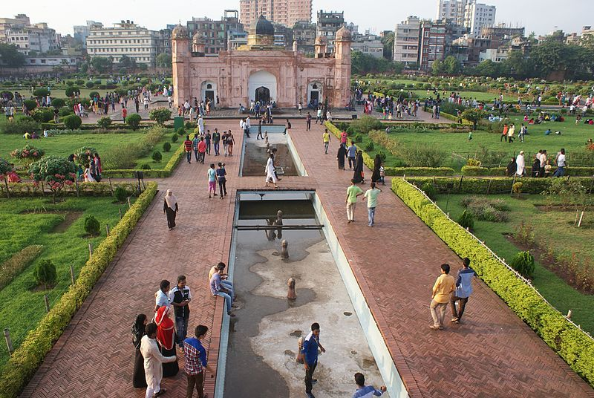
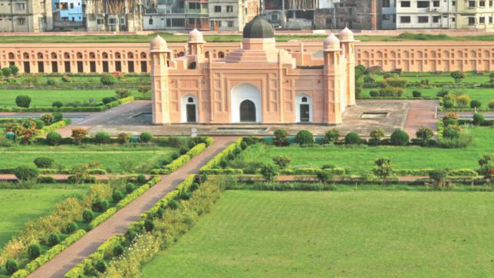
Example
Base Form | S Form (verb with s/es/ies)
I like Lalbagh Fort. We come here every Friday. Many people come here everyday. | Liza also thinks so. She carries a bag. It does not take us long time to get here.

Slide 14
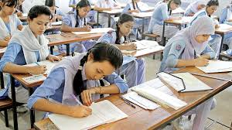
Individual Work
Read the following sentences and underline the verbs and also notice their structures:
English is an international language.
These mangoes are very sweet.
This book is not very big.
Are you a student?
Is the class small or big?
Why are you late?
Where is your father?

Slide 15
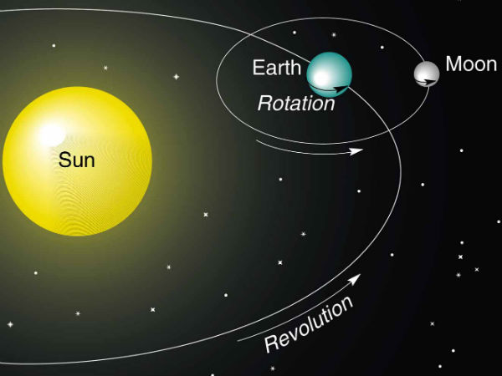
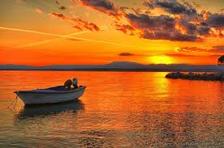
Use of Present Simple
Universal Truth
The earth moves round the sun.
The sun sets in the west.

Slide 16
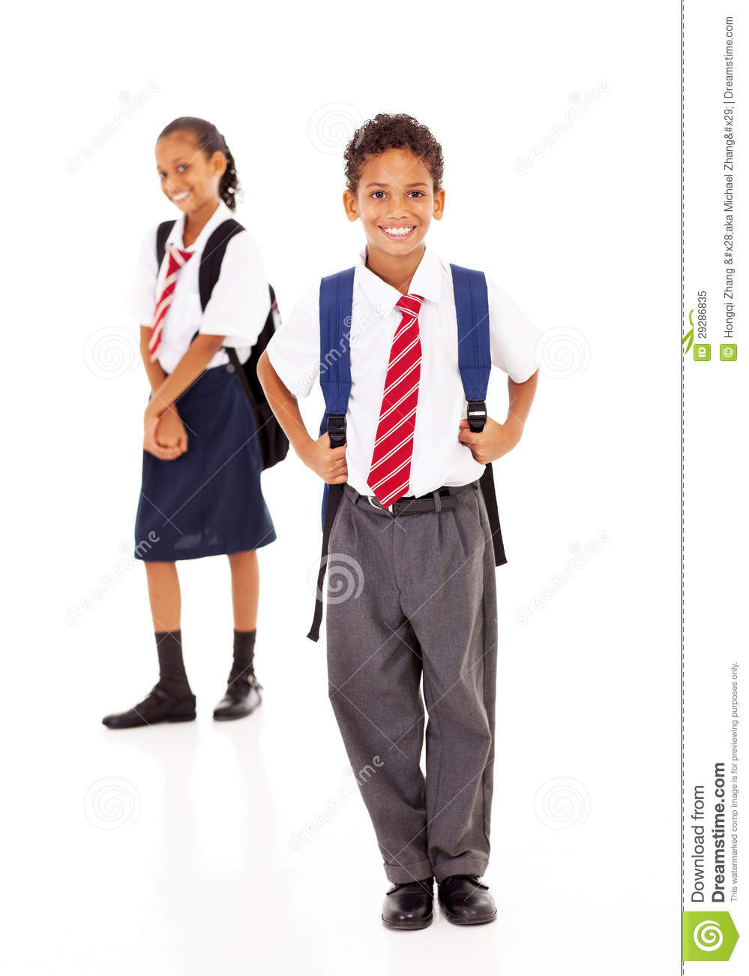
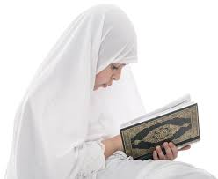
Habitual Fact
He goes to school at 9 o’clock everyday.
She often reads the Quran.
N. B: always, regularly, sometimes, often, generally, daily, everyday, occasionally, usually, normally – Present Indefinite Tense.

Slide 17
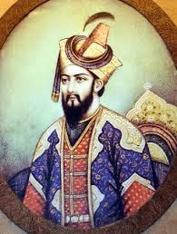
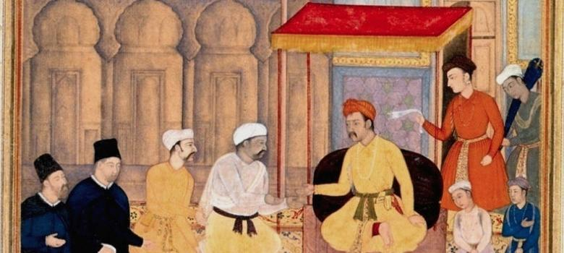
Historical Truth
Humayun ascends the throne.
Akbar innovates Bangla year.

Slide 18
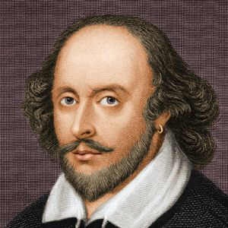
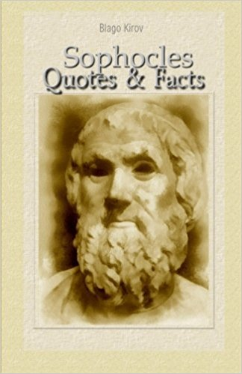
Writer’s Quotation
Shakespeare says, “Life is a tale told by an idiot.”
Sophocles says, “ There is no success without hardship.”

Slide 19
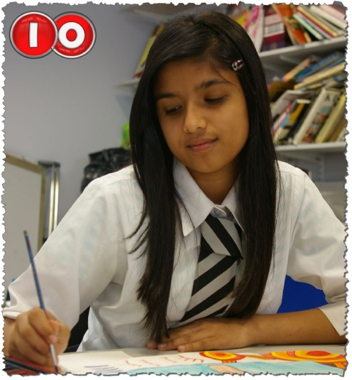
Conditional Sentence
If he wants, I shall help him.
Unless you read attentively, you will not do well.

Slide 20
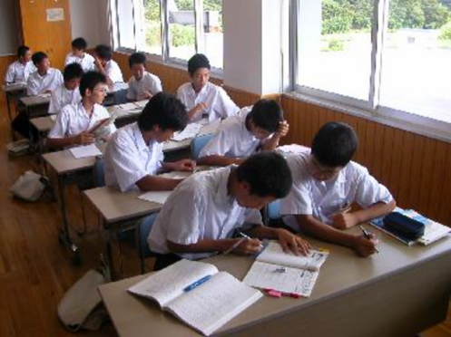
Pair Work
Change the verbs into simple present tense:
There was a law of laws and that was natural law. Water flew downward from upward. In the east the sun rose and in the west it set. Might was right and rule over everything. But truth prevailed upon that. According to law of nature fire burnt each and everything, water drowned and wind blew away.

Slide 21
Pair Work Solution
Check your answer:
There is a law of laws and that is natural law. Water flows downward from upward. In the east the sun rises and in the west it sets. Might is right and rule over everything. But truth prevails upon that. According to law of nature fire burns each and everything, water drowns and wind blows away.

Slide 22
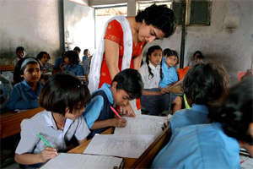
Group Work
Complete the sentences using the verbs:
The moon ---- at night.
Wind ---- violently.
He ---- not do it.
It ---- rain here everyday.
The sun ---- in the east.
---- he go home?
---- you a student?
---- they play cricket?
does
do
are
rises
shines
does not
blows
does

Slide 23
Group Work Solution
Check your answer:
The moon shines at night.
Wind blows violently.
He does not do it.
It does not rain here everyday.
The sun rises in the east.
Does he go home?
Are you a student?
Do they play cricket?

Slide 24
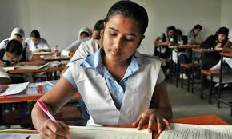
Assessment for Learning
Complete the passage about Mrs. Fatema Begum:
Mrs. Fatema Begum (a)---- from Bangladesh. She (b) ---- Bangladeshi. She (c) ---- a secondary school teacher. She (d) ---- in a girls’ school in Bogra. She (e) ---- English. Her husband is a doctor. He (f) ---- in a hospital. They (g) ---- three children, one boy and two girls. They (h) ---- after their children. Mrs. Begum (i) ---- balanced diet. She (j) ---- careful about her health.

Slide 25
Dear students, write it in your notebook:
Write five sentences about “Your family” using ‘be’ verbs and five more sentences using ‘action verbs’ in the present simple tense.

Slide 26
