Slide 1
Good Morning

Slide 2
GREETINGS
Good morning, students
Teacher
Good morning, teacher
Student’s
Teacher
How are you today ?
Fine
Student’s

Slide 3
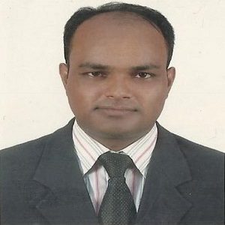
Teacher’s Identity
Lesson Identity
Subject: English. Class: One. Unit:02, Lesson: 1-3
(Introductions)
MD. ABDUL KADER
Assistant Teacher
Borni Govt. Primary School,
Companigonj, Sylhet.

Slide 4
Let’s enjoy a song

Slide 5
Ok, students our today’s lesson is
Introductions
Activity-A

Slide 6
Learning outcomes
By the end of the lesson the students will be able to-
Listening:
1.1 become familiar with English sounds by listening to common
English words.
3.1.1 understand simple questions about students.
3.2.1 understand simple statements.
Speaking:
1.1 repeat after the teacher and say simple words and phrases.
1.1.2 say simple words and phrases.
2.1.1 great each other.

Slide 7
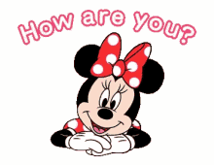
Let’s see some pictures

Slide 9
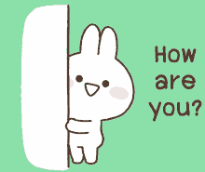

Slide 10
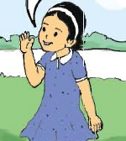
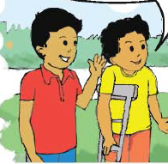
Look, listen and say.
Fine, thank you.
How are you?

Slide 11
Open your English book at page-14 and see the Activity- A
Fine, thank you.
How are you?

Slide 12
Pair work.
Fine, thank you.
How are you?
Fine, thank you.
How are you?
Repeat it once more.
Notes:
Students show up in reality.

Slide 13
Group Work
Green
ask and answer questions one another.
ask and answer questions one another with the help of the group members.
Yellow
Red
ask and answer questions one another with the help of the teacher.

Slide 14
One day one word
Spell out the word
fine
ভাল

Slide 15
Let’s enjoy goodbye song.

