Slide 2
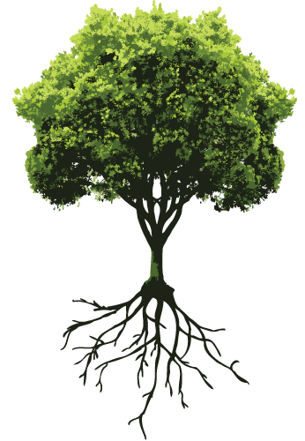
Welcome to English Class
Notes:
Welcome slide. This picture is related to the topic. So I have chosen it. Teacher may change it if he wants.

Slide 3
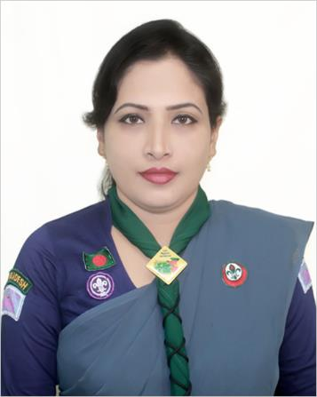
Teacher information
Sunayana Roy
Assistant teacher
Goalmath Secondary Girls School
Kachua, Bagerhat.
somabgt@gmail.com

Slide 4
Class information
Class : Ten
Subject : English 1st paper
Time: 50 min.
Date : 05/01/2020

Slide 5
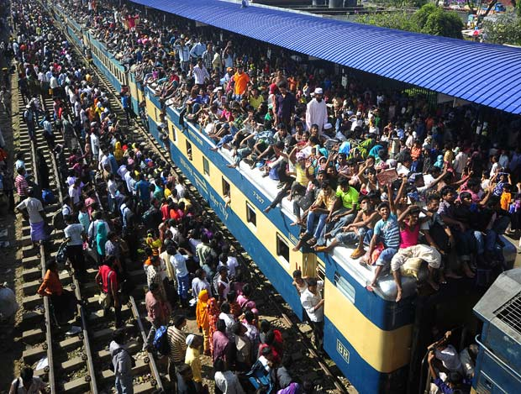
Watch & observe
Where are they going?
Village home
Notes:
Teacher may go according to animation.

Slide 6
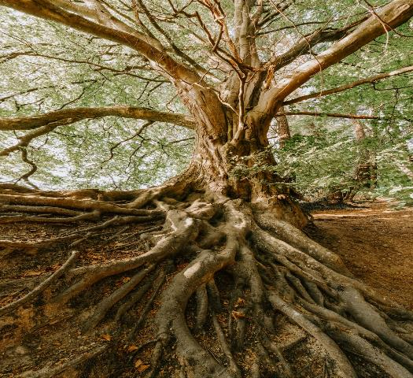
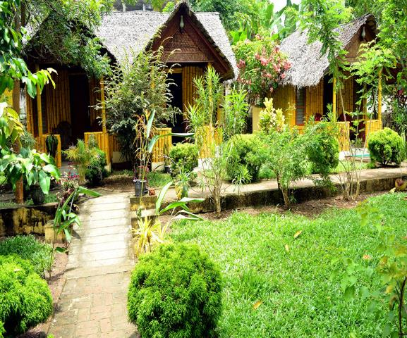
What do you mean?
Root
Birth place / Paternal address
Notes:
Inner significance of roots shown here.

Slide 7
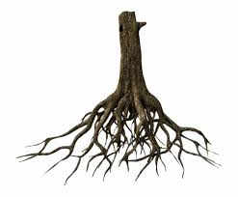
Todays lesson is
My Root
Unit-12, Lesson-1

Slide 8
Learning outcomes
After we have studied this lesson, we will be able to—
ask and answer questions
narrate incidents and events in a logical sequence
present information in a chart
read and understand the text through silent reading

Slide 9
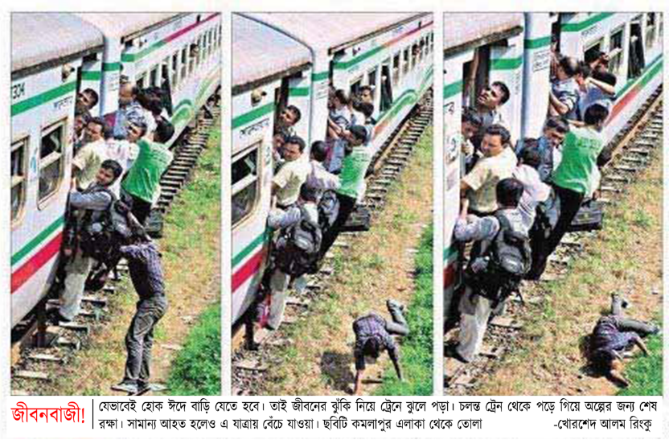
A Look at the pictures and the caption below. How do you feel to see this photo? Why do you think people take such risks to go home to celebrate their Eid?
Notes:
Text lesson begun. The circles are to highlight risks.

Slide 10
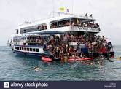
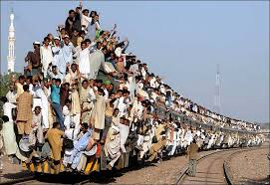
Going to village home is a must,
that may be at any cost.

Slide 11
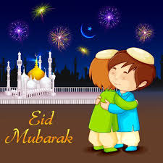
What is the picture about?

Slide 12
What is Eid?
Eid is the main religious festival of the Muslims in Bangladesh. Eid means happiness.

Slide 13
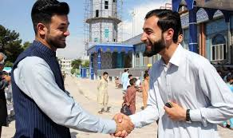
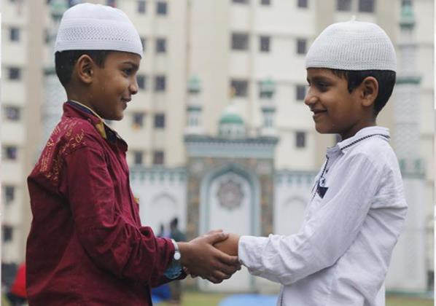
What does everyone want during Eid?
Everyone wants to share happiness with their near and dear ones during Eid.

Slide 14
So what happens then?
So most of the people, who are living outside their home for different reasons have a strong desire to get back home during the Eid vacations.

Slide 15
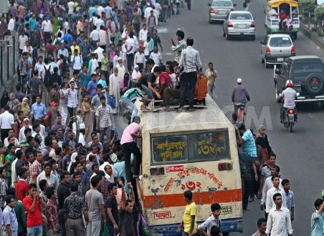
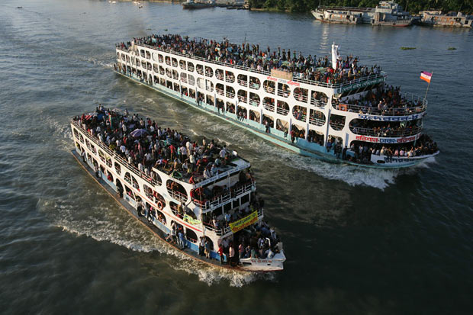
As a result, there is a mad rush in the--
buses
trains
or launches for the home-bound people.
Notes:
Text shown by showing images.

Slide 16
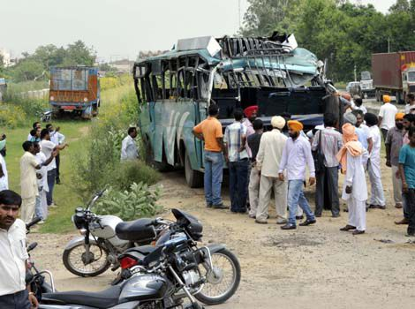
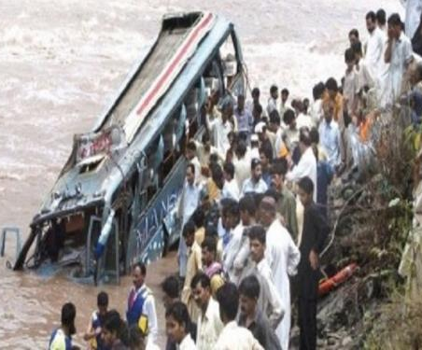
What is caused afterwards?
Accident.
Notes:
Though it is undesirable, it very practical.

Slide 17
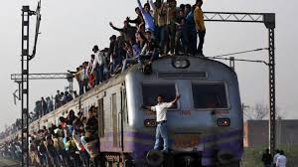
What makes people rush for their homes in spite of serious?

Slide 18
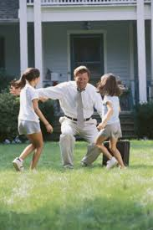
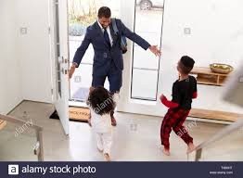
This is the pull of the roots.

Slide 19
Do human beings have-
roots like the trees?

Slide 20
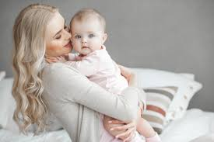
Yes
The answer is-
but unlike the roots of the trees they are invisible, they lie in our minds.

Slide 21
Dear leaners,
Let us have a tour from the text directly to know the rest about roots.
Open your text book at page 152 and start reading from “It’s these roots that make a bond between………………..feel empty and lost silently. I am always be with you.
Notes:
Reading skill will be focused in this option. Teacher may move in the classroom to help the students reading the lesson.

Slide 22
B Read the following text.
It's these roots that make a bond between us and family members, in­-laws, friends, neighbours or even between us and the land where we were born and grew up. In that sense our families, land of birth, relatives, our culture, traditions, or surroundings are our roots. And wherever we stay, we have a continuous pull of our roots. It's our roots that develop our identity making us what we are. When we lose that bond, we become rootless. Human beings who do not have any root or contexts, are non entity. In other words, they do not have their own identity. Such persons are devoid of values, humanity, and social responsibilities. They don't know where they are from, and/or where they are heading towards. This often makes them feel empty and lost.
Notes:
This may be helpful to the students those who have no books with them. Actually Text like this slide is not allowed in a digital presentation.

Slide 23
C Read the text in the speech bubbles. Make questions for them and then compare in pairs.
Eid is the main
religious festival of
the Muslims in
Bangladeh.
Eid means happiness.
In that sense our families, land of birth, relatives, our culture, traditions, or surroundings are our
roots.
It’s our root
that develops our
identity making s
what we are.
Notes:
Evaluation option from the text.

Slide 24
D Fill in the grid with appropriate information from the text above.
That makes our roots | The problems of a rootless person
1................................ 2................................ 3................................ 4................................ 5................................ | 1………………………… 2………………………… 3………………………… 4………………………… 5…………………………
Notes:
Evaluation.

Slide 25
E Work in pairs. Talk about these questions.
Do you have any root other than the place where you are living now? If yes, where is it and who are there?
If not, why not?
2. How do you label your roots?
My roots belong to
an extreme rural village a village
a semi-urban area (upozila) a small town
a moderate city a suburb
a city
3 Do you feel any attraction or pull of your roots?
4 How do you nourish your roots?
5 What, according to you, are the reasons why people become rootless?
F Make a classroom survey and present in a chart the types of roots your classmates have.
Notes:
Learners are supposed to do pair work in section E and Group work in section F.

Slide 26
Thanks
to
all

