Slide 1
Good Morning students.

Slide 2
IDENTITY
Md. Afsar Ali
Senior Teacher
Majhira Model High School
Shajahanpur, Bogra
Email: afsar09.3@gmail.com
Unit:10 Dreams
Lesson: 3 They had dreams-2

Slide 3
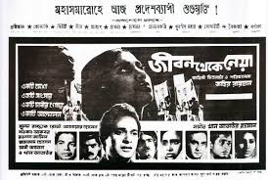
Do you know who made these legendary film?
Yes, I have seen these film.
Have you seen these film?
Zahir Raihan made these legendary film

Slide 4
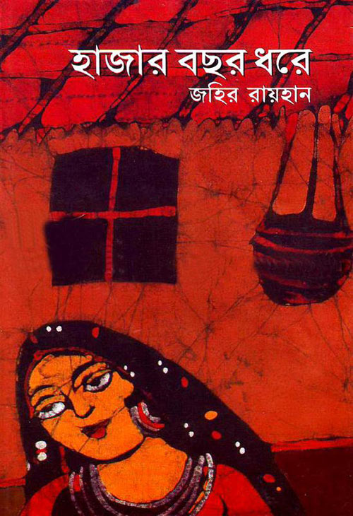
Look at the books.
Yes, I have read the books.
Have you read these books?
The famous writer Zahir Raihan is the writer of the books.
Who is the writer of these books?

Slide 5
OUR TODAYS LESSON IS-
UNIT:10 DREAMS
LESSON: 3 THEY HAD DREAMS-2

Slide 6
LEARNING OUTCOMES
# After finishing the lesson, the students will be able to-
֍ read and understand texts through silent reading;
֍ choose the best answer;
֍ infer meaning from the context;
֍ fill in the gap;
֍ write a paragraph.

Slide 7
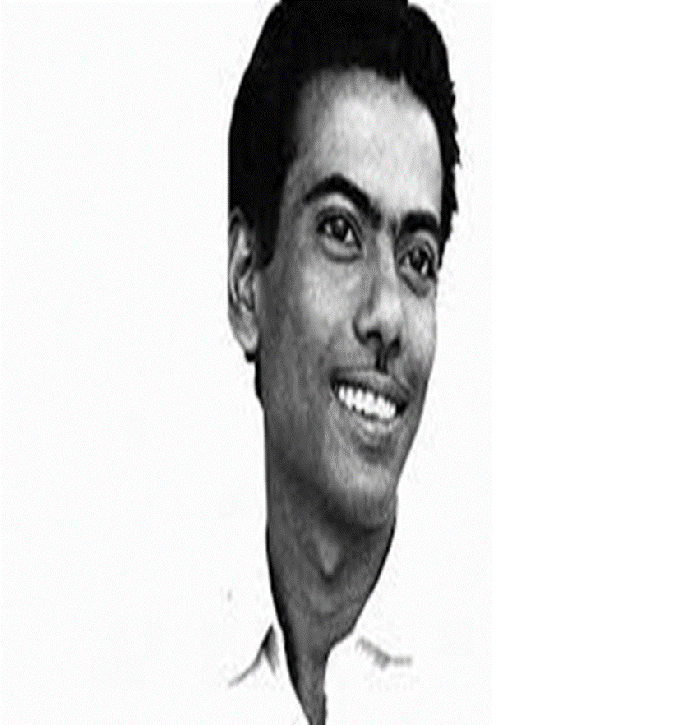
Having a natural ability to do something well
Talented
Zahir Raihan was a talented flim maker

Slide 8
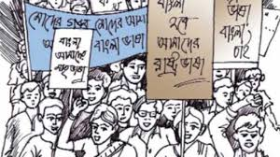
We want a country without colonial rule.
Procession
A line of people moring slowly for a specific purpose

Slide 9
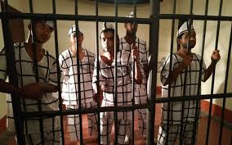
Nobody want to go in a prison
Prison
A building where the criminals are kept

Slide 10
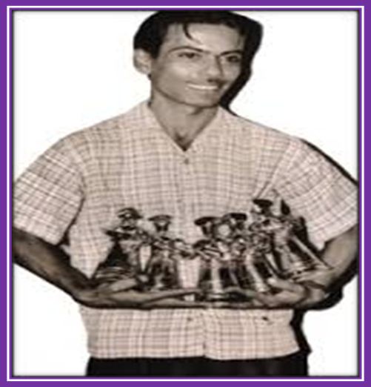
Legendary
Zahir Raihan was a legendary person
Very famous and admired

Slide 11
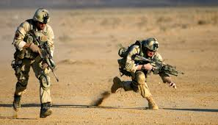
Inception
We could see the inception of a free independent country
The start of an institution

Slide 12
Read the passage carefully and answer the question
Zahir Raihan was one of the most talented film makers in Bangladesh. He was born on 19 August 1935 in the village Majupur, in Feni district.

Slide 13
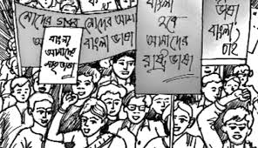
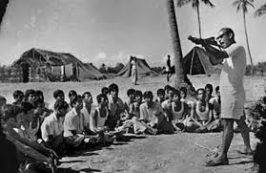
He was an active worker of the Language Movement. He was one of the ten students to go out in a procession on 21 February 1952 despite a ban on such activities. As a result, he and many others were arrested and taken to prison. Raihan was also present at the historical meeting of Amtala on February 21, 1952. He also took part in the mass movement in 1969. In 1971, he joined the Liberation War.

Slide 14
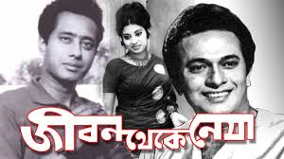
All through his life, Zahir Raihan dreamt of a democratic society, a society that would ensure freedom of speech. He had many dreams about our film industry too. He made a legendary film Jibon Theke Neya based on the Language Movement of 1952.

Slide 15
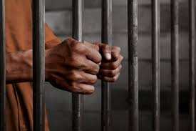
It was a protest against the autocratic government then ruling our country. The family portrayed in that film symbolically represented East Pakistan. The family was ruled by an autocrat who had to go to the prison for her conspiracy.

Slide 16
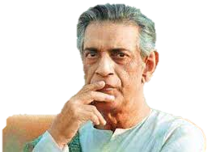
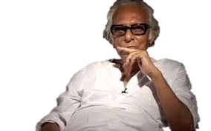
Satyajit Ray
Mrinal Sen
Ritwik Ghatak
During the Liberation War in 1971, this film was shown outside Bangladesh.Celebrated filmmakers like Satyajit Ray, Mrinal Sen, and Ritwik Ghatak appreciated this film. Raihan gave all his money the film made to the Freedom Fighters’ trust that he got from his film shows.

Slide 17
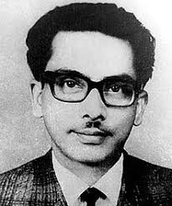
Besides, his great documentary on Pakistani atrocities, Stop Genocide, helped create world sentiment in favour of our liberation war.
On 30 December 1971, someone informed Raihan about an address somewhere at Mirpur, where he might find his brother, the famous writer Shahidullah Kaiser, who had gone missing from 14 December 1971. Kaiser was captured and killed by the Pakistani army and the local collaborators during the last days of the war.

Slide 18
Accordingly, Raihan left home to get his brother back but he never returned. Zahir Raihan’s dream was fulfilled. He could see the emergence of an independent Bangladesh though he did not get back his brother. And it’s a pity that this dreamer could not live to see his dream come true.

Slide 19
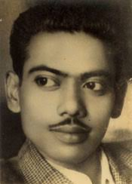
KNOW MORE ABOUT ZAHIR RAIHAN
Born:19 August.1935
Birth pl :Majupur, Feni
Joined: Mass Move-1969
Film: Jibon Theke
Neya
Joined : Language Move1952
Docu : Stop Genocide
Joined: liberation-War 1971
Disappeared:30 Dec.1971

Slide 20
Read the story again and put the tick on the correct answer
1. Zahir Raihan was a...........................
X
a) soldier
X
b) photographer
X
c) professor
√
d) patriot
2. Zahir dreamt for a democratic society..........
X
a) in his college life.
√
b) all through his life.
X
c) in his school days.
X
d) in his varsity life.
Click on the correct option.
INDIVIDUAL WORK

Slide 21
3. He had many dreams about our............
√
a) Film industry
X
b) country.
X
c) Garment industry.
X
d) Education sectors.
4. The film was shown.............
X
a) Outside Pakistan.
X
b) Inside Bangladesh.
√
c) Outside our country.
X
d) Outside the world.
Click on the correct option.

Slide 22
5. The critics.................the film
X
a) chose
X
b) disliked
X
c) liked
√
d) praised
6. Zahir got disappeared on.............
X
a) 16 December 1971
√
b) 30 December 1971
X
c) 26 March 1971
X
d) 15 August 1971
Click on the correct option

Slide 23
7. He was taken to............for procession on
21 February
X
a) hospital
√
b) Jail
X
c) clinic
X
d) Medical college.
8. Shahidullah Kaiser was Zahir Raihans’.............
X
a) uncle
X
b) cousin
√
c) brother
X
d) father
Click on the correct option.

Slide 24
C. Use appropriate information from the text above to complete the grid.
ZAHIR RAIHAN
participated in | famous as | best documentary | movie based on language movement | missing since | his dream
30
December,
1971
a
democratic
society
The Liberation
War,
Language
Movement
film
maker
Stop
Genocide
‘Jibon Theke
Neya’

Slide 25
D. Read the following sentences and complete them.
1. Zahir Raihan is famous as …………….
2. Raihan was imprisoned because ……………………………………………………………….
3. He participated in ………………………………. and ……………………….
4. Jibon Theke Neya symbolizes…………………………………….....
5. He donated ……………………………………………..
6. He worked to organize …………………………………………………… by his
great documentary Stop Genocide.
7. His disappearance is a great………………………………………….
film maker
he participated in the procession on 21st February, 1952
the Language Movement
the Liberation War
the Language Movement of 1952
money to the Freedom Fighters’ Trust
world sentiment against Pakistani atrocities
shock in the history of Bangladesh

Slide 26
Answer the following questions
1. Why is Zahir Raihan’s considered a freedom fighter though he was a film maker?
Answer: It is because his films and documentaries were a form of revolt against the Pakistani government. Besides, government he participated in Language Movement and Liberation War directly.
2. How does the title of the lesson fit to the story of Zahir Raihan?
Answer: Zahir Raihan was a dreamer and he dreamt of the freedom of Bangladesh. From the story we find that Zahir Raihan did many things to fulfill his dream of freedom. So, I think the title of the lesson fits to the story of Zahir Raihan.
3. Why is Zahir Raihan regarded to be a golden son of Bangladesh?
Answer: Zahir Raihan is regarded as the golden son of Bangladesh for his contribution to the struggle of Bangladesh for independence and to Bangla films.
4. Why did Zahir leavae home?
Answer: On 30 December 1972, being informed about his missing brother’s location, Zahir left home to bring him back. Unfortunately, he never back home.
PAIR WORK

Slide 27
Group Work
Make five sentences from the substitution table
Zahir Raihan | gave | born in Feni
He | was | his film.
The critics | appreciated | shown outside Bangladesh.
His film |  | a famous film maker
 |  | all his money to the freedom fighters’ trust
Zahir Raihan was born in Feni.
He was a famous film maker.
The critic appreciated his film.
His film was shown outside Bangladesh.
He gave all his money to the Freedom Fighters’ trust.

Slide 28
Fill in each gap with the suitable words
Zahir Raihan..........a freedom.........He.........from Feni. He…...........for a democratic.................He was a..........flim..........He.............all his...........to the freedom fighters’.............
fighter
hails
was
dreamt
society
famous
maker
gave
money
trust

Slide 29
Home work
Write a paragraph on about Zahir Raihan’s life.

Slide 30
Good bye
Have a nice day

