Slide 1
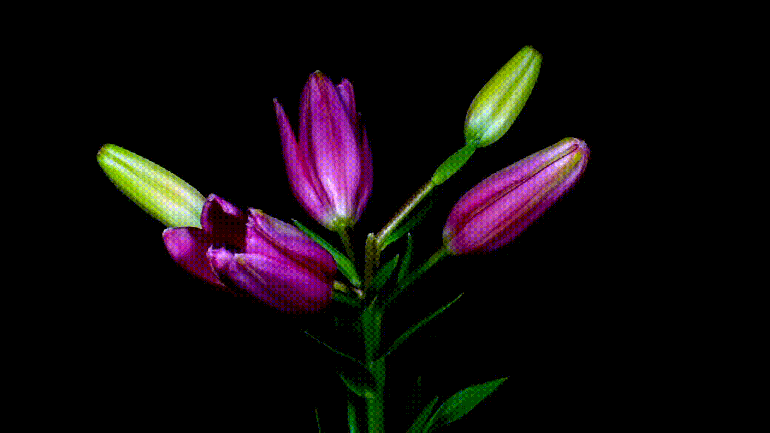

Slide 2
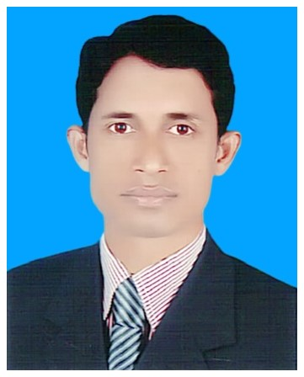
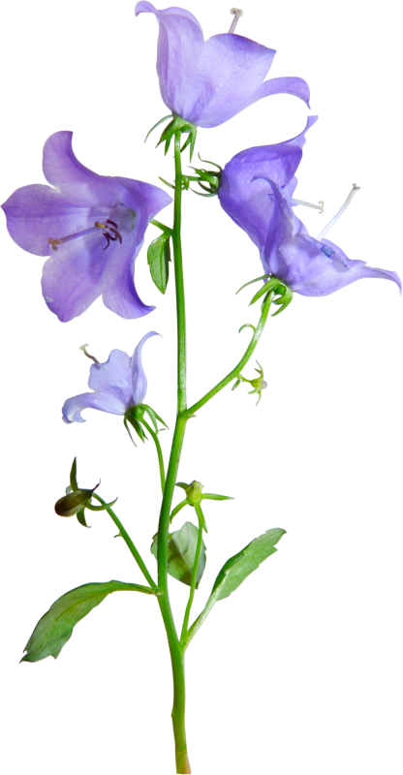
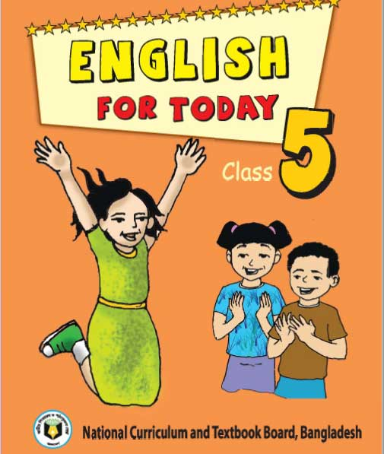
Identity
Lesson
Teacher
Class: Five
Subject : English
Unit : 15
(Happy Birthday)
Mohammod Abdul Hannan
Assistant teacher
Chunghar Govt. primary School
Kulaura, Moulvibazar

Slide 3
At the end of this lesson Students will be able to
Listening:
1.2.1 – recognize which syllable in a word in stressed.
3.4.1 understand statements made by the teacher and students.
Learning outcomes
Speaking:
1.1.1- repeat words, phrases and sentences after the teacher
with proper sounds and stress.
1.1.2- say sentences with proper intonation .
Reading:
1.5.1- read words, phrases and simple sentences with proper
pronunciation , stress and intonation.

Slide 4
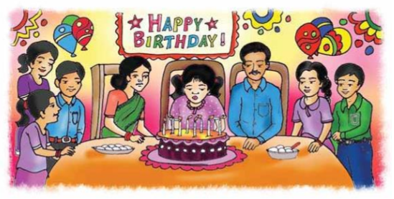
What do you see in the picture?
What are they doing?

Slide 5
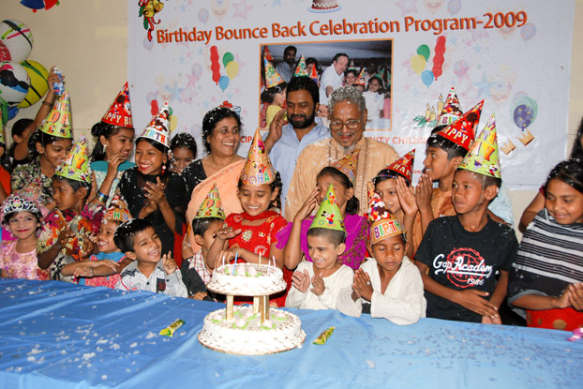
Let’s enjoy our today’s lesson about-
Happy Birthday

Slide 6
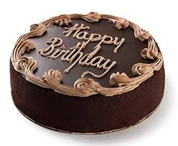
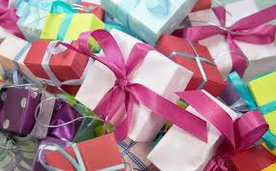
Look at the following pictures.
Birthday cake
Gift
Do you know when your birthday?

Slide 7
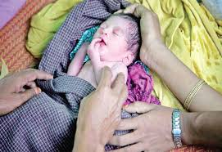
What is birthday?
The day when a person was born.

Slide 8
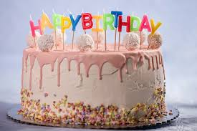
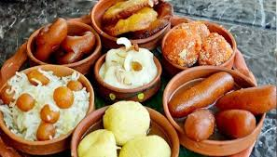
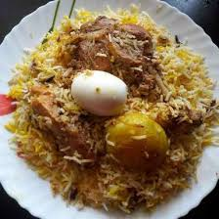
What things are needed to celebrate birthday?
Cake
Sweets
Special food

Slide 9
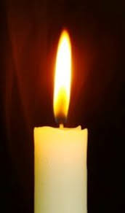
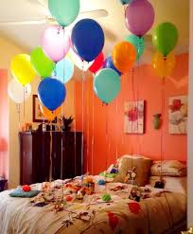
Candle
Balloon

Slide 10
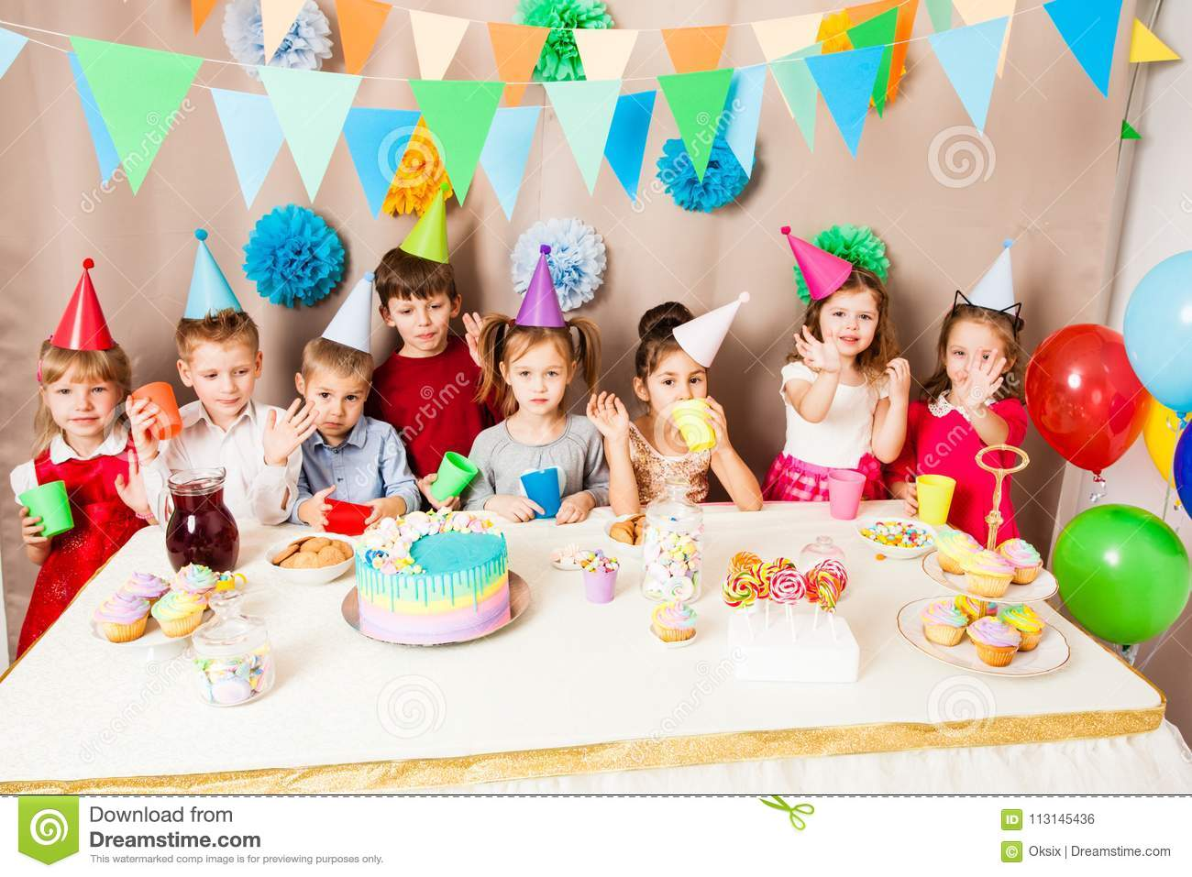
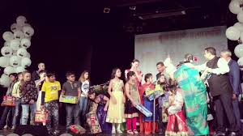
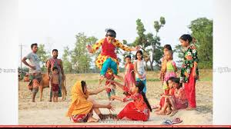
Birthday Activity
The children celebrate birthday with a cake, play
games and sing.

Slide 11
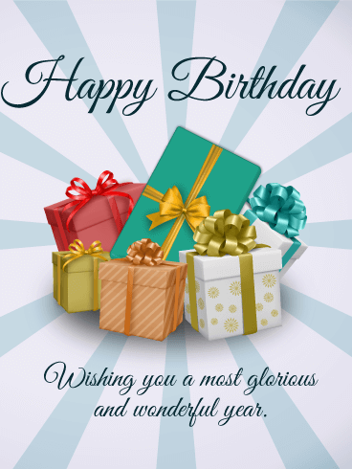
The friends often bring birthday gift.

Slide 12
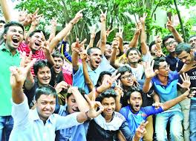
New Word, Meaning and Making sentence
Birthday
জন্মদিন
The day when a child is born.
Sentence : Today is my birthday.
Enjoy
উপভোগ করা
Pleasure in an activity or occasion.
Sentence : We enjoy swimming.

Slide 13
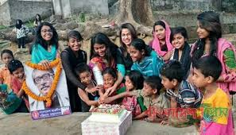
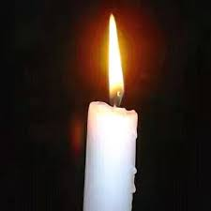
Celebrate
পালন করা, উদযাপন করা
Observe a happy day or event.
Sentence : We will celebrate our birthday.
Candle
মোমবাতি
Block of wax with a wick.
Sentence : I have a colour candle.

Slide 14
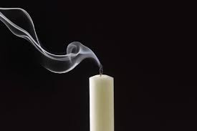
Blow out
ফুঁ দিয়ে নেভানো
Put out fire by air.
Sentence : The person blows out the candles.

Slide 15
Listen the text and match with your book
O
P
E
N
A
T
P
A
G
E
58

Slide 16
Fill in the blanks with the following words:
candles, each, around, wrapped, play, often, spend.
1)People _________ the world celebrate birthdays.
2)There are __________on the cake.
3)There is one candle for __________ year of the persons
birthday.
4)The children __________ games and sing song.
5)The gifts are ___________ in colourful paper.
around
candles
each
play
wrapped

Slide 17
Write ‘True’ for correct statement and ‘False’ for incorrect statement.
People around the world celebrate birthdays in the same way.
2. A birthday is a special day.
3. People sing a birthday song for the birthday person.
4. The friends do not bring any gift for the birthday person.
5. The most important thing is to enjoy the day.
False
True
True
False
True

Slide 18
Answer the following questions
1.What is the most important thing for a birthday?
Ans: The most important thing is to enjoy the day and spend
time with friends and family.
2. What do the children do on a birthday party?
Ans: The children play games and sing.
3. What do people bring to the birthday party?
Ans: People bring a birthday gift to a birthday party

Slide 19
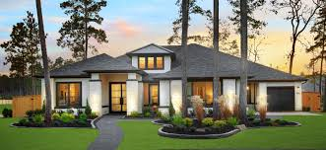
Home work
Write a short composition at least in eight sentences about
A birthday Party

Slide 20
