Slide 1

WELCOME TO OUR CLASS

Slide 2

TEACHER’S INTRODUCTION
Harish Chandra Debnath
H@ris’ English Aid
NGN BD
harishenglishaid@gmail.com
Cell# 017 60 65 12 12

Slide 3

LESSON INTRODUCTION
CLASS : THREE
SUB : ENGLISH
UNIT : 27; LESS: 1-3(A,B)
TIME : 50 MINUTES
DATE : 22/02/2019

Slide 4
LEARNING OUTCOMES: At the end of the lesson students will be able to :-
3.3.1 understands statesment.
LISTENING:
6.1.1 say What the speaker is doing.
6.1.2 say What others are doing.
SPEAKING:

Slide 5
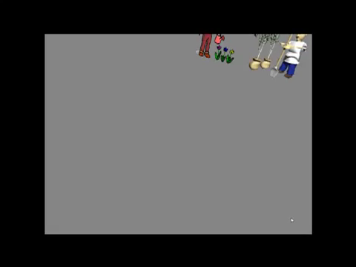
Let’s enjoy a video………..

Slide 6
What do you see in the video?
What more are in the video?
What are they doing?

Slide 7


Today’s Lesson is …
What are they doing?

Slide 8


Let’s listen to an audio

Slide 9
What are they doing?
They’re planting seeds.

Slide 10
What are they doing?
They’re watering plants.

Slide 11
What are they doing?
They’re washing their hands.

Slide 12
What are they doing?
They’re eating oranges.

Slide 13

Open your text book
Page No:- 54

Slide 14
Grammar point
They
More than one person
They’re
They are

Slide 15

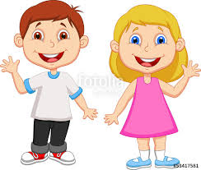
Now we will say in pair
LOTA and SORNA
NAFI and PAKHI

Slide 16
What are they doing?
They’re drawing

Slide 17
What is she doing?
She is sleeping

Slide 18


Claps for them

Slide 19

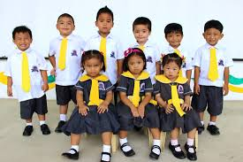
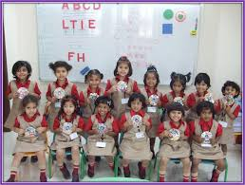
Now we will say in group
group A
group B
What are they doing?
What is he doing?

Slide 20



Slide 21


Slide 22

