Slide 2
Welcome to
everybody.

Slide 3
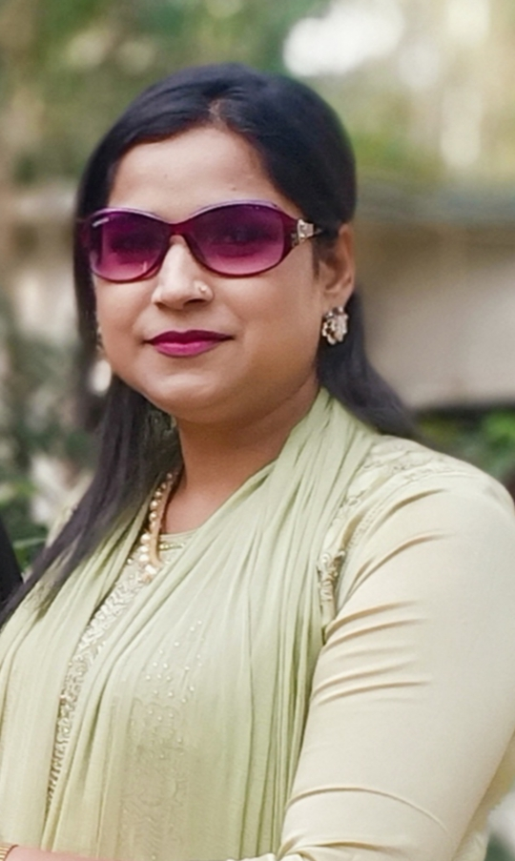
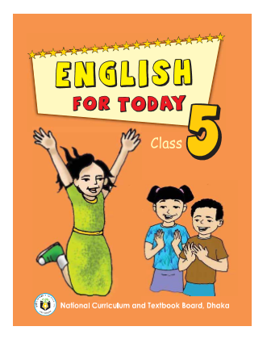
Class: Five
Subject: English
Unit: 15
Lesson: 1
Lesson Title: Happy Birthday
Today’s lesson: A person’s birthday is a……..friends and family.
Date: 01/04/2021
Time: 40 minutes.
Nasima Akter
Assistant teacher
Chatiachala Govt. Primary School,
Sakhipur,Tangail. .

Slide 4
By the end of the lesson students will be able to…
Listening: 3.4.1: understand statements made by the
teacher and students.
Speaking: 6.2.1: talk about people, objects, events etc.
Reading: 1.5.1: read words, phrases and sentences in the
texts with proper pronunciation, stress
and intonation.
5.1.1: read silently with understanding
paragraphs.
Writing: 3.1.1: write words, phrases and sentences using cursive
capital and small letters.
3.1.2: write words, phrases and sentences using non-
cursive capital and small letters.

Slide 5
Let’s watch a video
How have you enjoyed the song?

Slide 6
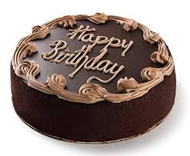
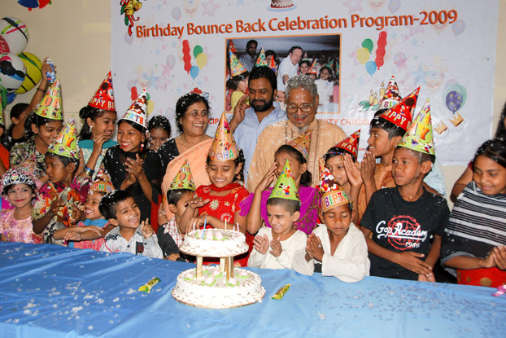
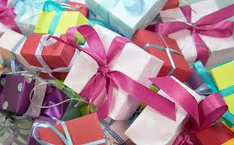
Look at the following pictures.
Birthday cake
Birthday party
Gift
Do you know when your birthday is?

Slide 7
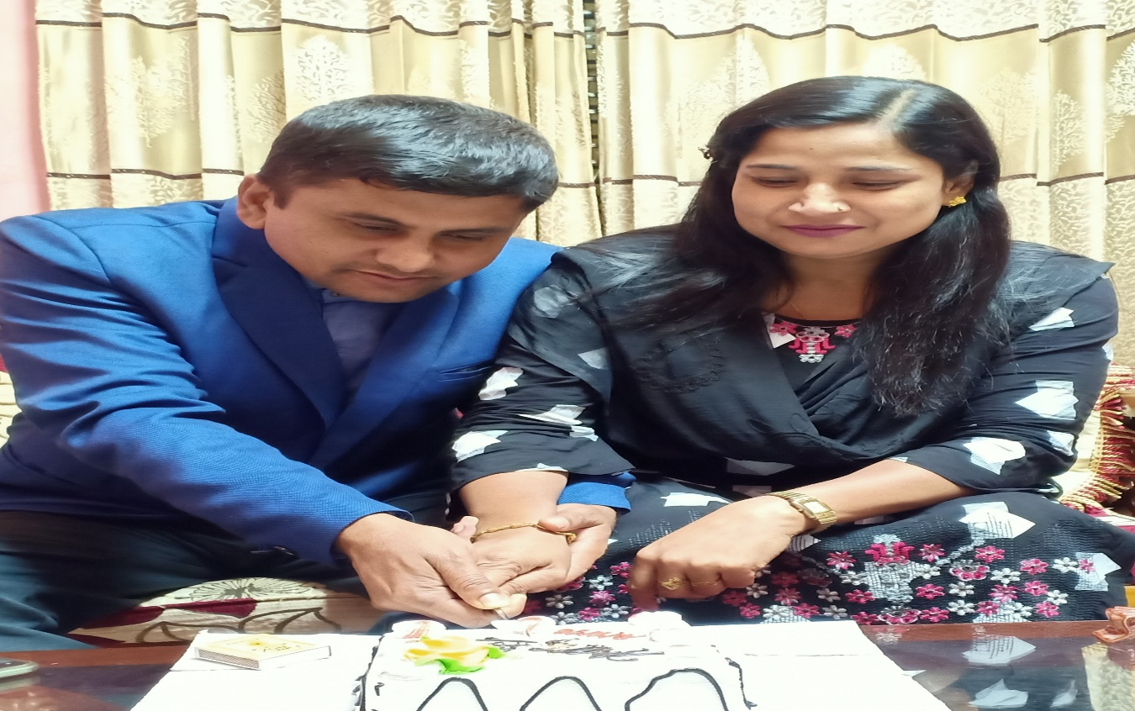
Lesson declaration
Can you guess the name of today’s lesson?
Yes, our today’s lesson is “ Happy Birthday .”

Slide 8
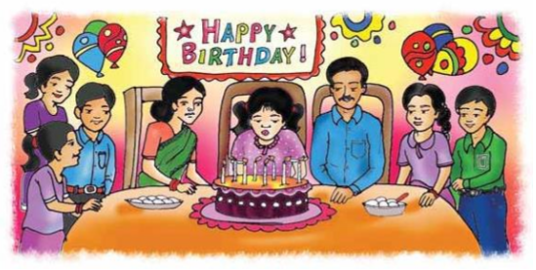
What can you see in the picture?
What are they doing?

Slide 9
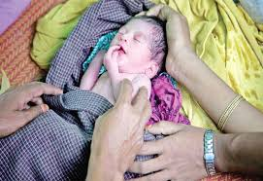
What is a birthday?
A person’s birthday is a special day. This is the date when the person was born.

Slide 10
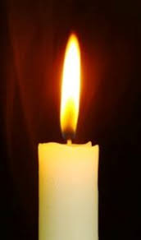
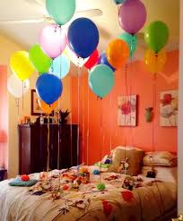
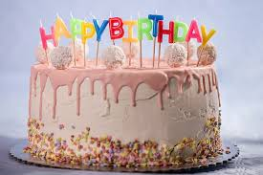
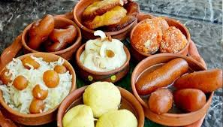
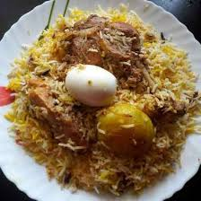
What things are needed to celebrate birthday?
cake
balloon
sweets
Special food
candle

Slide 11
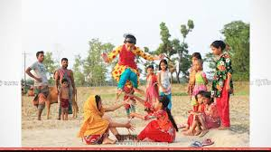
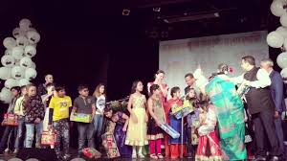
What do the children do on a birthday?
The children play games and sing.

Slide 12
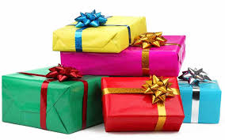
What do the friends bring on a birthday?
The friends often bring a birthday gift.

Slide 13
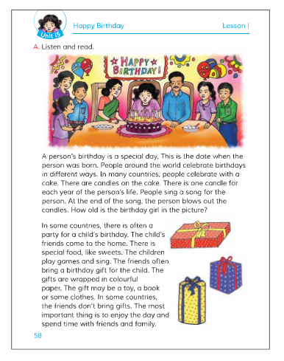
Open your book at page no 58.
Now I am reading out the text. You all listen to me attentively and underline the new/unknown words.

Slide 14
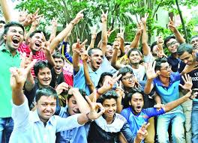
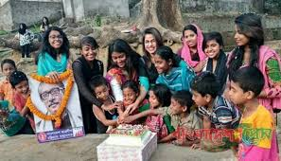
Birthday
The day when a child is born.
Enjoy
Pleasure.
Celebrate
Observe.

Slide 15
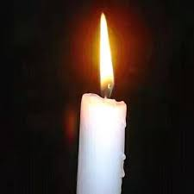
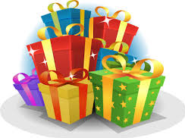
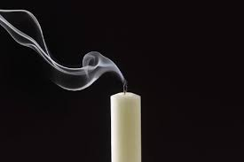
Candle
Wax
Gift
presentation
Blow out
Put out

Slide 16
Now listen to the audio carefully and try to understand the text.
Once again listen to the audio.

Slide 17
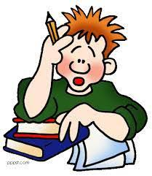
Individual work
Fill in the blanks with the following words:
candles, each, around, wrapped, play, often, spend.
1)People --------------the world celebrate birthdays.
2)There are ------------on the cake.
3)There is one candle for---------- year of the persons birthday.
4)The children ------------games and sing song.
5)The gifts are------------- in colourful paper.

Slide 18
Match the answers:
1)People the world celebrate birthdays.
2)There are on the cake.
3)There is one candle for year of the persons birthday.
4)The children games and sing song.
5)The gifts are in colourful paper.
around
candles
each
play
wrapped

Slide 19
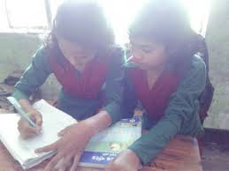
Pair work
Write ‘True’ for correct statement and ‘False’ for incorrect statement.
People around the world celebrate birthdays in the same way.
A birthday is a special day.
People sing a birthday song for the birthday person.
The friends do not bring any gift for the birthday person.
The most important thing is to enjoy the day.

Slide 20
Match the answers:
People around the world celebrate birthdays in the same way.
False
2) A birthday is a special day.
True
3) People sing a birthday song for the birthday person.
True
4) The friends do not bring any gift for the birthday person.
False
5) The most important thing is to enjoy the day.
True

Slide 21
Group work
Answer the following questions by discussing in your group :
What day is a special day to a person?
Do people around the world celebrate birthday in the same ways?
How do people celebrate birthday in most of the countries?

Slide 22
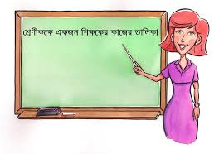
Presentation
One student from each group will come to the front and present their group work.

Slide 23
Match the answers:
Ans: A birthday is a special day to a person.
Ans: No, people around the world celebrate birthday in different ways.
Ans: In most of the countries people celebrate birthday with a cake.

Slide 24
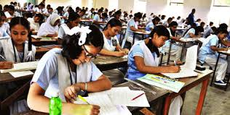
Evaluation
What do people bring to a birthday party?
What do the children do on a birthday party?
What is the most important thing of a birthday?

Slide 25
Match the answers:
Ans: People bring a birthday gift to a birthday party.
Ans: The children play games and sing.
Ans: The most important thing is to enjoy the day and spend time with friends and family.

Slide 26
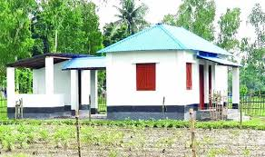
Home work
Write a short composition about birthday by answering the following questions:
When is your birthday?
What do you do on this day?
Whom do you invite on your birthday?
What do people bring for you?
How do you enjoy the day?

Slide 27
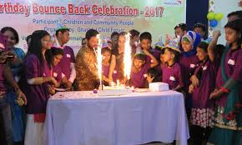
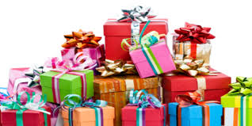
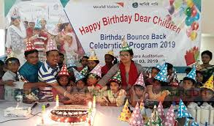
Thank you for your attention, active participation and cooperation throughout the class.
Let’s sing the “Goodbye” song.

Slide 28
Thank you
everybody

