Slide 1
WELCOME

Slide 2
Teacher Introduction
Ishaque Mohammad Ali
Assistant Teacher
Chandina Model Govt. Primary School
Chandina, cumilla

Slide 3
Class:
One
Subject:
English

Slide 4
Lesson:
2
Letter
Aa to Dd

Slide 5
Learning outcomes:
By the end of the lesson the learners will be able to -
1.Say the letters (Aa-Dd)
2.Identify the capital letters (A-D)
3.Identify the small letters (a-d)

Slide 6
Creating emotion
Enjoying Video

Slide 7
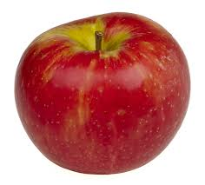
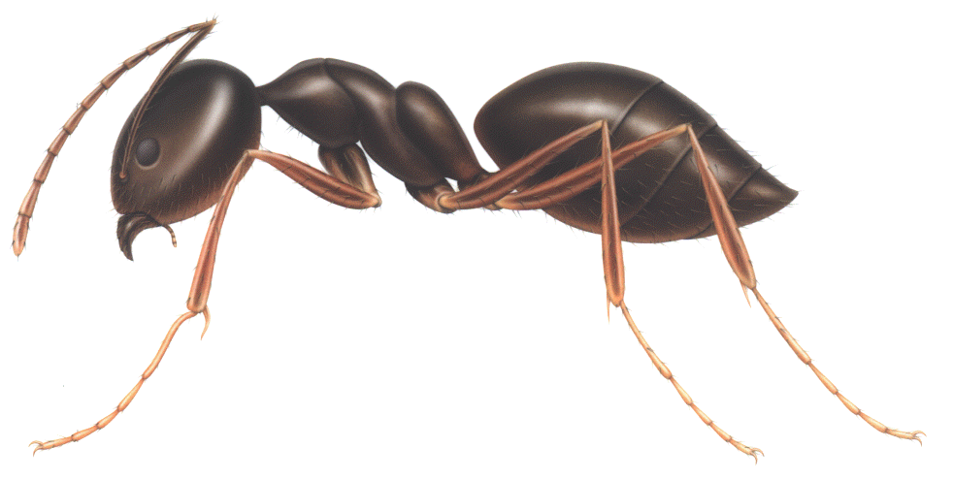
Apple
A
apple
a
Ant
A
ant
a

Slide 8
Ball
B
ball
b
Bat
B
bat
b

Slide 9
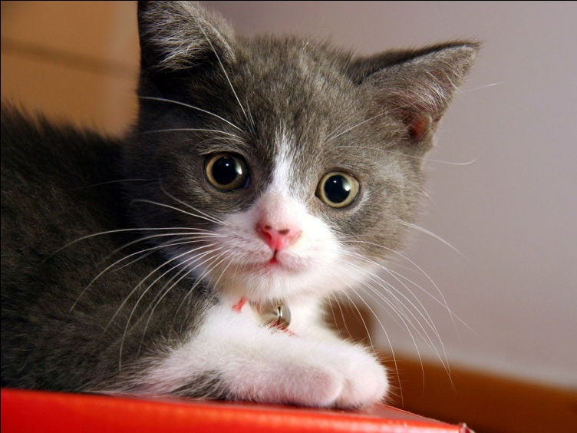
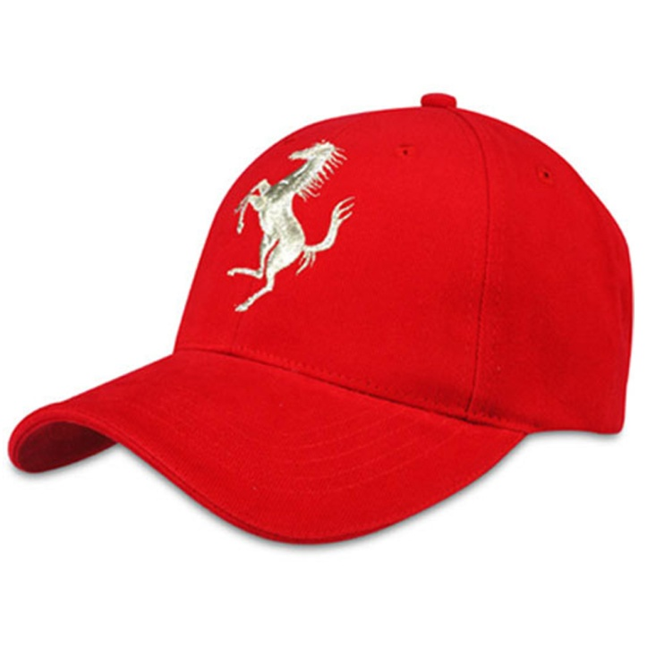
Cat
C
cat
c
Cap
C
cap
c

Slide 10
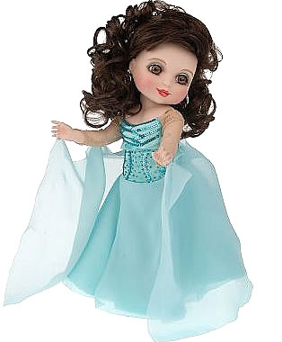
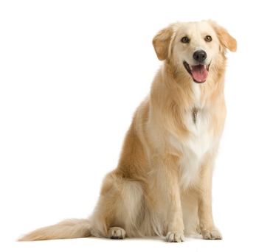
Doll
D
doll
d
D
Dog
d
dog

Slide 11
Cat, Ant, Dog, doll, ball, Bat, Apple, ass, Cap, and, day, Come

Slide 12
Open at page 10

Slide 13
Match:
A
d
B
a
C
b
D
c

Slide 14
Look and say:
A
C
D
B

Slide 15
Look and say:
a
d
b
c

Slide 16
d
b
A
C
c
a
D
B

Slide 17
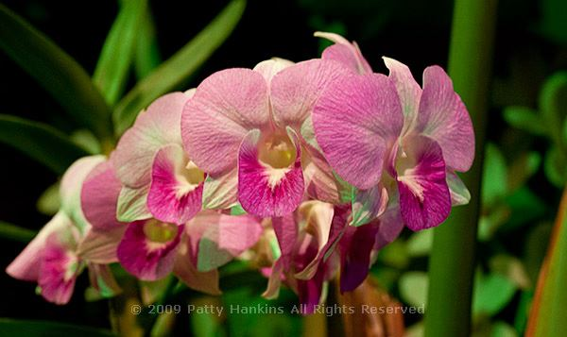
Thanks to all
Good-bye.

