Slide 1
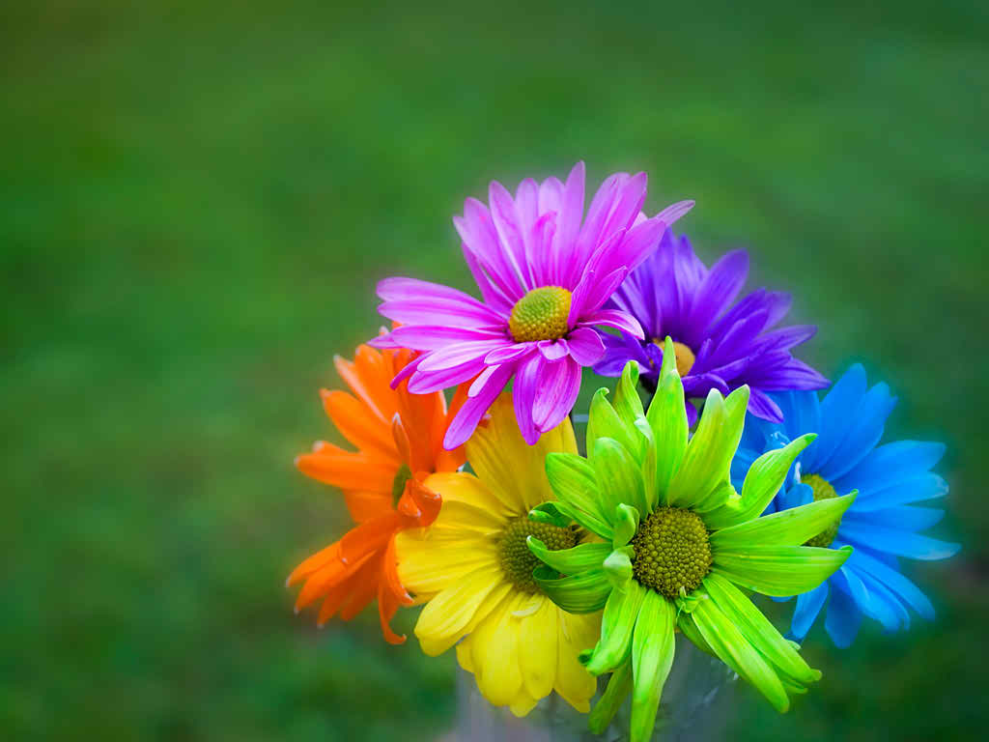
Well come

Slide 2
Teachers interoducction
Zayada Samad Nigar
Head teacher
Bararchar Gov: Pri: School
Palash Norrsingdi

Slide 3
Subject: English
Class: Two
Lesson: Colours
Unite; 16 (A)
Page: 33

Slide 5
To day we read four name of colours

Slide 6
Learning outcome
Student will able to recognize and say the name of the colours

Slide 7
Red
Orange
Yellow
Green

Slide 8
Red

Slide 9
Orange

Slide 10
Yellow

Slide 11
ss
Green

Slide 12
Group
Group a Group b
Roll 1,2,3,4,5,6 Roll 7,8,9,10,11,12
Group c Group d
Roll 13,14,15,16,17,18, Group 19,20,21,22,23,24

Slide 13
Group work
Match with colours box
Red
Yellow
Green
Orange

Slide 14
Match the colour box
Red
Yellow
Green
Orange

Slide 15
Let we open our book page at 33

Slide 16
Every body colour the blank box
Orange
Red
Green
Yellow

Slide 17
red
Orange
Yellow
Green

Slide 18
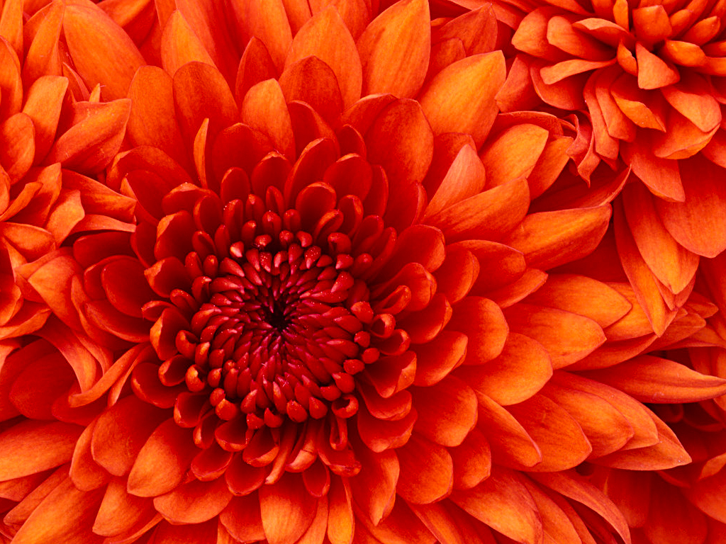
Thanks

