Slide 2
Teacher’s Identity
Lipi Sharma
Assistant teacher
Madhobpur GPS
Chhatak,Sunamganj

Slide 3
LEASON IDENTITY
Class: Five
Subject: English
Unit:3 Lesson:1-2, Saikat’s family
Lesson whole :(Saikat Islam ----and lions).

Slide 4
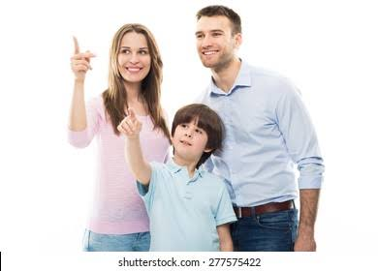
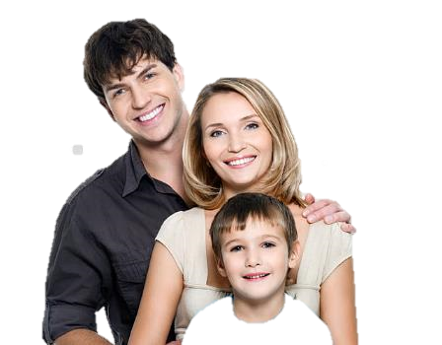
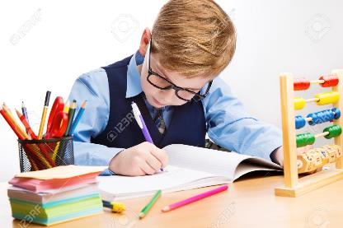
What can you see in the picture?

Slide 5
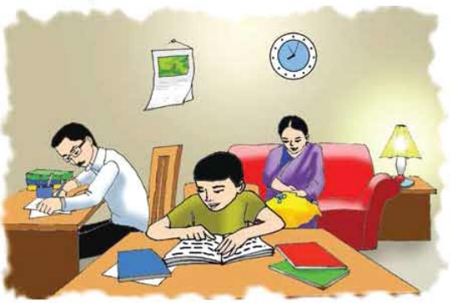
Look at the picture very carefuly
Mother
Son
Father
Do you know who they are ?
It’s a family tree
It’s a family picture

Slide 6
Lesson Declaration
Saikat’s family

Slide 7
Learning outcomes
Students will be able to-
Listening : 3.2.1 Understand questions about family and friends of students.
Speaking : 1.1.1 say words, phrases and sentences with proper sounds,and stress.
Reading : 1.5.1 read words,phrases and sentences in the text with proper pronunciation, stress intonation.
Writing : 8.1.1 Make sentences using words and phrases given in the textbook.

Slide 8
Let’s play a game called word-netting .
Today we will make word net by using the word Family
Tell me some words related to family
Father
Sister
Family
Mother
Brother

Slide 9
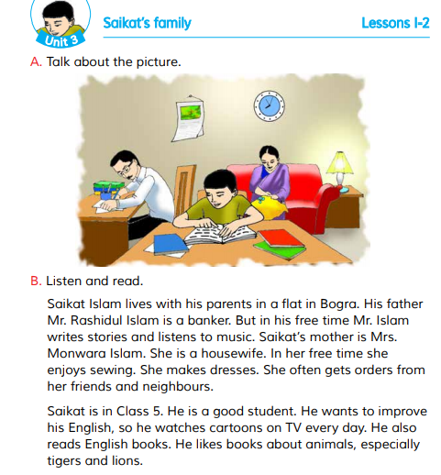
Open at page 10

Slide 10
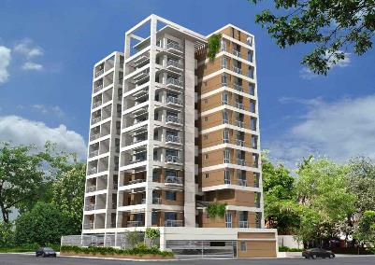
Let’s know the lesson with the picture:
Saikat Islam lives with his parents in a flat in Bogura.
His father Mr. Rashidul Islam is a banker. But in his free time Mr. Islam writes stories and listens to music.

Slide 11
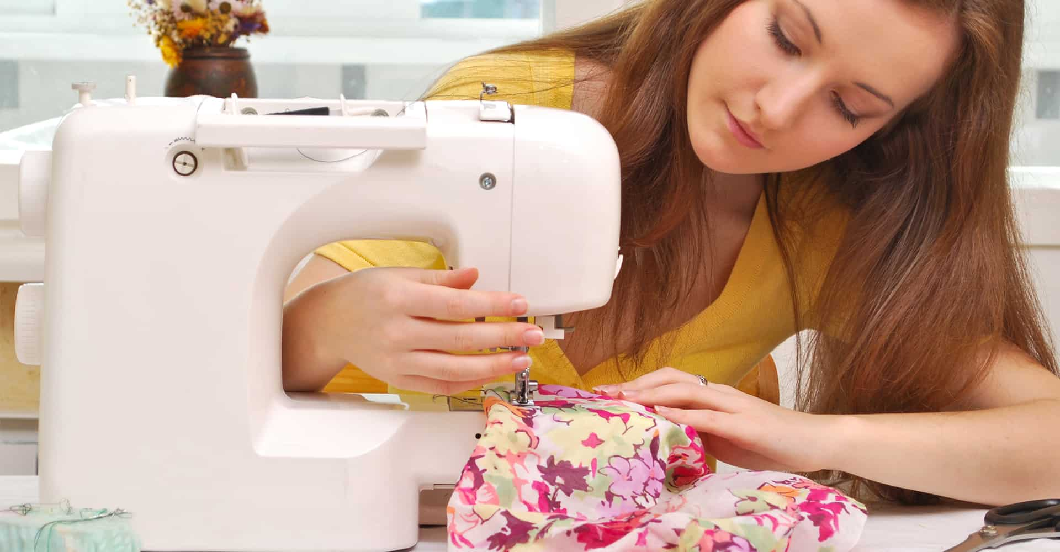
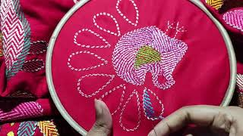
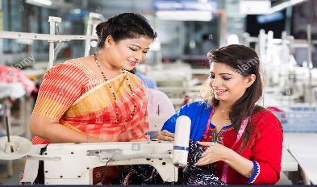
Saikat’s mother is Mrs. Monwara Islam. She is a housewife.
In her free time she enjoys sewing. She makes dresses. She often get orders from her friends and neighbours.

Slide 12
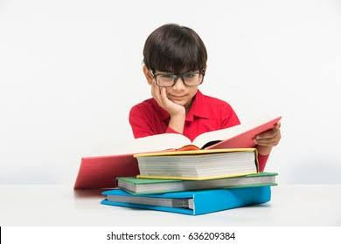
Saikat is in class 5. He is a good student. He wants to improve his English, so he watches cartoons on TV everyday. He also reads English books. He likes books about animals,especially tigers and lions.

Slide 13
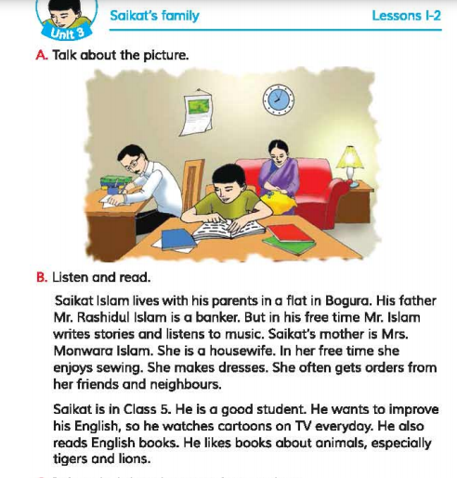
Teacher’s loud reading
Have a look at page 10 of your book:
Listen to me attentively.
Put your finger under the line.
Saikat’s family

Slide 14
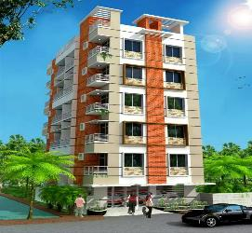
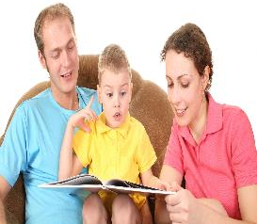
Teaching Vocabularies
Let’s find out new or difficult words:
Flat
A set of rooms for living which is a part of a larger building.
ফ্ল্যাট
Parents
Father and mother.
বাবা-মা

Slide 15
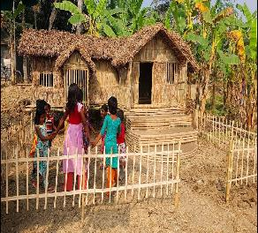
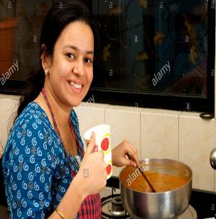
Neighbour
Someone who lives very near to you.
প্রতিবেশী
Housewife
A married woman who works in her house.
গৃহিনী

Slide 16
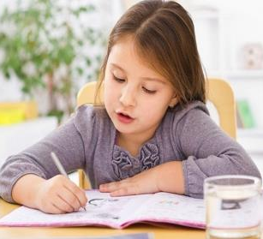
Improve
To get better.
আরো ভালো করা বা হওয়া
Especially
Particularly
বিশেষভাবে

Slide 17
Practice of pronunciation
Neighbour
Flat
Housewife
Practice of pronunciation
Improve
Especially
Parents

Slide 18
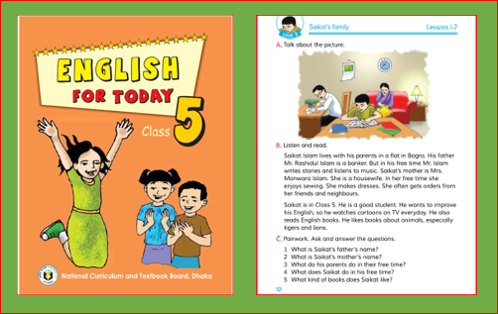
Dear students, open your book at page no 10. Read the text silently.

Slide 19
Let’s play A bingo game
Neighbour
Flat
Housewife
New words
Improve
Especially
Parents

Slide 20
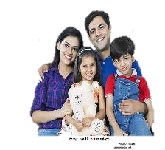
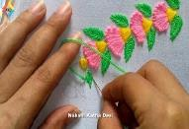
Make sentenec
Family
We have a happy family.
Sew
My mother enjoys sewing.
Music
My father likes to listen music.
Watch
We like to watch cartoons on TV.
This Photo by Unknown Author is licensed under CC BY-SA

Slide 21
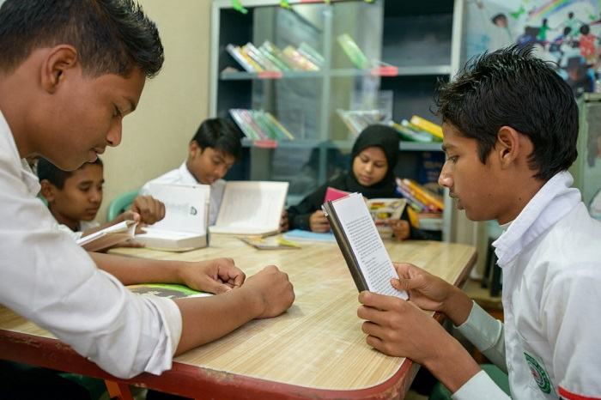
Group work
Group-A
Who is Saikat ?
What is Saikat’s mother’s name ?
Group-B
Group-C
What does Saikat’s father do ?

Slide 22
Pair work
Rearrange the words to make a meaningful sentence:
a) saikat, in, is, 5, class
Let’s check:
Saikat is in class 5.
b) a, student, he, good, is
He is a student.
c) English, to, he, his, improve, wants
He wants to improve his English.
d) also, reads, English, he, books
He also reads English books.
e) a, housewife, is, she
He is a housewife.

Slide 23
Read the questions and try to answer:
Let’s check:
IW
1. a) Who is Saikat?
Ans. a) Saikat is a student.
b) Where does Saikat live?
Ans. b) Saikat lives in a flat.
c) What does Saikat’s father do ?
Ans. c) Saikat’s father is a banker.
d) What does Saikat’s mother do in her free time?
Ans. d) Saikat’s mother enjoys sewing in her free time.
e) What kind of books does Saikat like ?
Ans. e) Saikat likes books about animals, especially tigers and lions.

Slide 24
Match the words of column A with the similar meaning of Column B. Two extra meaning are given in column B.
Column A
Column B
a) Student
i) the activity of making things made of cloth.
ii) a woman who looks after her family.
b) Listen
iii) pupil.
c) Sewing
iv) a description, either true or imaginery.
d) Housewife
v) to teach.
e) Story
vi) hear attentively.
vii) Fond of.

Slide 25
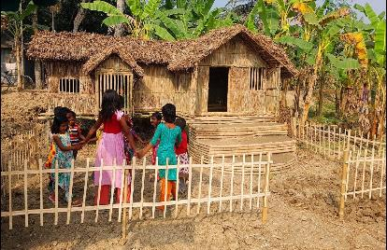
One day one word
Neighbours
প্রতিবেশী
We love our neighbours

Slide 26
Home work
Write a short composition about your Family.

Slide 27
