Slide 1
Good Morning

Slide 2
GREETINGS
Good morning, students
Teacher
Good morning, teacher
Student’s
Teacher
How are you today ?
Fine
Student’s

Slide 3
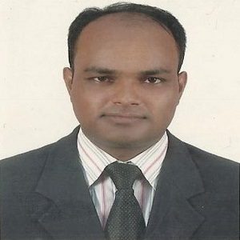
Teacher’s Identity
Lesson Identity
Subject: English. Class: Four. Unit:14, Lesson: 1-2
(Mita’s Day)
MD. ABDUL KADER
Assistant Teacher
Borni Govt. Primary School,
Companigonj, Sylhet.

Slide 4
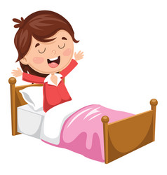
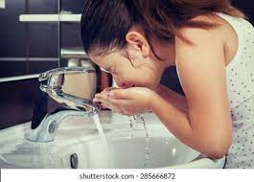
Lets see some pictures
She gets up.
She washes face.

Slide 5
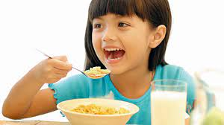
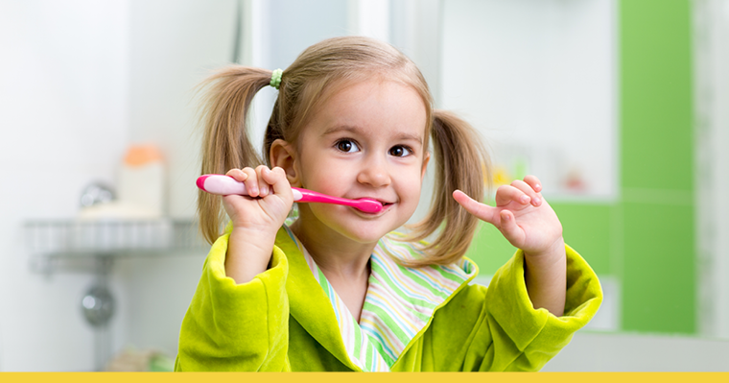
She has breakfast.
She brushes her teeth.

Slide 6
Ok, dear students our today’s lesson is
Mita’s Day

Slide 7
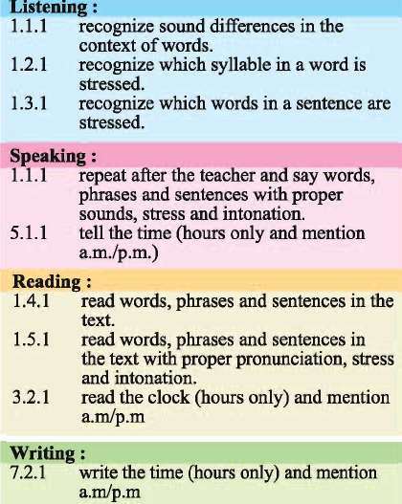
Learning outcomes
Student will able to:

Slide 8
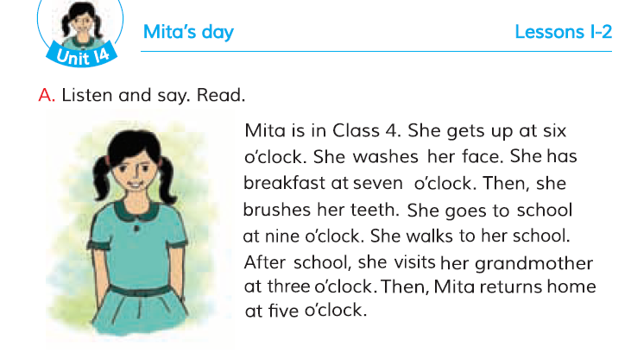
Teacher’s model reading (wcw)
0pen the page 28
First time I read then you will read after me.

Slide 9
Ok, my dear students lets enjoy a video.

Slide 10
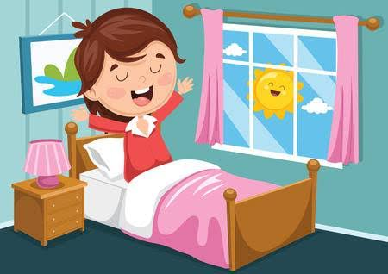
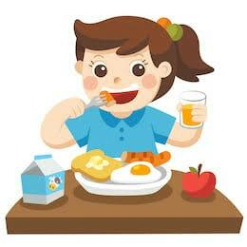
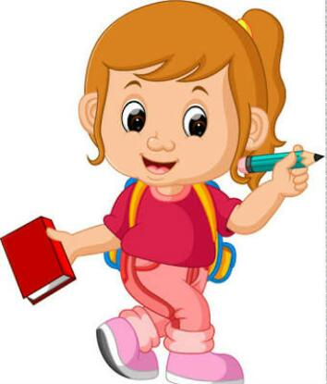
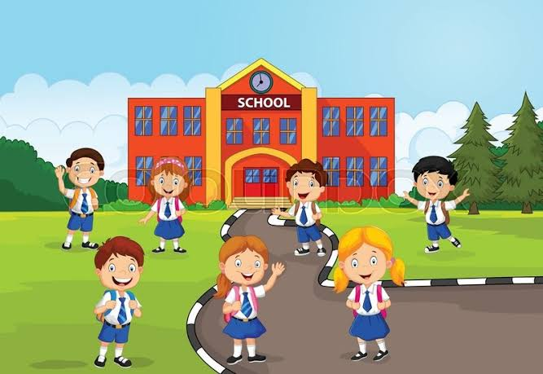
Look at the following pictures tell me what you see in picture.
1
2
3
4
4. When do you return home from school?
2. When do you have breakfast?
3. When do you go to school?
1. When do you get up?

Slide 11
New words with meaning:
Get up: wake up

Slide 12
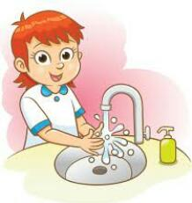
New words with meaning:
Wash: clean

Slide 13
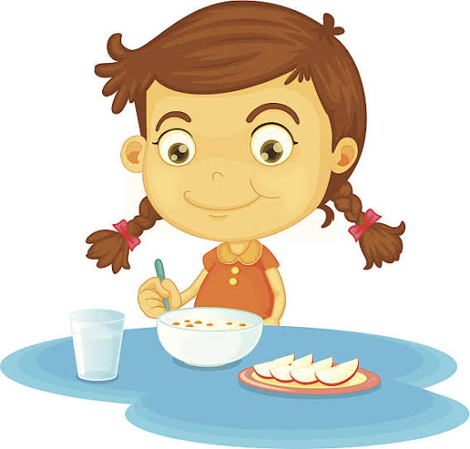
New words with meaning:
Breakfast: a meal eaten in the morning

Slide 14
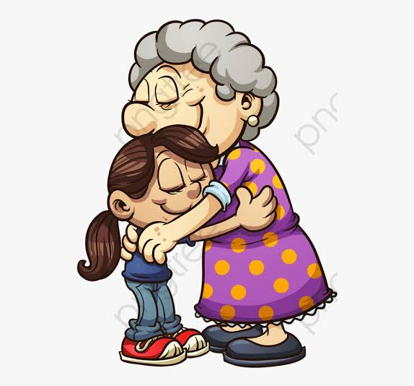
New words with meaning:
Visit: go to see and spend time with (someone) socially.

Slide 15
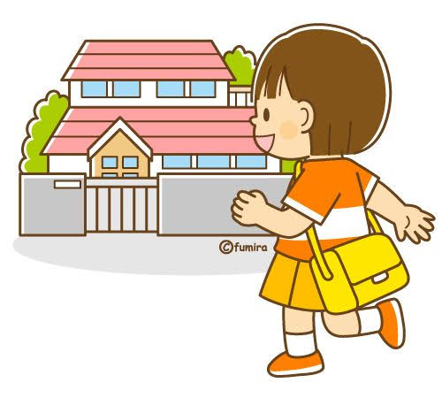
New words with meaning:
Return: come or go back to a place or person.

Slide 16
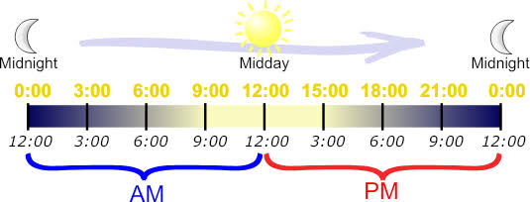
New words with meaning:
am: ante meridian
pm: post meridian

Slide 17
Read the text with group

Slide 18
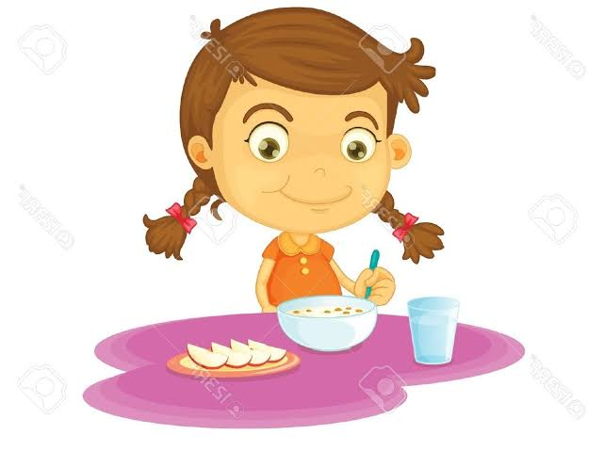
Answer the following questions:
Group work
1. When does Mita get up?
3. Whe does Mita return home?
2. When does Mita have breakfast?

Slide 19
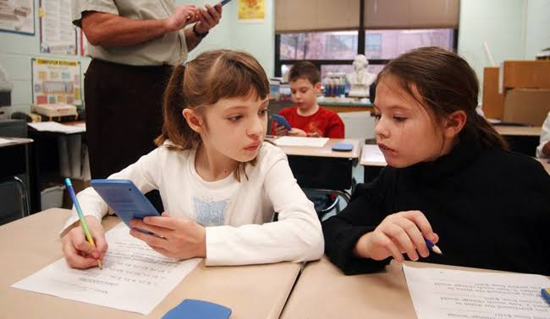
Now you will check your answers with your friend.

Slide 20
Fill up the gaps:
Individual work
1) Mita gets up at …
2) She has breakfast at …
3) She goes to school at …
4) She visits her grandmother at …
5) She returns home at …
1) 6 a.m.
2) 7 a.m.
3) 9 a.m.
4) 3 p.m.
5) 5 p.m.

Slide 21
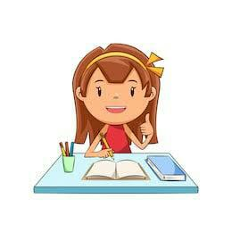
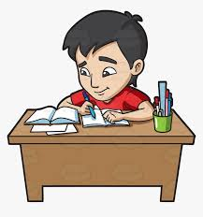
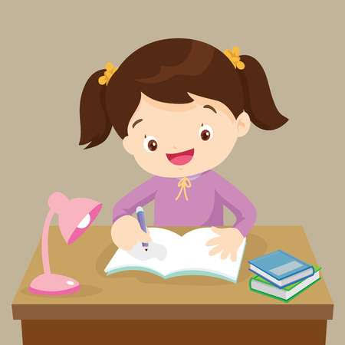
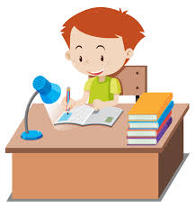
Home work
Write a short composition about your daily routine from the support of Mita’s day using a.m. and p.m.

