Slide 1
Welcome to my class

Slide 2
Introduction of teacher
Lesson introduction
Class-2
Subject-English
Unit-23
Lesson-4-6
Where is it?
SANGITA BISWAS
Assistant teacher
Maulanabad Govt Primary School Jhenidah sadar,Jhenidah.

Slide 3
Learning outcomes-------
Students will be able to-----
3.1.2Understand simple questions and statements about familiar objects .
1.1.2-Say simple words& phrases with proper sound, stress.
3.1.2Ask and answer questions about familiar objects.
1.4.1Read words and phrases with the help of visual clues and simple sentence.

Slide 4
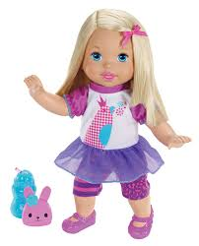
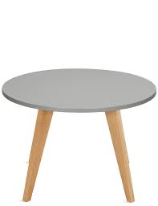
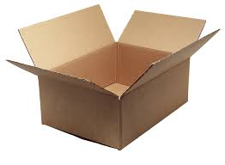
Where is the doll?
On the box
Under the table
In the box

Slide 5
Today’s lesson:
‘Where is it?’

Slide 6
in

Slide 7
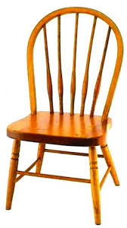
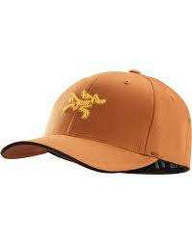
Where is the cap?
on

Slide 8
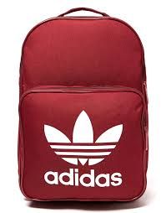
Where is the book?
under

Slide 9
in

Slide 10
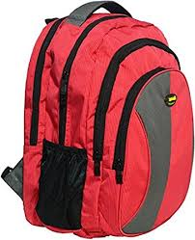
on

Slide 11
under

Slide 12
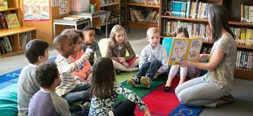
Loud reading by the teacher .

Slide 13
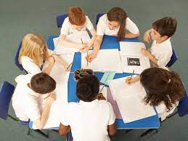
STUDENT READING WITH TEACHER
Then WCW/PW/IW

Slide 14
I W
Look at the picture and fill in the gaps.
The book is ----- the bag.
The book is ----- the bag.
The book is ----- the bag.

Slide 15
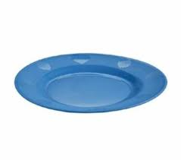
P W
Match the words with picture.
Where is the plate?
on
in
under

Slide 16
Home work
Draw a pen on the bag.

