Slide 1
welcome

Slide 2
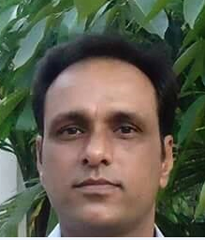
Teacher introduction
Ranadhir Das
Assistant teacher
Dokkhin sangor Govt. Primary School,
Baniachong, Hobiganj.

Slide 3
Class-Four
Subject-English
Unit-39
Lesson:2

Slide 4
Learning Outcomes
1.1.1 repeat after the teacher and say words, phrases and sentences with proper sounds and stress.
6.2.1 takl about people, objects, events.
1.4.1 read words, phrases and sentences in the text.
3.1.1 to write words, phrases and sentences using non-cursive capital and small letters.
Learning Outcomes
Learning Outcomes

Slide 5
Look at the picture

Slide 6
Our today’s lesson is-
Occupations

Slide 7
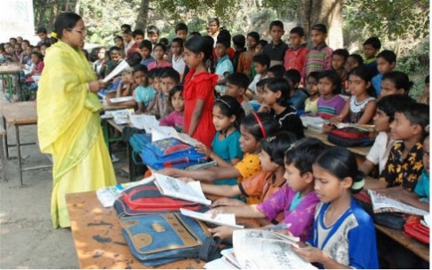
Look at the picture
What is she?
She is a teacher.
What does she do?
She helps us to learn in a school.

Slide 8
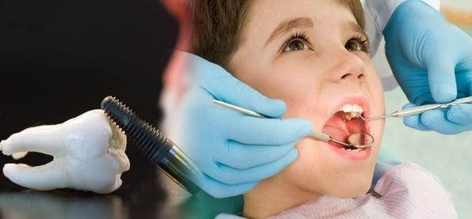
Look at the picture
What is he?
He is a dentist.
What does he do?
He takes care of teeth.

Slide 9
Look at the picture
What is she?
She is a nurse.
What does she do?
She helps a doctor take care of
sick people.

Slide 10
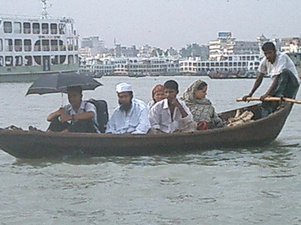
Look at the picture
What is he?
He is a boatman.
What does he do?
He takes people across a river.

Slide 11
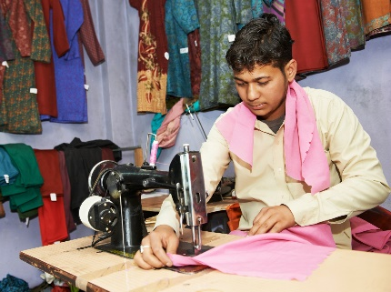
Look at the picture
What is he?
He is a tailor.
What does he do?
He sews and stitches clothes.

Slide 12
Teacher’s reading.

Slide 13
Students reading

Slide 14
Individual work
What does a cleaner do?
Who takes people across a river?

Slide 15
New words-
boatman
cleaner
dentist
tailor
stitch
teeth
across
sew

Slide 16
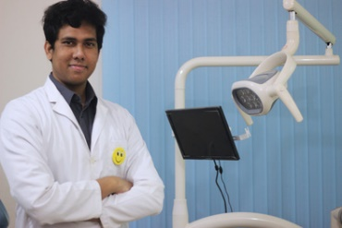
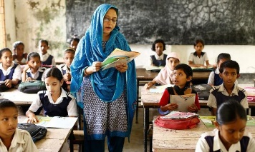
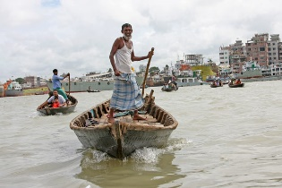
Group Work
Match with the pictures
Boatman
Dentist
Tailor
Teacher

Slide 17
Answer the questions:-
1. What does a teacher do?
2. Who takes care of teeth?

Slide 18
Evaluation
1. Choose the best answer-
a. A tailor …………. Clothes.
b. A cleaner ……… and cleans things.
i. sew
ii. stitches
i. sell
ii. washes
iii. cut
iv. Sew and stitch
iii. buy
iv. make
c. A boatman takes people across a
……… .
d. A dentist takes care of ……. .
i. pond
ii. River
i. leg
ii. teeth
iii. sea
iv. sew
iii. mouth
iv. ear

Slide 19
Answer the questions:-
1. Who washes and cleans things?
2. Who helps a doctor take care of sick people?

Slide 20
Homework
You will write others five occupations that you know in English.

Slide 21
GOODBYE

