Slide 2
IINTRODUCTION OF TEACHER
SANGITA BISWAS
Assistant Teacher
MAULANABAD GOVT PRIMARY SCHOOL<JHENIDAH SADAR<JHENIDAH

Slide 3
CLASS-4
SUBJECT-ENGLISH
S
UB
J
E
C
T
&
C
L
A
S
S

Slide 4
Lesson Introduction
Lesson:12
Lesson Title:
Days Of the Week

Slide 5
Learning outcomes:
After this lesson the students will be able to-
7.1.1 write names of the days of the week with proper spelling.

Slide 6
To day’s topic
[
Look and discuss in pairs.
Then try to find the missing
words.
Yesterday was ........... .
Today is .................... .
Tomorrow will be ............ .
Days of the Week

Slide 7
S
e
v
e
n
D
a
y
s
of
the
W
e
e
k
Days of the Week
Sunday
Monday
Tuesday
Wednesday
Thursday
Friday
Saturday

Slide 8
Lets Try to spell properly.
the students will try to spell loudly with teacher
Sunday
Wednesday
Monday
Thursday
Tuesday
Friday
Saturday

Slide 9
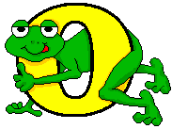
Lets Try one more.

Slide 11
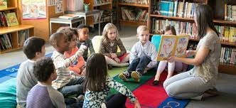
Teacher’s reading
Teacher will read loudly and the students will also read loudly with teacher.

Slide 12
Lets Try to understand..
Sunday
First day of the week.
Weekdays
or
Working days
Monday
Second day of the week.
Tuesday
Third day of the week.
Wednesday
Fourth day of the week.
Thursday
Fifth day of the week.
Friday
Weekend
Sixth day of the week.
Saturday
Seventh day of the week.

Slide 13
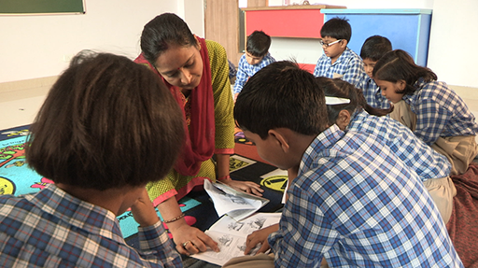
Group work
the students will try to read the names of the days and spell loudly in group.

Slide 14
Evaluation
1. Fill in the gaps with proper letter:
a. Su...day
r
r
b. Tue...day
o
o
c. We...nesday
u
u
d. Fr...day
d
d
b. M...nday
s
s
c. Sat...rday
i
i
d. Thu...sday
n
n

Slide 15
Ask and answer in pairs
Q. How many days are there in a week ?
A. There are ........................
seven days.
Q. What is the first day of the week ?
A. It is ........................
Sunday.
Q. What day is it today ?
A. It is ........................
Saturday.
Q. What day was it yesterday ?
A. It was ........................
Friday.
Q. What day will it be tomorrow ?
A. It will be ........................
Sunday.

Slide 16
Ask and answer in pairs
Q. What is the last day of the week ?
A. It is ........................
Saturday.
Q. What is the second day of the week ?
A. It is ........................
Monday.
Writing skill test
Now everyone try to write the names of the seven days in your own note book using capital and small letters as needed.

Slide 17
Thanks
Good bye

