Slide 1
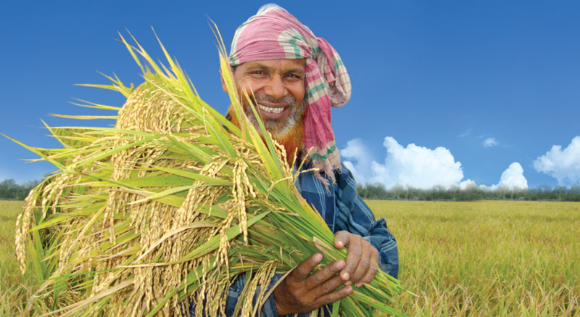
Good
morning
Welcome
everybody
to
my
multimedia
class.

Slide 2
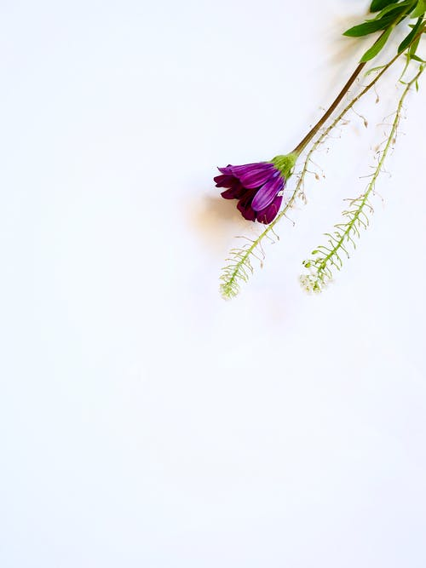
 Prepared By 
Introduction to lesson
Md. Sultan-ul Arefin
Assistant Teacher
Gurudaspur Model Govt. Primary School
Gurudaspur, Natore.
Class : Five
Subject : English
Unit : 9
Lesson Title : Occupation
Lesson : 5-6 (Activity-H)
Duration : 35 minutes

Slide 3
Let’s watch a video clip
Have you enjoyed the video clip?

Slide 4
Let’s see some pictures

Slide 5
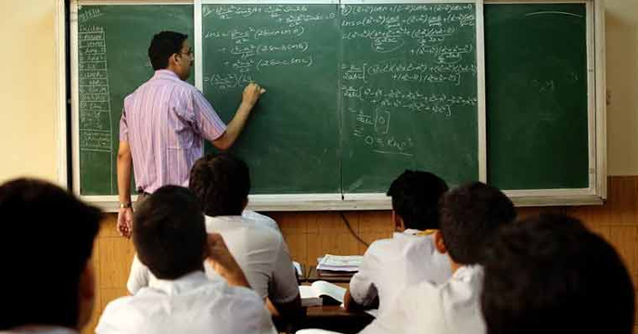
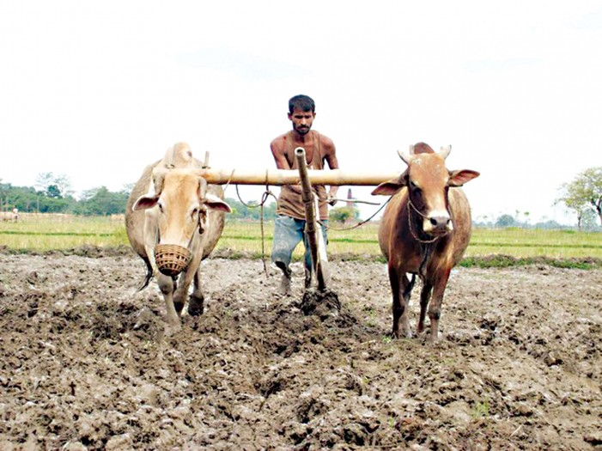
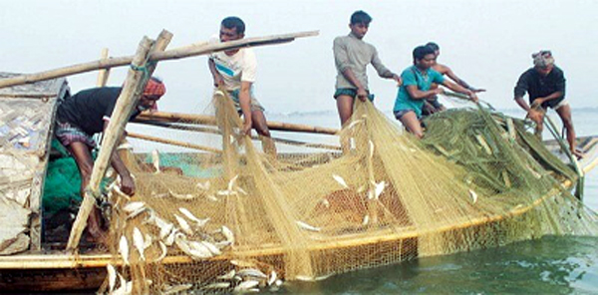
What can you see in the pictures?
Teacher
Farmer
These are different occupations
What do they do?
Say two sentences about the each picture.
Fisherman
Doctor

Slide 6
Lesson Declaration
Well, To day we are going to read-
Occupations
- Activity H

Slide 8
Checking the previous class:
Students, please answer the following questions.
What does a dancer do?
What does a painter do?
What does a cultivator do?

Slide 9
Dear students, now look at the activity H attentively. Now you have to write a composition considering the following questions.
H.

Slide 10
Dear students, please look at the board. I am writing something on the board. It may help you to write the composition-
The person’s name is Soma. Sha teaches. She works in a college. She starts work at 8.30 a.m. She likes her job very much as she has a passion for teaching. Her job is very important as teachers are the bachbne of a nation.

Slide 11
Dear students, please write the activity H from your text book considering the following questions. .
H.

Slide 12
Playing Game
Dear students, now we are going to play a game. It is called “Bingo Game”. Listen the instruction carefully.
After playing the game I will rewards the winner(s).

Slide 13
Let’s play the bingo game.
Farmer
Teacher
Singer
Tailor
Pilot
Poet
Driver
Actor

Slide 14
Lesson Evaluation
My dear students, what have we learnt from today’s lesson?
Well, “We’ve learnt about how to write a short composition by the help of some questions”

Slide 15
Task
Home work
Write a short composition about a person you know.

Slide 16
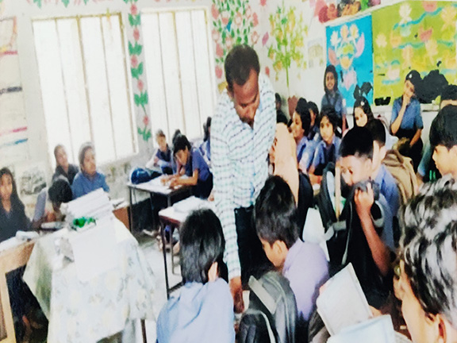
Thank you all
See we tomorrow

