Slide 2
Presented by:

Slide 3
Lesson information Subject-English Class-1 Unit-8 Lessons(1-3)
Part of lesson: A.b.
Look,listen and say.

Slide 4
Learning outcome:
At the end of the lesson, students will be able to
3.1.2-understand simple questions about familiar objects.
3.1.2-answer questions asked by the teacher about a few familiar objects.

Slide 5
Let us enjoy a greeting song.

Slide 6
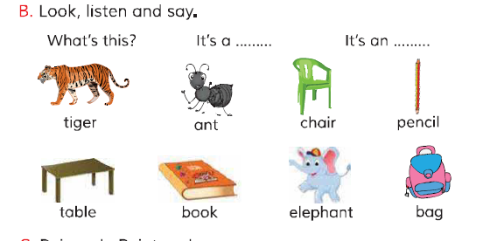
Look at the picture.

Slide 7
Individually work.

Slide 8
Look at the picture.

Slide 9
Look at the picture.

Slide 10
Look at the picture.

Slide 11
Look at the picture.

Slide 12
Look at the picture.

Slide 13
Look at the picture.

Slide 14
Look at the picture.

Slide 15
Look at the picture.

Slide 16
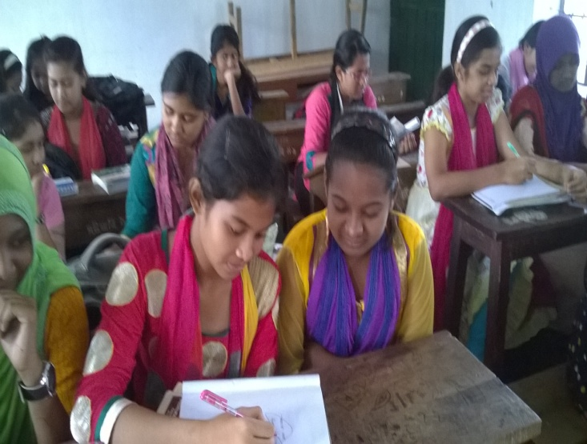
Pair work.What's this?

Slide 17
Listen and say.What's this?

Slide 18
Listen and say.What's this?

Slide 19
Listen and say.What's this?

Slide 20
Listen and say.What's this?

Slide 21
Listen and say.What's this?

Slide 22
Listen and say.What's this?

Slide 23
Listen and say.What's this?

Slide 24
Listen and say.What's this?

Slide 25
Now we’ll work in group.
Answer the following questions.

Slide 26
Tiger

Slide 27
Ant

Slide 28
Chair

Slide 29
Pencil

Slide 30
Table

Slide 31
Book

Slide 32
Elephant

Slide 33
Bag

Slide 34
Make sentence by each ward.

Slide 35
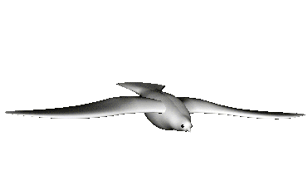
Wish you good luck for today and good bye.

