Slide 1
Welcome to everybody

Slide 3
SANGITA BISWAS ASST.TEACHER MAULANABAD GOVT.PRIMARY SCHOOL
JHENIDAHA SADAR<JHENIDAH

Slide 4
CLASS-4 SUBJECT-ENGLISH
Lesson-FAMILY

Slide 5
Learning out come:
Students will be able to:
1.2.1
Understand basic English sounds,words,phrases in proper stress and intonation.
3.1.1
Read the text with proper pronunciation ,stress and intonation.

Slide 6
WARM UP:BY GOOD MORNING SONG
PLAYING EIA AUDIO SONG

Slide 7
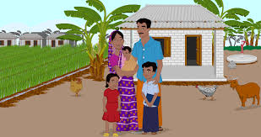
LESSON DECLARATION:
Today we will read about family
Family

Slide 8
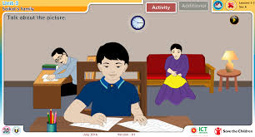
What are you looking this picture?
What are you looking this picture?
This is a joint family.
This is Single family.

Slide 9
Joint family
where parents,grandparents,childrens,uncle,aunt,cousins live together.
Single family
Where only parents and childrens live together.

Slide 10
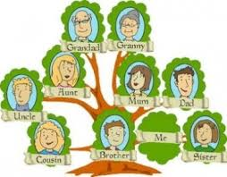
Family Tree

Slide 11
Connect of Text
Open your book @ page no 6.

Slide 12
:Teacher’s reading.
SS reading with teacher
Eleciting new words
SS reading with pair/group
Individual reading

Slide 13
Evaluation
Write 5 sentences about your family.

Slide 14
THANKS

