Slide 1
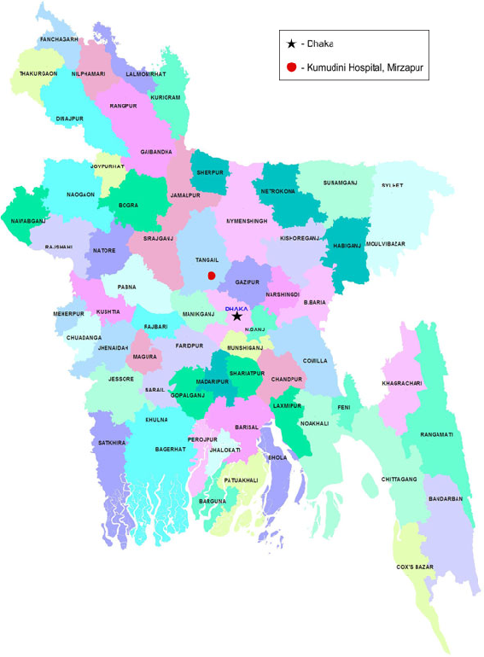
my
dear
students

Slide 2
Prepared By
Lesson Detail
Md. Sultan-ul Arefin
Assistant Teacher
Gurudaspur Model Govt. Primary School
Gurudaspur, Natore.
Class: Five Unit: 10 Lesson: 1 Lesson Title: My home district. Today’s lesson: A (Read)
Part of the lesson: My home…through the town.
Time: 40 minute

Slide 3
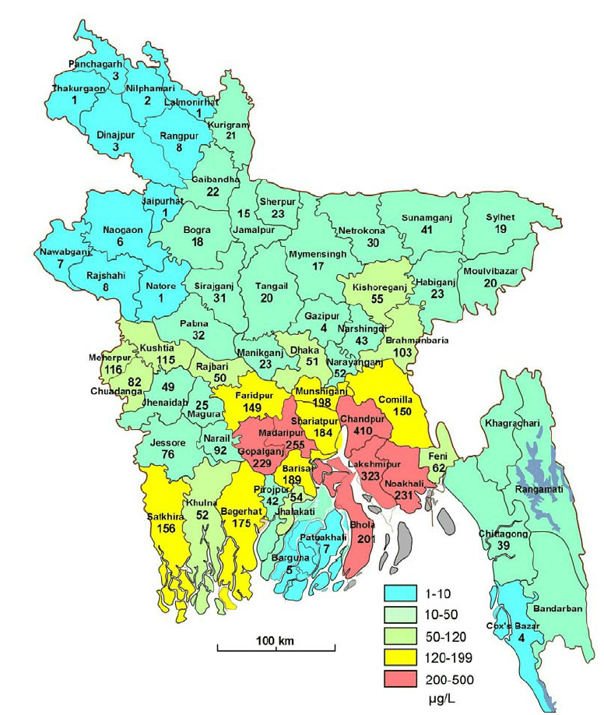
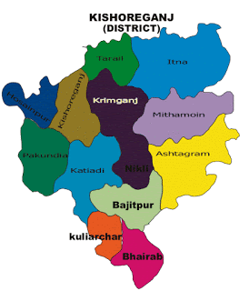
Map of Bangladesh
Map of Kishoregonj District

Slide 4
Declaration of Topic
Well, To day we are going to read-
My home district
A. Read about Mamun’s home district. Page: 38

Slide 5
Learning outcomes
Students will be able to-
Speaking
1.3.1 recognize which words in a sentence are stressed.
3.3.1 understand questions about objects around them.
3.4.1 understand statements made by the teacher and students.
Listening
1.1.1 say words, phrases and sentences with proper sounds and stress.
1.1.2 say sentences with proper intonation.
Reading
1.5.1 read words, phrases and sentences in the text with proper pronunciation, stress and intonation.
1.6.1 recognize and read statements, commands, greetings, questions and answers.

Slide 6
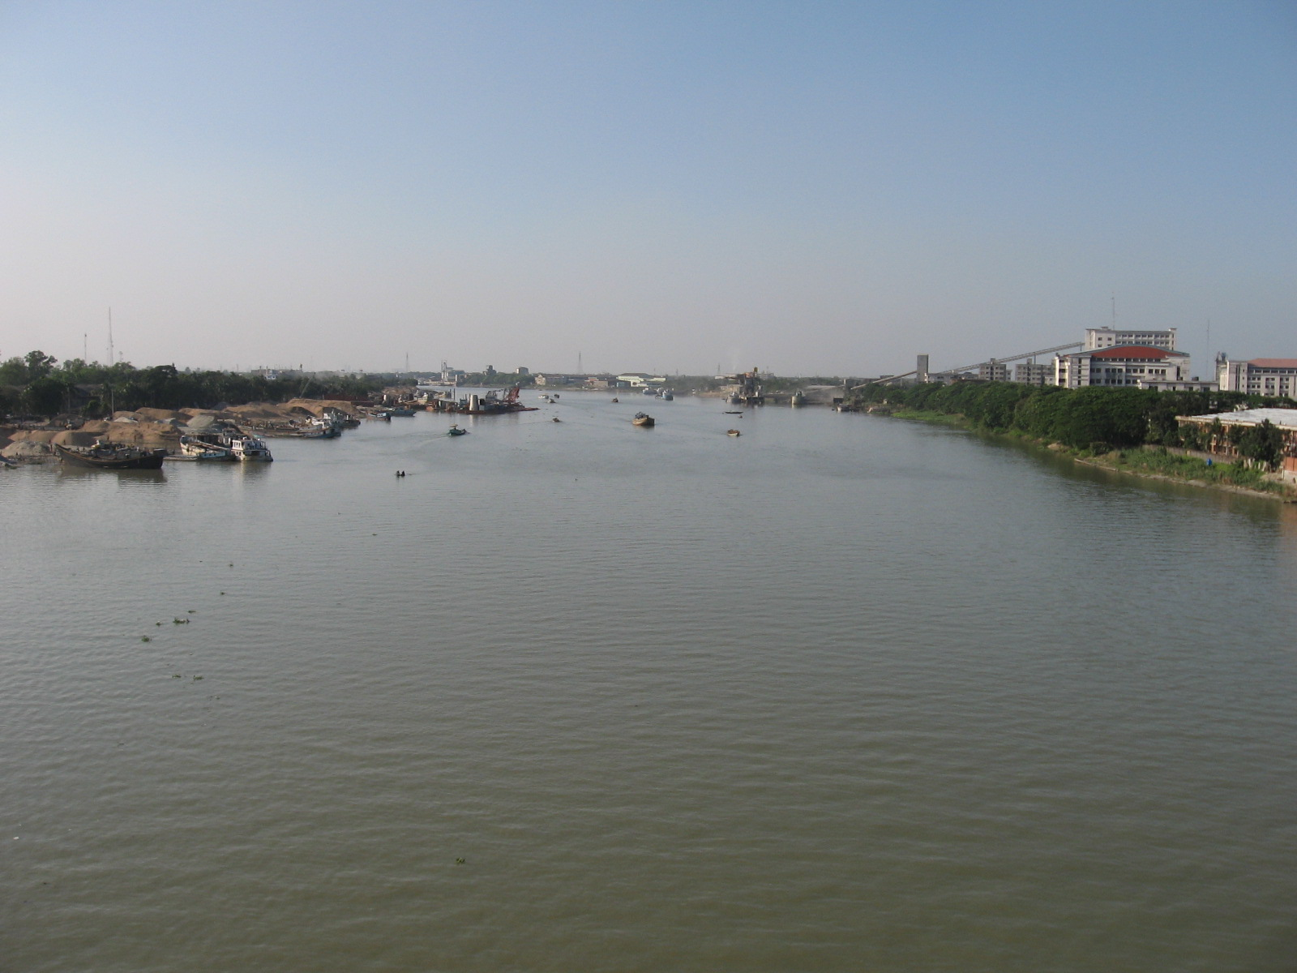
Kishoregonj municipality
River Narasunda

Slide 7
Kishoregonj
8
municipalities
13
upazilas
108
unions
1794
villages
About
Kishoregonj

Slide 8
Area
Place
Vocabulary teaching
Aged
Old
Flow
Move
Across
Through
Landlord
Landower
Quadrangle
Square

Slide 9
A
B
a. Area
i. Aged
b. Landlord
ii.
Match the words of the column A with their similar meaning in column B
c. Through
iii. Place
d. Old
iv. Move
v. Landower
e. Flow
vi.
vii. Across

Slide 10
Teacher’s Model Reading
Dear students, open your English book at page 34. I am reading the text loudly, please put your fingers on the text.

Slide 11
Practice
Group Reading
In this stage the students will read the text in group.

Slide 12
Practice
Pair Reading
In this stage the students will read the text in pair.

Slide 13
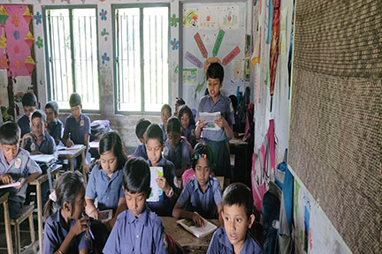
Practice
Individual Reading
In this stage one student reads the text and others listen.

Slide 14
Practice
Silent Reading
Students, please read the
text silently and try to understand.

Slide 15
Group work
Ask and answer the question orally
Upazila Group
Union Group
Village Group
Say the name of some important places of Kishoregonj.
What is the size of Kishoregonj town?
What does consist the Kishoregonj district?
How far is Kishoregonj from Dhaka?

Slide 16
Pair work
Ask and answer in pair.
1. How far is Kishoregonj from Dhaka?
2. How many municipalities and upazilas are there in Kishoreganj?
3. How did Kishoregonj get its name?
4. Which river flows through the town?

Slide 17
Task
Put tick mark on the correct answer:
1. How many municipalities are there in Kishoreganj?
a. 8
Wrong answer
b. 9
Wrong answer
c. 10
Correct answer
d. 11
Wrong answer

Slide 18
2. How many upazilas are there in Kishoreganj?
a. 10
Wrong answer
b. 11
Wrong answer
c. 12
Correct answer
d. 13
Wrong answer

Slide 19
3. How many unions and in Kishoreganj?
a. 15
Wrong answer
b. 14
Wrong answer
c. 13
Correct answer
d. 12
Wrong answer

Slide 20
4. Which river flows through the town?
a. The Padma
Wrong answer
b. The Jamuna
Wrong answer
c. The Narasunda
Correct answer
d. The Fuleshwari
Wrong answer

Slide 21
Checking the learner’s learning
I will check the each and every student’s works properly. I will also directly help the weak student’s if they needed.

Slide 22
Task
Home work
Read the text attentively at your home.

Slide 23
Dear student, please stay safe and use musk.
See you later, bye………

