Slide 1
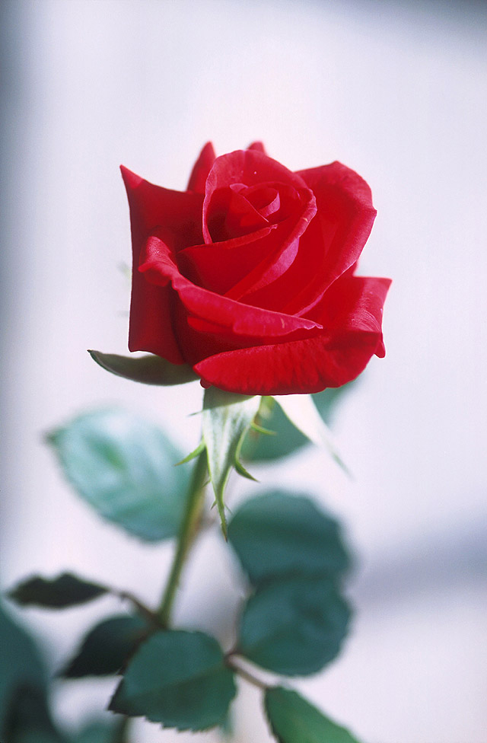
Well come

Slide 2
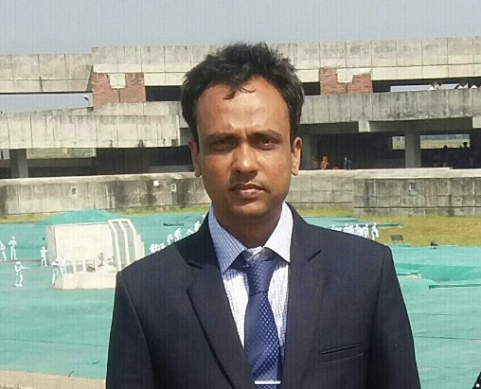
identity
Englsish 1st paper
Unit : five
Lesson :2
Time 45 mnts
18/4/2021
Md Hasanul Kabir
Lec in English
H. A, Harindia Alim Madrasa
Harindia , Kotchandpur, Jhenaidah

Slide 3
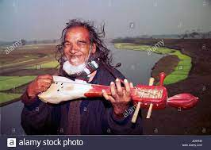

Slide 4
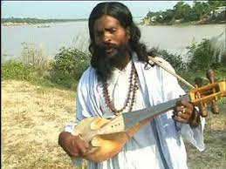
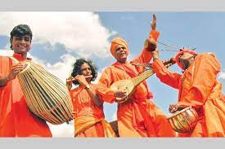

Slide 5
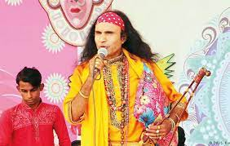

Slide 6
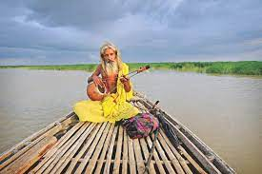

Slide 7
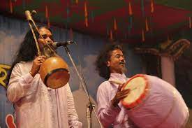

Slide 8
Lesson declaration
Folk music

Slide 9
At the end of the lesson
You will be able to know
About folk music
Characteristics of folk music
Names of different of folk songs
Vocabularies

Slide 10
folk music
noun
music that originates in traditional popular culture or that is written in such a style. Folk music is typically of unknown authorship and is transmitted orally from generation to generation.

Slide 11
According to the passage
Folk misic may be described as that type of ancient music which springs from the heart of a community , based on their natural style of expression uninfluenced by the rules of classical music and modern popular songs.

Slide 12
The characteristics of folk music.
To be composed by rural folk
To be sung in groups or individually
No regular practice is required for it
To be sung and to be performed by illiterate or semi literate persons.
To contain a strong emotive expression of human love and separation

Slide 13
Some names of folk music.
Baul: Birbum and Kustia.
Jari : Dhaka, Myamansing, Sylhet, chattagram, Faridpur, Murshidabad.
Gambhira : Rajsahi, Dinajpur,Pabna, cooch bihar.
gambhira : Rajsahi , Malda.
Besides those songs, there are sari , vatiyally and many pastoral songs.

Slide 14
classicial | Established
mysticla | Spiritual
metaphor | Allegory
interact | Coperate
emotive | Passonate
inequality | Injustice
combination | Addition
secular | Nonrelegious
sophisticated | Refined
distinctive | specific

Slide 15
Single work
What is folk misic?
Who generally sing?
Is there any variety in the song?
Do you know how to sing any folk music? If it is , you can sing.

Slide 16
Group work
What are the characteristics of folk music?
Where do we see the environment of arranging the concert ?

Slide 17
Home work
Write a paragraph about folk music
Write a dialogue between two friends about folk music

Slide 18
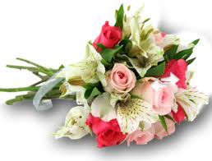
When more again
inshaallah

