Slide 1
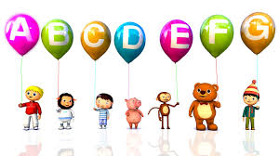
Welcome to English Class

Slide 2
Presented By
Lesson Identity
Kamrujaman
Asst. Teacher
Paschim chhatnai Govt. Primary School
Dimla,Nilphamary
Class: 1
Subject: English
Lesson:alphabet song Lesson:4-6
Unit:1

Slide 3
Alphabet song

Slide 4
Lets see a video

Slide 5
Listen,say and sing
a b c d e f g
h l j k l m n o p
q r s t u v
w x y z
Now I know my a b c,
Next time sing along with me!

Slide 6
Open your EFT book at page no.3 and
read loudly with me.

Slide 7
BYE

