Slide 1
w
E
C
O
M
E
L

Slide 2
Presented by
Shamsunnahar
Assistant teacher
Nabinagar west government primary school
Nabinagar,Brahmanbaria.

Slide 3
Class:four
Subject:English
Lesson:Unit 6(Lessons 1-2)
Todays lesson: At the shop
Time: 30minute
Date:-- 12/04/2021

Slide 4
Learning outcoms:
Students will be able to :
1.1.1 recognice sound differences in the context of word.
3.4.1 understand statements made by the teacher and students
2.1.1 recognize and read cardinal number from 101-500.
Listening
Speaking
Reading

Slide 5
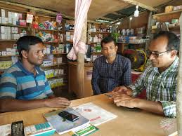
What can you see in the picture:

Slide 6
Todays lesson
At the shop

Slide 7
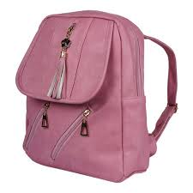
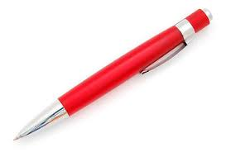
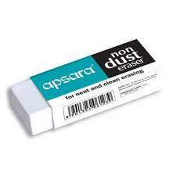
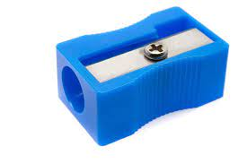
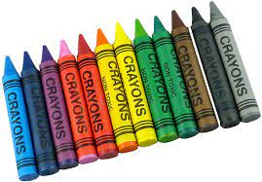
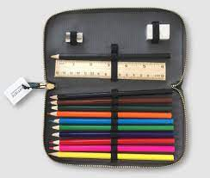
Now we saw some picture

Slide 8
Can you say this name?
Thies name are-
pencil
pen
eraser
bag
sharpener
paper
crayons
Pencil case

Slide 9
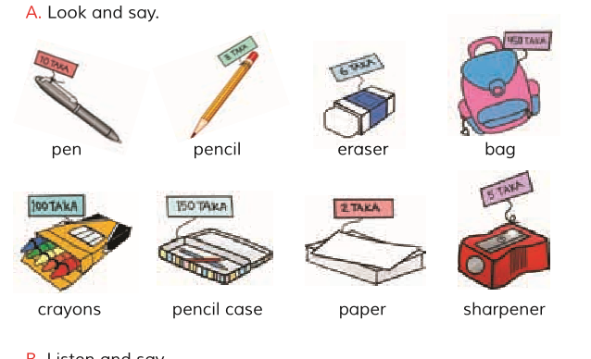
How much each of them cost?

Slide 10
pencil
eraser
pen
bag
Lets game
sharpener
paper
crayons
Pencil case

Slide 11
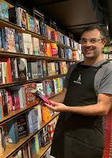
Now we will listen to a dialogue between a salesperson and Tania.
Can I help you?
Yes,please.I’d like two pens,a pencil and a piece of paper.

Slide 12
Anything else?
Yes,a pencil case,please.
Ok.That’s 150 taka.
Here you are.

Slide 13
You gave me 200 taka.That’s 50 taka change.
Thank you.Bye.
Thank you.Bye.Come again.

Slide 14
Indivisual read in silent
Can I help you?
Yes,please.I’d like two pens,a pencil and a piece of paper.
Anything else?
Salesperson
Tania
Ok.That’s 150 taka.
Yes,a pencil case,please.
You gave me 200 taka.That’s 50 taka change.
Here you are.
Thank you.Bye.Come again.
Thank you.Bye.

Slide 15
Pair work:
Act the dialogue which was between Tania and the Salesperson.

Slide 16
Home work
Write a dialogue between you and a salesperson.

Slide 17
H
T
s
N
k
A

