Slide 1
WELCOME

Slide 2
IDENTITY
GOLAM HOSSAIN
Senior Teacher (English)
Govt. Science School & College,
Tejgaon, Dhaka
Email : hossainsalim2001@ gmail.com
Phone : 01913138642
Class - Nine
Subject – English
1st Paper
Unit – Five
Lesson - Two
Date : 27.04.2021

Slide 3
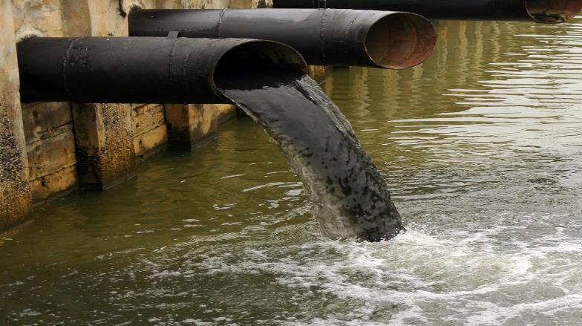
What can you see in the pictures?

Slide 4
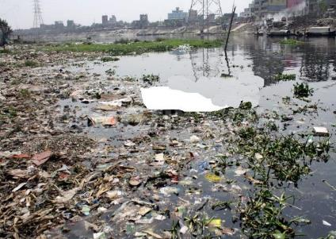
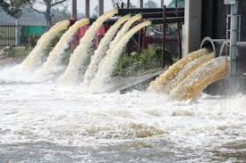

Slide 5
Let’s Watch a Video

Slide 6
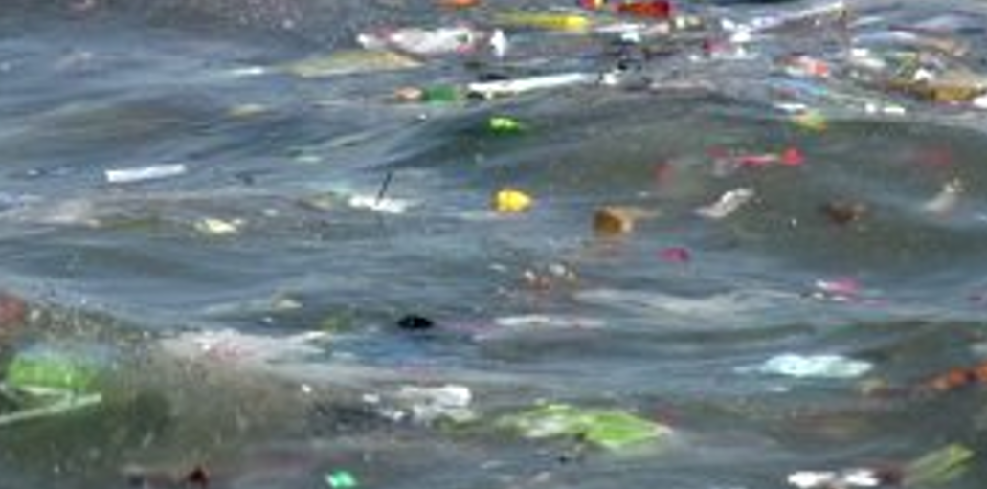
Today’s lesson is… Water Pollution.

Slide 7
Learning Outcomes
By the end of this lesson students will be able to…
tell about pollution .
tell some words meaning and synonym.
describe and write about the causes of water pollution.
explain bad effects of water pollution.

Slide 8
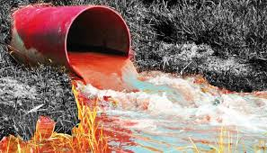

Slide 9
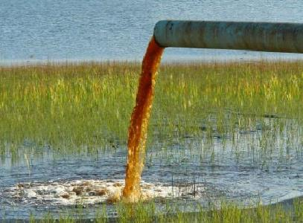
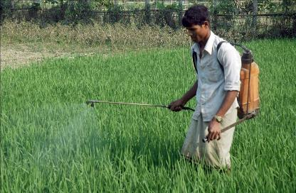

Slide 10
Word meaning
Ocean
Sea
Leakage
Escape
Pesticide
Pest-killing compound

Slide 11
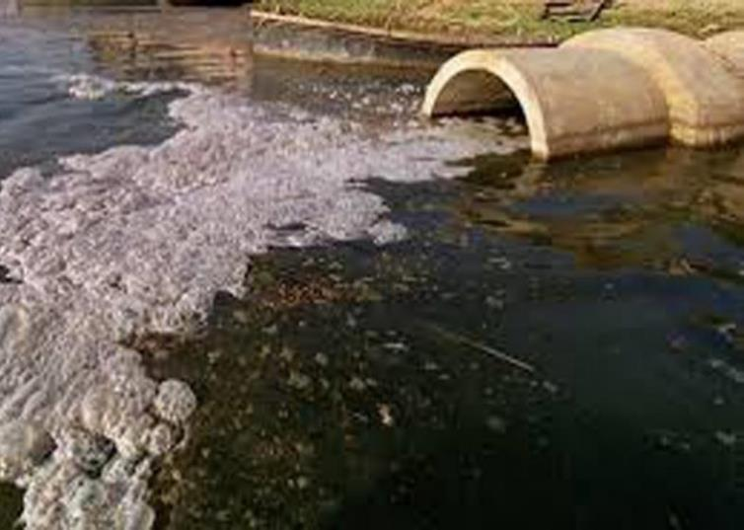

Slide 12
Pair work
Write about the causes of Water Pollution.

Slide 14
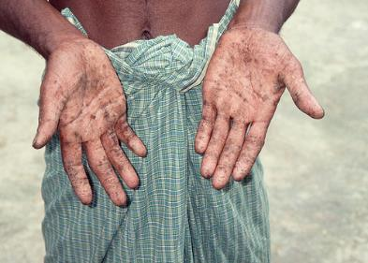
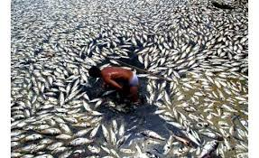

Slide 15
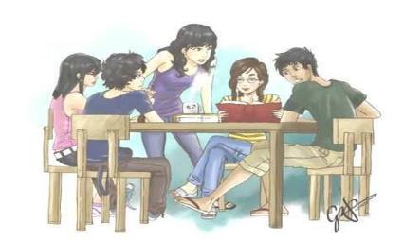
Group Work
Water Pollution is dangerous for man and animal’s; Explain it.

Slide 16
Evaluation
What is water pollution?
How is water polluted?
What are the effects of polluted water to man?

Slide 17
HOME WORK
Write a short paragraph about Water Pollution.

Slide 18
Thank You

