Slide 1
Good morning
ALL THE STUDENTS

Slide 2
IDENTITY
MD.Jahangir alam
Assistent Teacher
Vedvedi Govt.Primari School,
Rangamati, sadar.

Slide 3
LESSON IDENTITY
Subject: English
Lesson : 4-5
Lesson part- A
Unit : 2 (Alphabet)
Time : 35 mn
Class:1

Slide 4
Learning Outcomes:
Students will be able to -
1.1.1 –becomes familiar with English sound by listing to common English words.
1.1.1 – repeat after the teacher simple words and phrases.
1.1.2 – say simple words and phrases.
1.2.1 – recognize and read the alphabet both small and capital (non-cursive)
1.1.1-to practice letter shapes/ simple writing patterns etc.
1.2.1- write non-cursive capital letters small.

Slide 5
LOOK LISTEN AND SAY.
A
a
B
b
C
c

Slide 6
LOOK LISTEN AND SAY. TRACE IN THE AIR.
A
a
CAPITAL LETTER
SMALL LETTER

Slide 7
SAY AND READ. TRACE AND WRITE.
A
--------------------------------------------------------------------------------------------------------------------------------------------------------------------------------------------------------------------------------------------------------
-------------------------------------------------------------------------------------------------------------------------------------------------------------------------------------------
a

Slide 8
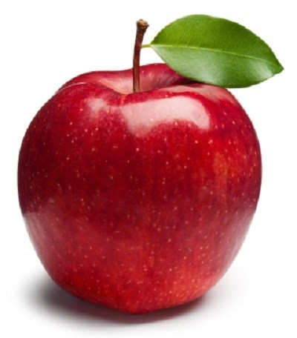
What is this ?
Apple

Slide 9
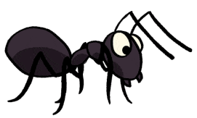
LOOK LISTEN AND SAY.
ant

Slide 10
LOOK LISTEN AND SAY.
Apple
ant

Slide 11
LOOK LISTEN AND SAY. TRACE IN THE AIR.
B
b
CAPITAL LETTER
SMALL LETTER

Slide 12
SAY AND READ. TRACE AND WRITE.
B
--------------------------------------------------------------------------------------------------------------------------------------------------------------------------------------------------------------------------------------------------------
b
-------------------------------------------------------------------------------------------------------------------------------------------------------------------------------------------

Slide 13
LOOK LISTEN AND SAY.
B
b
BAG PLAY BALL

Slide 14
LOOK LISTEN AND SAY.
BALL
bag

Slide 15
LOOK LISTEN AND SAY. TRACE IN THE AIR.
C
c
CAPITAL LETTER
SMALL LETTER

Slide 16
SAY AND READ. TRACE AND WRITE.
c
--------------------------------------------------------------------------------------------------------------------------------------------------------------------------------------------------------------------------------------------------------
-------------------------------------------------------------------------------------------------------------------------------------------------------------------------------------------
c

Slide 17
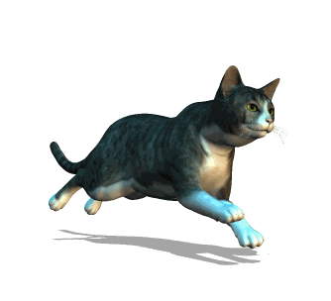
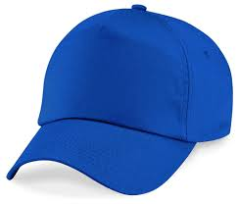
LOOK LISTEN AND SAY.
C
C
CAT
cap

Slide 18
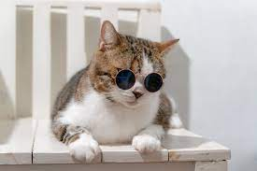
LOOK LISTEN AND SAY.
CAT
cap

Slide 19
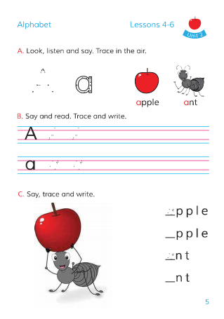
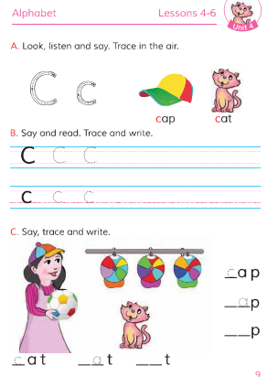
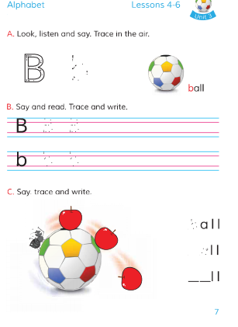
Open your Book at page-5,7,9.

Slide 20
Open your Book at page-5.

Slide 21
Open your Book at page-7.

Slide 22
Open your Book at page-9.

Slide 23
Write the missing letter.
n
__pple
a__t
A
a
b
B__ll
__ag
a
__ap
c__p
C

Slide 24
Match the letters with the pictures
C
B
A

Slide 25
Thanks all the students

