Slide 1
Welcome

Slide 2
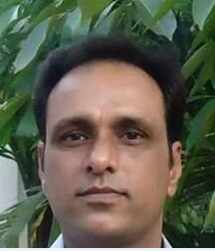
Teacher introduction
Ranadhir Das
Assistant teacher
Dokkhin sangor Govt. Primary School,
Baniachong, Hobiganj.

Slide 3
Class: Two
Subject: English
Lesson:4-6
Unit: 6

Slide 4
Learning Outcomes
By the end of the lesson the students will be able to--------
1.1.1 Become familiar with English sounds by listening to common English words.
1.1.1 Repeat after the teacher similar words and phrases with proper sounds and stress.
1.2.1 recognize and read the alphabet both small and capital. (non-cursive)
1.2.1 write non-cursive small letters.

Slide 5
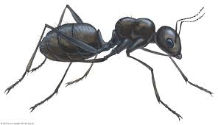
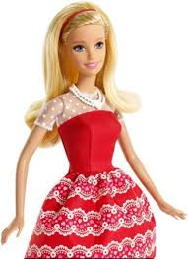
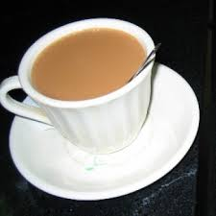
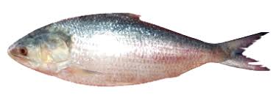
Look at the picture

Slide 6
Today’s Lesson
Alphabet
Aa---Ll

Slide 7
Now look at the picture.
Say and read loudly
ant

Slide 8
Now look at the picture.
Say and read loudly
bat

Slide 9
Now look at the picture.
Say and read loudly
cup

Slide 10
Now look at the picture.
Say and read loudly
doll

Slide 11
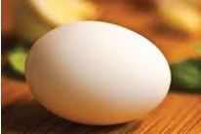
Now look at the picture.
Say and read loudly
egg

Slide 12
Now look at the picture.
Say and read loudly
fish

Slide 13
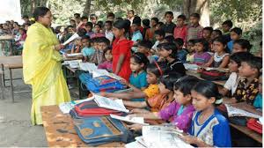
Teacher’s reading.

Slide 14
GOODBYE

