Slide 1
WELCOME

Slide 2
INTRDUCTION
Ishaque Mohammad Ali
Assistant teacher
Chandina Model Government Primary School
Chandina, cumilla
Class- Five (revise of class four)
Subject – English
Unit – 14 (lesson part A & B)
Time- 40 minuts

Slide 3
Loook at the picture

Slide 4
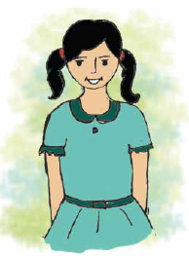
Mita,s day

Slide 5
Learning outcomes
Students will be able to
1
Recognise sound differences in the context of word
2
Repeat after teacher and say words, phrases and sentences…..
3
Read word ,phrases and sentences in the text.
4
write the time (hours only) and mention am/pm

Slide 6
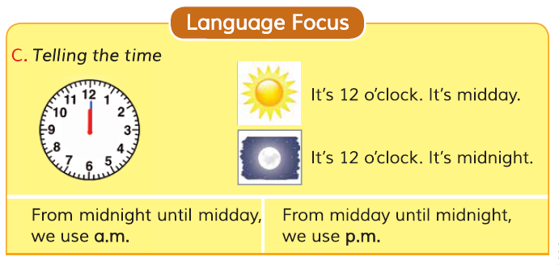
Before going to lesson ,we shed some light on the previous lesson

Slide 7
Mita is in class four.

Slide 8
She gets up at six o,clock.

Slide 9
She washes her face.

Slide 10
She has breakfast at seven
O,clock.

Slide 11
Then she brushes her teeth.

Slide 12
She goes to school at nine
O,clock. She walks to her school.

Slide 13
After school at three o,clock,
She visits her grand mother.then
Mita return home at five o,clock.

Slide 14
Get up
visit
New words
wash
Return
Brush
walk

Slide 15
B. Complete the sentences with the time in numbers. Use a.m. or p.m.
Mita gets up at
She has breakfast at
She goes to school at
She visits her grandmother at
She returns home at
6 a.m
7 a.m
9 a.m
3 p.m
5 p.m

Slide 16
Answer the following questions in your exercise book
Task
When does Mita go to school?
Write two thing Mita do at home.
What time Mita visit to her grandmother?

Slide 17
Bye bye
Good bye

