Slide 1
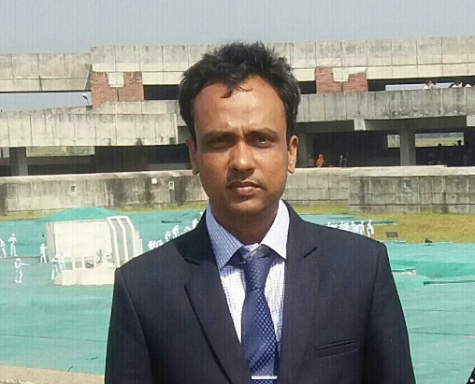
English 2nd paper
Unit 12
Lesson 3
Time 45 mnts
26/4/21
Md Hasanul Kabir
Lec in English
H. A, Harindia Alim Madrasa
Harindia , Kotchandpur, Jhenaidah

Slide 2
Welcome
Well come

Slide 3
By the class
A student will be able to use the correct form of sub , obj and possessive.

Slide 4
A case is a grammatical function working in a sentence as the function of noun or pronoun.
Case as far as we know is of three kinds
Subjective case
Objective case
Possessive case.

Slide 5
Subjective case: subjective case works in a sentence as a subject.
Ex: I / my should do the work. Inc
I should do the work. correct.
Now we have to know where subjective case is used in a sentence.
At a glance:
Sub + verb তার মানে verb এর আগে sub case হয়।
Than/as + sub তার মানে than /asএর পরে sub case হয়।
Ex: He is better than I/my. Inc
he is better than I .correct.

Slide 6
2. Objective case functions in a sentence as object.
Where to set it.
Verb + objective case
I saw him / his
Preposition + objective case
He is waiting for me /my
Infinitive + objective case
I went there to see him /his
Participle + objective case
Seeing him /his , he went to the another side.

Slide 7
3. Possessive case:
Possessive case functions of possession of a noun or pronoun
Where to set
Possessive + noun.
This is my pen
It is your opinion.

Slide 8
How to make possessive of nouns or pronouns.
For noun:
If noun is a singular
Noun’s noun
রহিমের কলম খুব দামি
Rahim’s pen is very costly.
If noun is plural
Nouns’ noun
এটা বালিকা বিদ্যালয়।
It is a girls’ school

Slide 9
sub | obj | Possessive
I | me | my
He | him | his
She | her | her
you | you | your
they | them | their
We | us | our

Slide 10
Single work
Correct the following sentences choosing the correct case.
He /her is going there
He knows him/ his name.
Ovi is doing the work for me/my
My /you name is kaila.
It is my / mine problem
This country is your country/ yours.

Slide 11
Home work
Each of you will make 10 sentences using the three kinds of cases.

Slide 12
No more today, when more again.

