Slide 1
Welcome
Well come

Slide 2
English 2nd paper
Unit 12
Lesson 3
Time 45 mnts
26/4/21
Md Hasanul Kabir
Lec in English
H. A, Harindia Alim Madrasa
Harindia , Kotchandpur, Jhenaidah

Slide 3
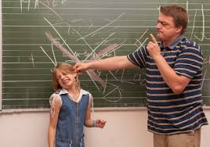
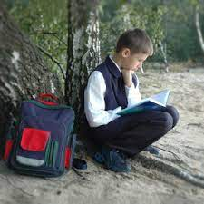

Slide 5
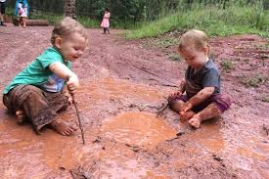
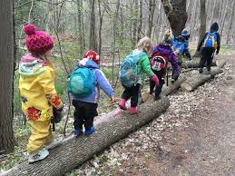

Slide 7
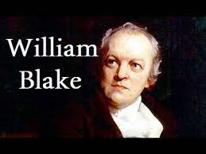
The Schoolboy by William Blake
This piece was first published in the second half of Blake’s masterpiece, Songs of Experience. The publication of this volume came approximately five years after the publication of Songs of Innocence in 1789. These poems by William Blake were later combined and republished together as Songs of Innocence and Experience. Blake’s ‘The Schoolboy’ is a pastoral poem that focuses on the problems inherent in formal learning. The boy, who hates going to school, feels that he would be better educated by the natural world.

Slide 8
At the end of the lesson , a student will be able to know
About a school boy.
How a school should be.
Theme

Slide 9
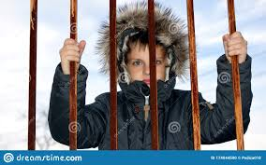
A school boy does not want to go to school because a school seems to be a prison .

Slide 10
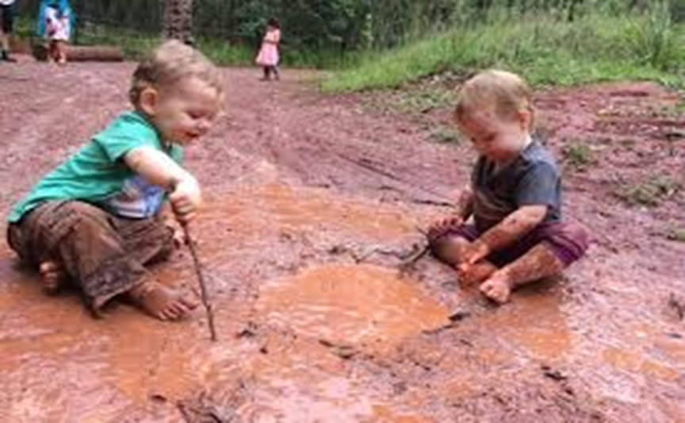
A school boy wants to mingle with nature.
His sweet company

Slide 11
He loves to rise summer morn.

Slide 12
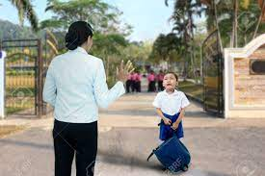
He requests his parents not to allow him to school by nipping their bud.

Slide 13
Group work
Read the following lines and ask with one another.
The poem “The schoolboy” by William Blake has been told through the perspective of a school going boy. The boy is fed up with the daily routine of gong school and coming up. He wants to explore the natural beauty of the world. He thinks that he has been trapped in the monotonous way of living the life. The boy tells about the miserable conditions he has to endure as when he goes to the school. Further, he asks the world that when he has been made to explore the beauty of nature, why is he captured in the daily routine of the life. He persuades his parents and asks them to give their favor in helping him to change his situation. He questions to his parents that after the time will be spent, it will never return back to him.
The lines of the poem have a rhyming scheme of ABABC. In the fourth stanza, the poet uses rhetorical questions. Rhetorical questions are the questions which are asked not to get any answer but contains an answer. It creates a dramatic effect and focuses on the issue rather than getting an answer. Lines which uses rhetorical questions are:
“How can the bird that is born for joy
Sit in a cage and sing?”
The metaphor is also used in the poem when the poet compares the youth with “spring” in the phrase “his youthful spring!” A metaphor is a hidden comparison between two things which possess at least any one idea common to each other. The things may be completely different from each other but would have either one characteristic in common

Slide 14
Themes
Blake makes use of some interesting and important themes in ‘The Schoolboy’. He explores childhood and youth, as well as themes of education, nature, and freedom in this piece. His main character and speaker, the schoolboy, spends the poem describing the difference between freedom in the natural world and the cruel restrictions of formal education.

Slide 15
No more today, when more again.

